Slide 1
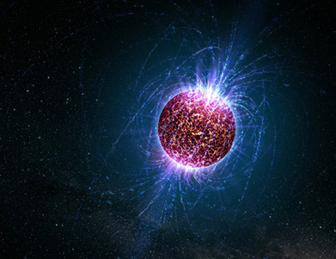


Heavy Ion Collisions and constraints from Neutron Star Phenomenology
Thomas Klähn
D. Blaschke
R. Łastowiecki
F. Sandin

Slide 2

CRAB PULSAR
Age | 955 yrs | Rotation | 29.6 /s
Mass | ? | Radius | ?
Luminosity | ? | B-field | ?
Courtesy of http://www.ast.cam.ac.uk/~optics/Lucky_Web_site

Slide 3
Neutron StarS in Observation:
Masses
Radii
Temperature /Age
Redshift
Rotation
Optimum: Have all these data available
for as many NS‘s as possible

Slide 4

Neutron StarS in Observation:
Masses
Radii
Temperature /Age
Redshift
Rotation
?
Optimum: Have all these data available
for as many NS‘s as possible
Reality: Have some of these data for some NS
Not all of them are undoubted
?
?
?
?

Slide 5
Neutron Stars in Theory:
F. Weber

Slide 6
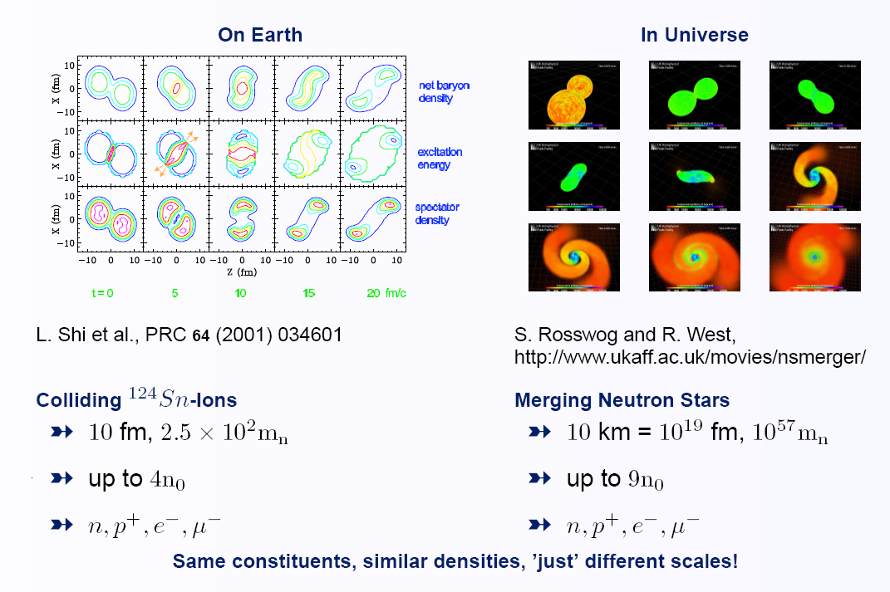
HIC and neutron stars
Klähn et al., Phys.Rev. C74 (2006) 035802

Slide 7
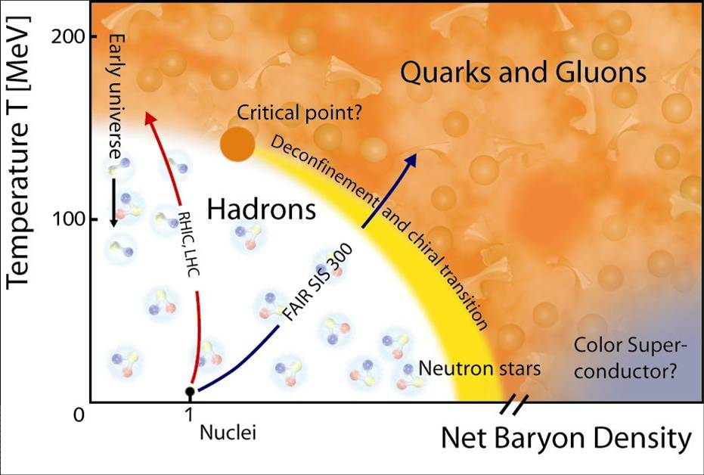
The QCD Phase Diagram
The QCD Phase Diagram
phase transition from
nuclear to quark matter
is predicted
IF realised in nature, then in NS.
Heavy Ion Collisions (HICs)
hot, „dilute“, symmetric matter
Compact Stars
cold, dense, asymmetric matter
superconducting phases
www.gsi.de
A realistic EoS necessarily covers the whole phase diagram.
Opportunity for cross checks: HIC <-> NSs

Slide 8
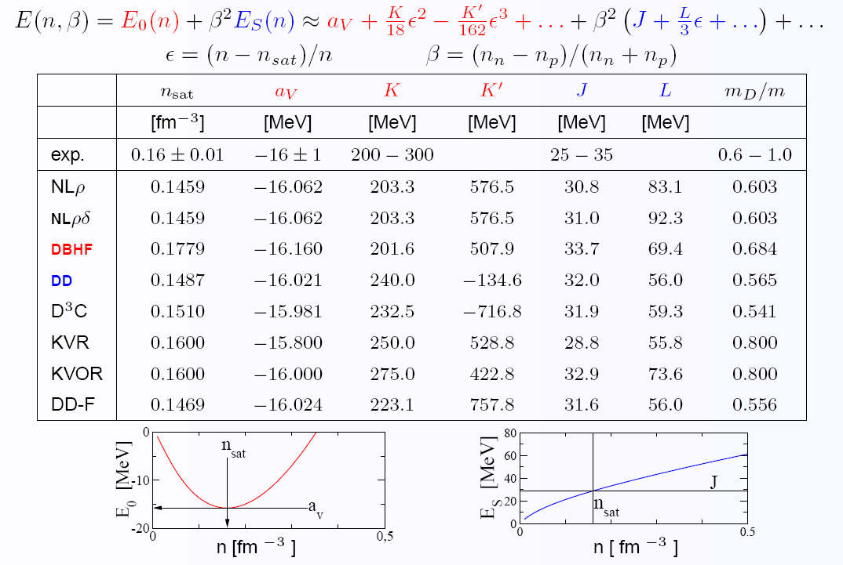
Equation of state
cold, nuclear matter far beyond saturation density is not well understood:
Klähn et al., Phys.Rev. C74 (2006) 035802

Slide 9
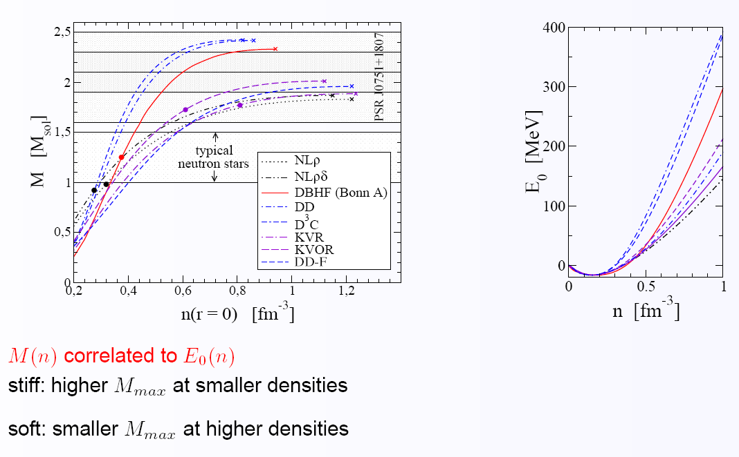
Neutron star masses
Large neutron star masses (about ) would provide a serious constraint.
Klähn et al., Phys.Rev. C74 (2006) 035802

Slide 10
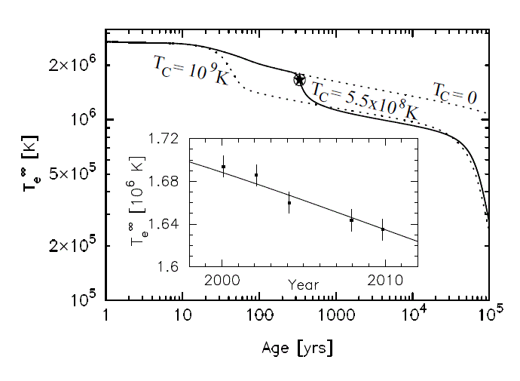
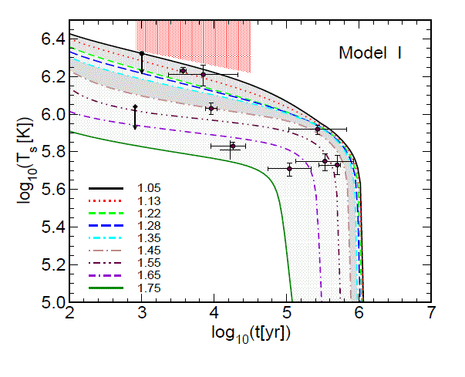
ConcluSionS
… of the “CompStar School and Workshop” (Catania - May 3-12, 2011)
The most exciting news of the last year are:
Mass of Pulsar J1614-2230 : P.Demorest et al., Nature 467, 1081-1083 (2010)
Rapid cooling of Cas A Ho, Heinke, Nature 462: 71-73, 2009
Page, Prakash, Lattimer, Steiner, Phys.Rev.Lett.106:081101,2011
Blaschke, Grigorian, Prog.Part.Nucl.Phys. 59 (2007)

Slide 11
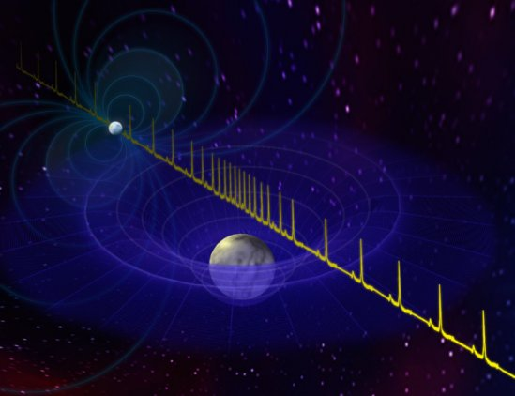
PSR J1614-2230
Binary system in Scorpius
1200 parsecs from Earth
NS - millisecond pulsar (P=3.15 ms)
white dwarf companion
Recycled pulsar – accretion
Time signal is getting delayed when passing near massive object.
General relativistic effect.
Size of the effect depends on the mass and inclination angle.
Pulse delay best to measure when pulsar is exactly behind companion

Slide 12
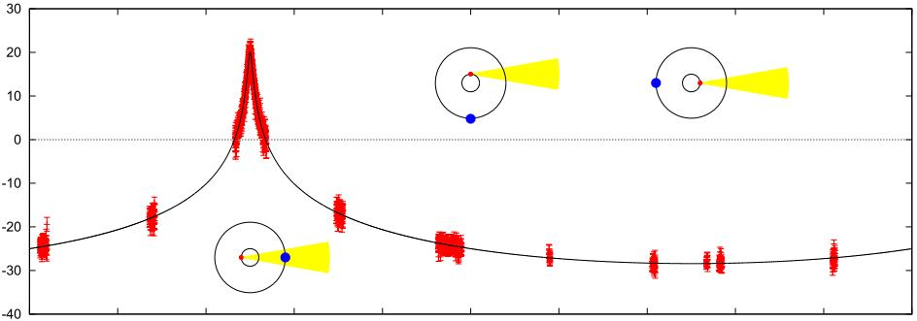
PSR J1614-2230
Binary system in Scorpius
1200 parsecs from Earth
Neutron star with white dwarf companion
NS - millisecond pulsar (P=3.15 ms)
Recycled pulsar – accretion
Time signal is getting delayed when passing near massive object.
General relativistic effect.
Size of the effect depends on mass and inclination angle.
Pulse delay best to measure when pulsar is exactly behind companion

Slide 13

PSR J1614-2230
Observational Results:
89.17 inclination angle
companion mass of 0.5 solar masses.
(companion is a helium-carbon-oxygen white dwarf)
neutron star mass:
  WORLD (universal? intergalactic?) RECORD!
P.Demorest et al., Nature 467, 1081-1083 (2010)
Highest well known mass of NS before:
(there are heavier, but far less precisely measured candidates)

Slide 14
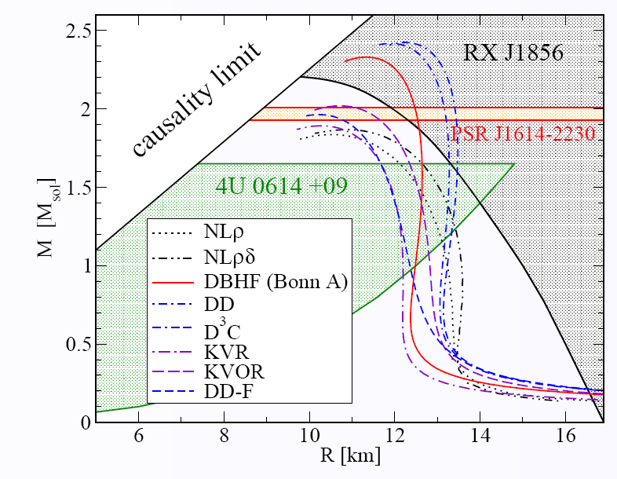
Why PSR J1614 Is so exciting
Large neutron star masses (about ) would provide a serious constraint.

Slide 15
Why PSR J1614 Is so exciting
?
Mass correlates
to stiffness.
Maximum mass
limits ‘softness’
What about
maximum
stiffness?

Slide 16
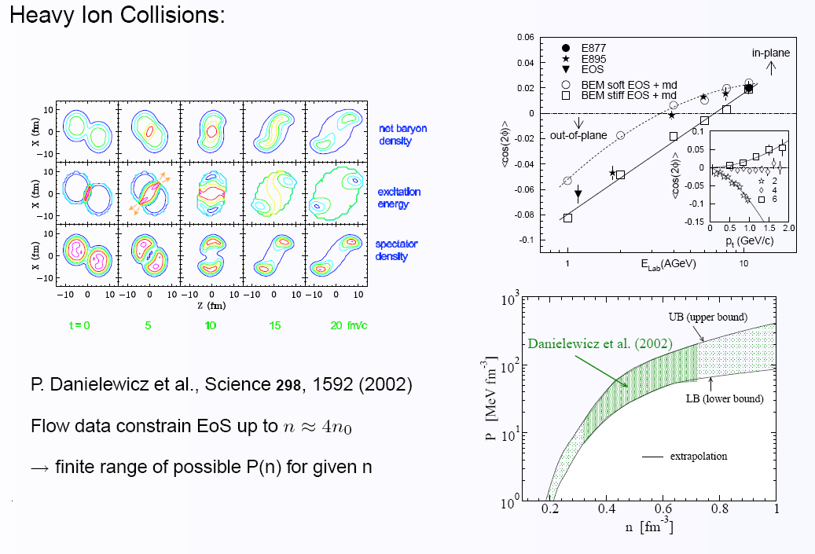
Flow constraint

Slide 17
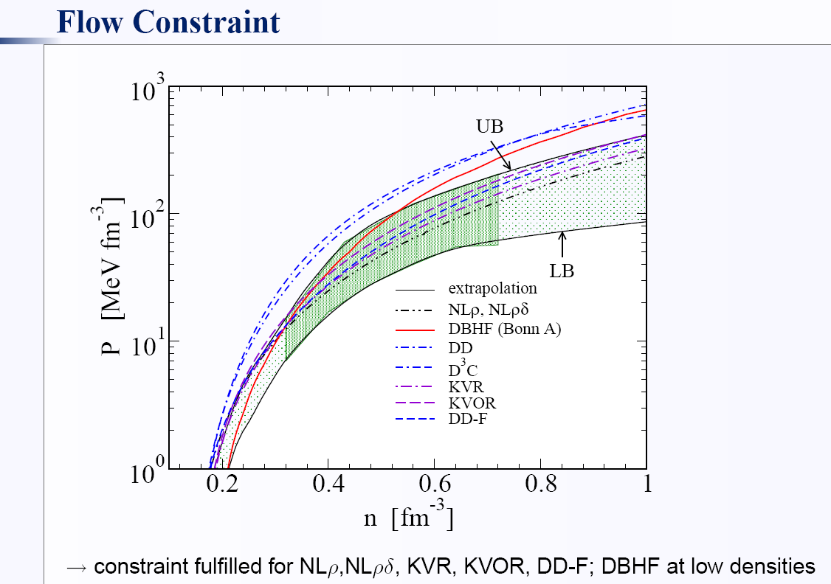
Flow Constraint

Slide 18
‘PSR J1614 + Flow’ Constraint
TROUBLE
WITH FLOW
NOT HEAVY
ENOUGH

Slide 19
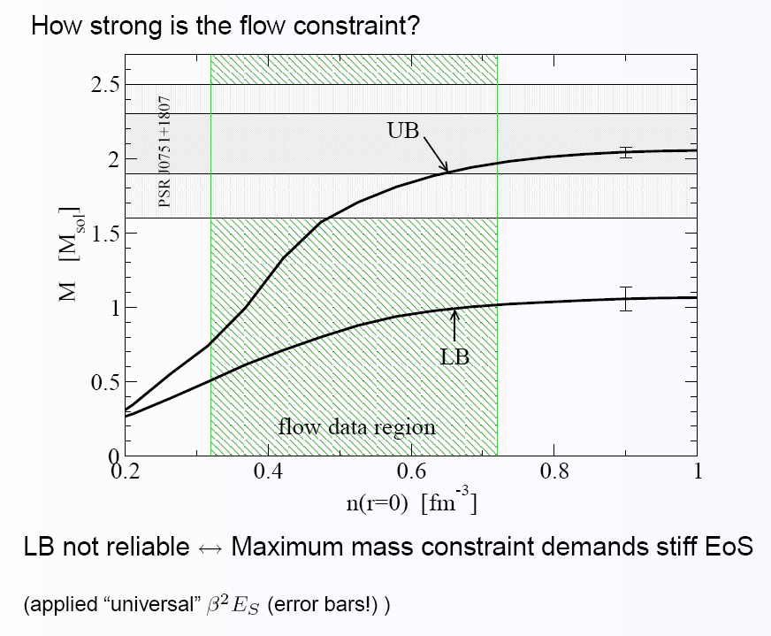
the Upper Flow Limit AnD NS
If UB confirmed
unambiguously...
HIC can constrain
maximum NS mass!
... estimated this :
NS can constrain HIC:
Klähn et al.,
Phys.Rev. C74 (2006) 035802

Slide 20
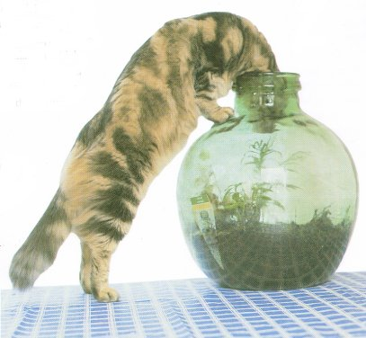
Quark Matter in PSR J1614?
Can QM be present in PSR J1614?
Presently, one cannot know
whether quark matter exists in
PSR J1614.
However, if there is NO
quark matter in this object,
it is in no other NS we know.
Why is this so?
The more massive a NS is
the higher is the central density.
Would clarifying the question of QM in NS
affect experiments which explore the
QCD phase transition?
It certainly would! And more than
this… we would LEARN a lot!

Slide 21
‘PSR J1614 + Flow’ constraint
TROUBLE
WITH FLOW
NOT HEAVY
ENOUGH
Purely nuclear EoS
What about QM?

Slide 22
Quark matter in PSR J1614?
One of the big unknowns when describing
quark matter in NSs is the nuclear equation of state.
In pratice: nuclear and quark matter are modeled independently -> Maxwell/Gibbs
Favorable: Nucleons (…, diquarks, mesons) as quark correlations.
Already on the quark matter level we
rely on effective models.
Need good phenomenology to fix parameters.
Aim: A hybrid EoS, consistent with NS and HIC data
applicable at relevant ranges of
temperature, density and asymmetry

Slide 23
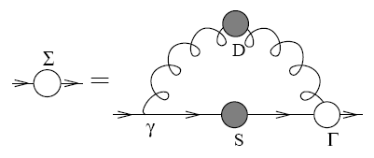
Quark Matter
Confinement and DCSB are features of QCD.
Currently, none of the existing models addresses both features
consistently in a ‚first principle‘ approach at relevant densities.
Bag-Model:
While Bag-models certainly account for confinement (constructed to do exactly this)
they do not exhibit DCSB (quark masses are fixed).
NJL-Model
While NJL-type models certainly account for DCSB (applied, because they do)
they do not (trivialy) exhibit confinement.
Modifications to address this problem exist (e.g. PNJL)
Still holds: Inspired by, but not based on QCD.
Lattice QCD still fails at T=0 and relevant μ
Possible approach: In-medium Dyson-Schwinger equations
Derive gap equations from QCD-Action. Self consistent self energies.
Successfuly applied to describe meson and hadron properties
Extension from vacuum to finite densities desirable
→ EoS within a QCD based framework

Slide 24
Hadrons As Quark Bound states
Problem is attacked in vacuum Faddeev Equations
Cloet et al. (2008)
Current quark mass dependence of
nucleon magnetic moments and radii
Eichmann et al. (2008)
The nucleon as a QCD bound state
in a Faddeev approach.
Baryons as composites of confined quarks and diquarks
q-propagator, d-propagator, Bethe-Salpeter-Ampl., Faddeev Ampl.
Bethe Salpeter Equations
P. Maris (2002)
Effective masses of diquarks.
Bhagwat et al. (2007)
Flavour symmetry breaking
and meson masses

Slide 25
Hadrons As Quark Bound states
Problem is attacked in vacuum Faddeev Equations
Cloet et al. (2008)
Current quark mass dependence of
nucleon magnetic moments and radii
Eichmann et al. (2008)
The nucleon as a QCD bound state
in a Faddeev approach.
But barely explored in medium
Baryons as composites of confined quarks and diquarks
q-propagator, d-propagator, Bethe-Salpeter-Ampl., Faddeev Ampl.
Bethe Salpeter Equations
P. Maris (2002)
Effective masses of diquarks.
Bhagwat et al. (2007)
Flavour symmetry breaking
and meson masses

Slide 26
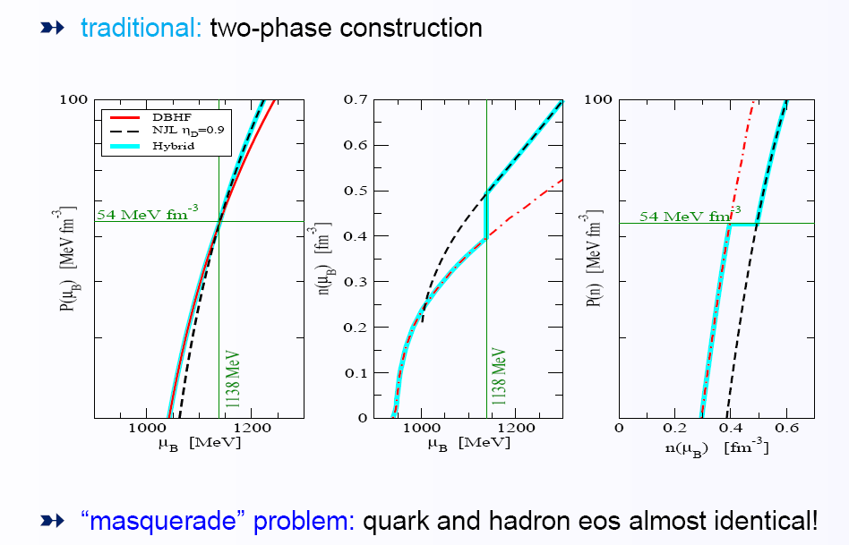
Phase transition
Work around: model nuclear and free quark matter EoS independently
construct a phase transition
A phase transition softens the equation of state!

Slide 27
Phase Transition
A ‘softer than nuclear matter’ equation of state does not automatically
result in a remarkably soft quark matter EoS (as Bag models usually predict).
The upper limit on the QM EoS stiffness (at transition) is the NM EoS stiffness.
Extreme scenario: both EoS are roughly the same
-> no latent heat, phase transition region small
-> maximum mass of pure neutron star similar to that of hybrid star
-> ‘masquerade’-problem (Alford)

Slide 28
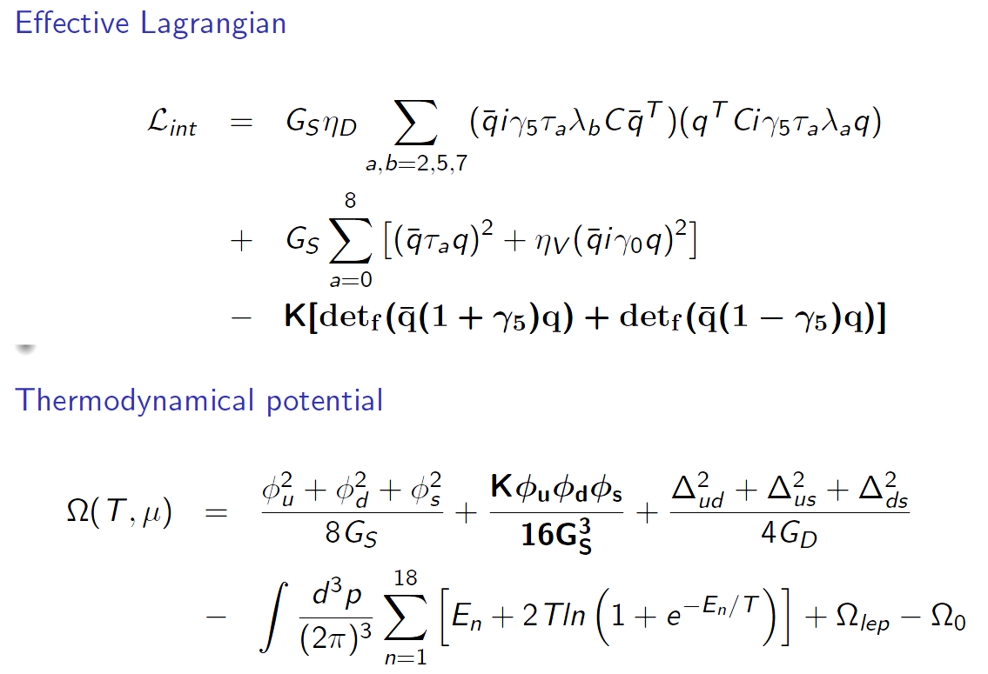
Adjusting The Quark Matter EoS

Slide 29
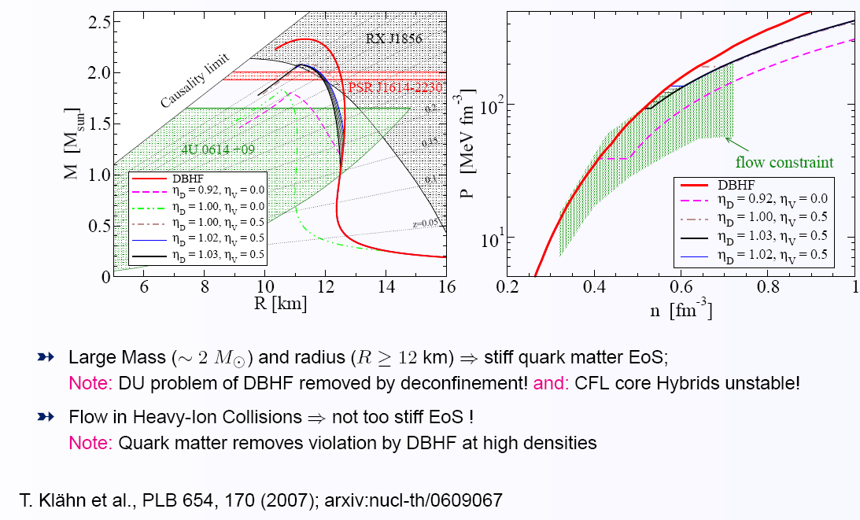
Adjusting the Quark Matter EoS
One of the big unknowns when describing quark matter in NSs
is the nuclear equation of state.
Favorable: Nucleons (… and diquarks … and mesons!!!) as quark correlations
In medium… this is a challenge we have to face now and in the future.
Work around: model nuclear and quark matter independently
construct a phase transition
A phase transition softens the equation of state! VERY GOOD!!! Solves some problems.

Slide 30
Adjusting the Quark Matter EoS
One of the big unknowns when describing quark matter in NSs
is the nuclear equation of state.
Favorable: Nucleons (… and diquarks … and mesons!!!) as quark correlations
In medium… this is a challenge we have to face now and in the future.
Work around: model nuclear and quark matter independently
construct a phase transition
A phase transition softens the equation of state! VERY GOOD!!! Solves some problems.
Doesn’t look very systematic

Slide 31
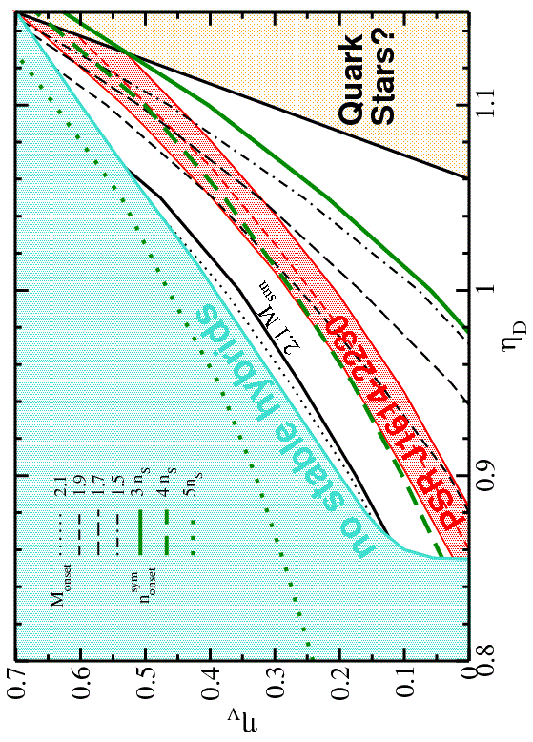
Adjusting the Quark Matter EoS
Scan of roughly
200 hybrid EoS with
different vector
and diquark couplings.
Which parameters
support hybrid NS?
How massive is
the QM core?
Consequences for SM?

Slide 32
Adjusting the Quark Matter EoS
no stable hybrids
PT at too large n

Slide 33
Adjusting the Quark Matter EoS
no stable hybrids
PT at too large n
Quark Stars?
PT at too small n

Slide 34
Adjusting the Quark Matter EoS
no stable hybrids
PT at too large n
Quark Stars?
PT at too small n
PSR J1614

Slide 35
Adjusting the Quark Matter EoS
no stable hybrids
PT at too large n
Quark Stars?
PT at too small n
PSR J1614
M_{max} increases

Slide 36
Adjusting the Quark Matter EoS
no stable hybrids
PT at too large n
Quark Stars?
PT at too small n
PSR J1614
M_{max} increases

Slide 37
Adjusting the Quark Matter EoS
no stable hybrids
PT at too large n
Quark Stars?
PT at too small n
PSR J1614
Massive
Quark Cores are HERE
M_{max} increases

Slide 38
Adjusting the Quark Matter EoS
no stable hybrids
PT at too large n
Quark Stars?
PT at too small n
PSR J1614
Comparison with
sym. matter:
QM in PSR J1614?
Yes <->
No <->
It is remarkable that
this critical value is
rather constant!
Still: For this model…

Slide 39
Conclusions
Compact Stars provide increasingly severe constraints on the cold dense matter EoS
in combination with HIC data it might soon be possible to pin the EoS
check EoS already from both sides to describe EoS with sound phenomenology
Example here: PSR J1614 vs Flow = EoS neither too soft nor too stiff
quark matter in compact stars is NOT ruled out by large masses
hybrid stars might masquerade as ‘classical’neutron stars
not discussed here: transport properties -> time evolution of NS observables
quark matter in the non-perturbative density regime is not well understood
consistent approaches are required
long term goal 1: EoS and transport properties on same level
long term goal 2: Improve towards QCD based approaches
long term goal 3: Dense nuclear matter on quark level
expected is an increase of NS data by an order of magnitude within the next 10 years
Personal opinion: Physics of NSs is about to enter a new era.
Newly available observations will challenge theory
in terms of consistency.

Slide 40
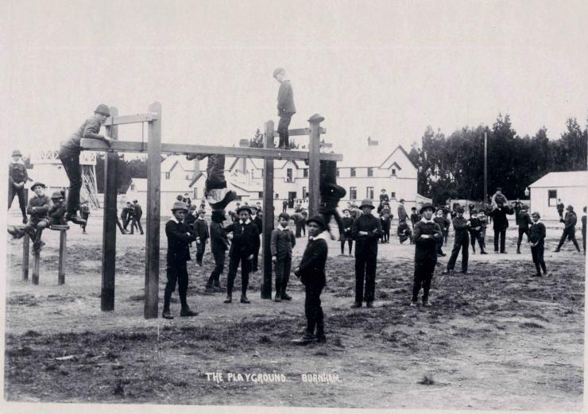

since 1933...
(Baade/Zwicky)
Thank you ;)

