Slide 1
FAIR = rare probes - Highest Beam Intensities – high sensitivity
Construction Budget: 1500+ Million Euro Invest - in kind
Operating Budget: 200+ Million Euro annually
Four high intensity driver accelerators: the UniLac
5 GeV Proton / 2 AGeV Uranium Synchrotron SIS 18
30 GeV Proton / 10 AGeV Uranium Synchrotron SIS 100
90 GeV Proton / 35 AGeV Uranium Synchrotron SIS 300 (to be funded
FAIR provides primary Proton and Ion beams on 4 primary targets
+ secondary rare isotopes & Antiprotons in 4 Storage Rings
+ APPA: Atomic- and applied Science, plasma- bio- material science
+ NuSTAR: RIB, nuclear Astro, nuclear structure, multi-Hypernuclei
+ CBM: Relativistic Heavy Ions & dense baryonic matter
+ PANDA: Massive Charmonium, X, Y, Z, Glueballs or Hybrids
+ Beauty-Baryon-AntiBaryon pairs in a pBar-p Collider HECR
+ FAIR under construction as an International Facility with 10 Owners

Slide 2
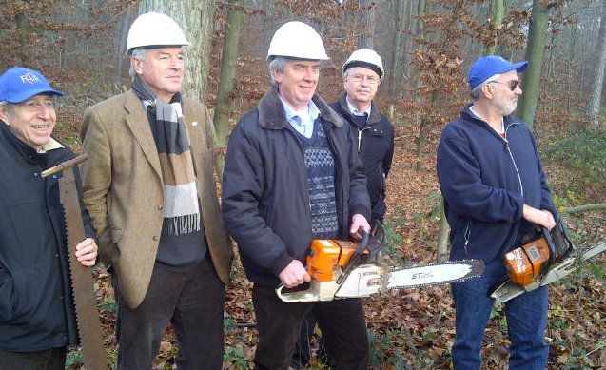
Boris Sharkov
2

Slide 3
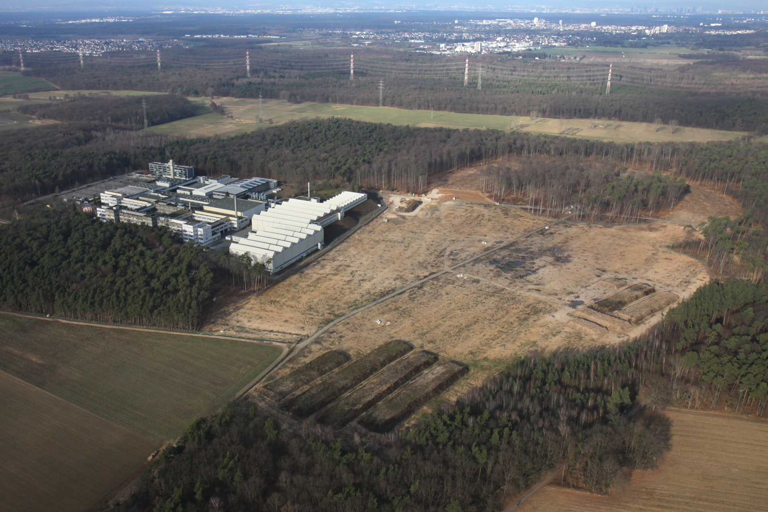
January 2013: clearcutting of Ring- and Exp.- Areas

Slide 4
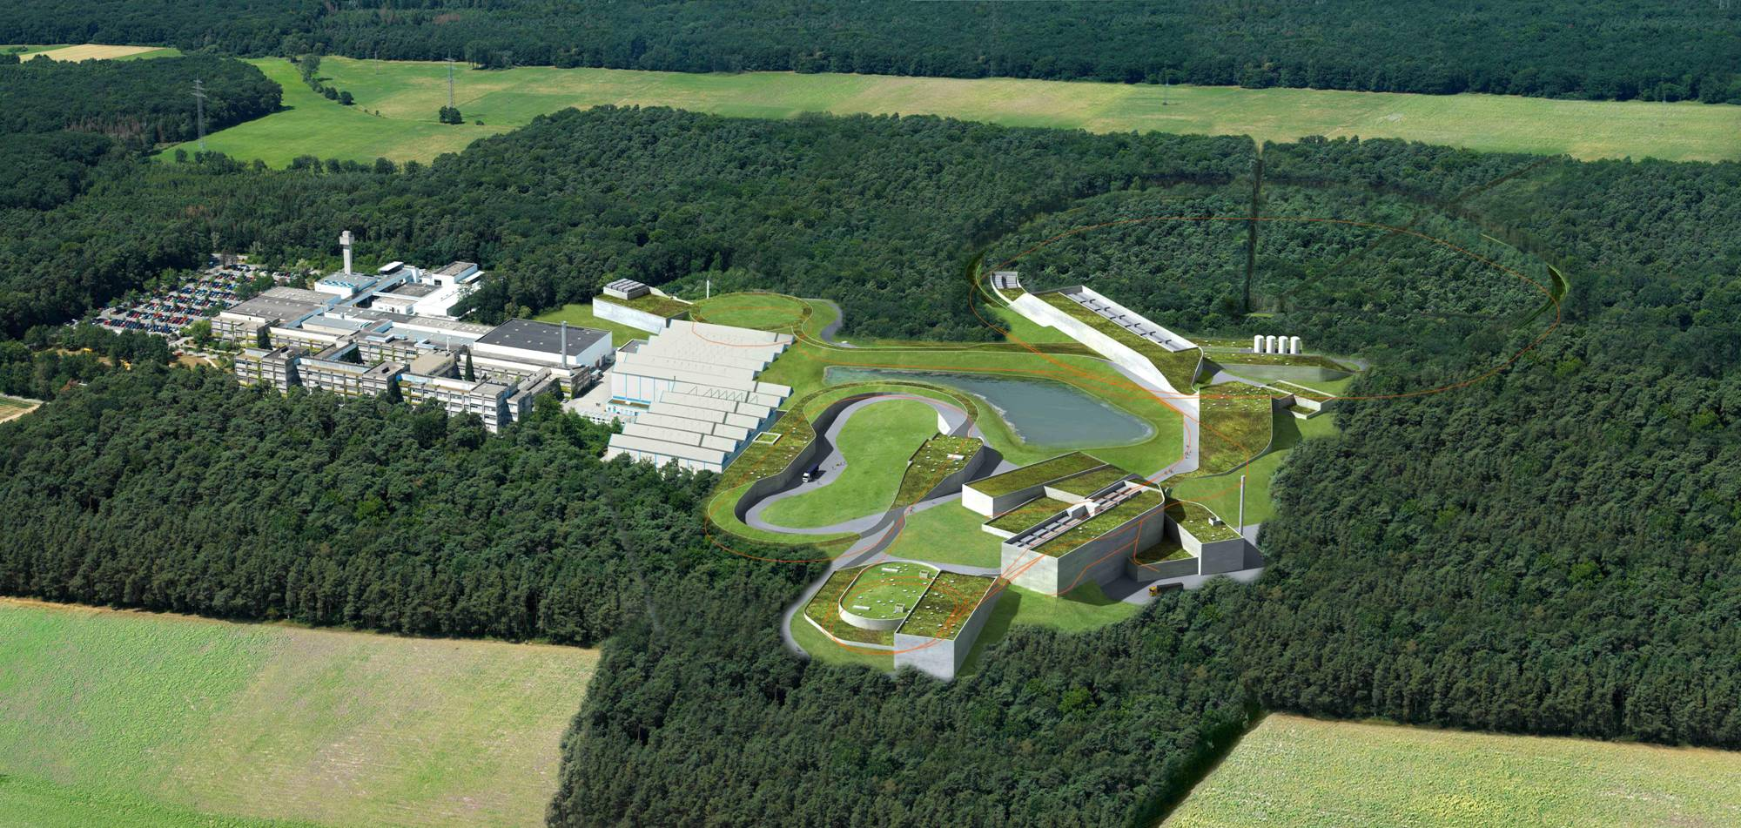

















FAIR’s Charm and Beauty in 2020
Observers
India
Russia
Austria
China
Finnland
France
Germany
Italy
Poland
Slovenia
Spain
Sweden
Romania
UK

Slide 5
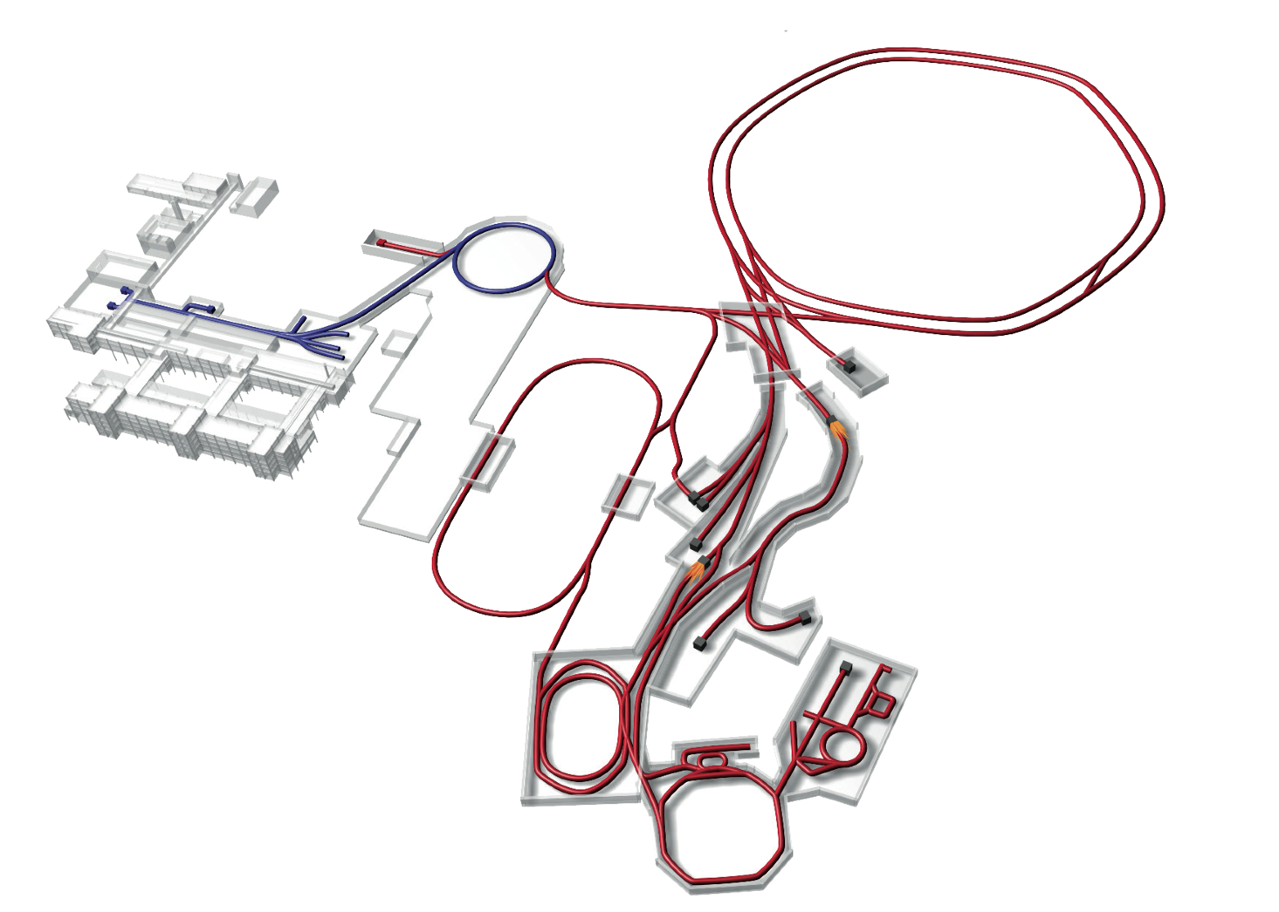
FAIR
Nuclear Structure & Astrophysics
(RIBS Rare-isotope beams)
Hadron Physics
(Stored and cooled _
14 GeV/c anti-protons /p-p collider)
SIS18
p-Linac
SIS100/SiS300
UNILAC
QCD-Phase Diagram
(HI beams 2 to 45 GeV/u)
Sparc
Target
ESR
Cryring
CBM Target
HESR
Rare-Isotope
Production Target
Fundamental Symmetries FLAIR
& Ultra-High EM Fields
(Antiprotons & naked ions in Cryring/ESR)
Panda
Target
Anti-Proton
Production Target
Dense Bulk Plasmas
(Ion-beam bunch compression
& Petawatt-laser , Prior)
CR &
RESR
Cryring ?
Materials Science & Radiation Biology
(Ion- & antiproton beams)
100 m
NESR
Accelerator Physics

Slide 6
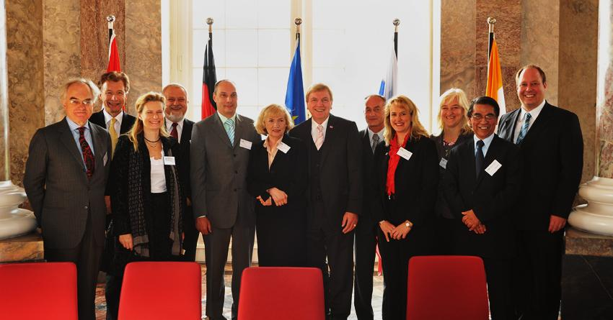

International Treaty between Shareholders
Signing of the FAIR Convention by representatives of
Finland, France, India, Poland, Romania, Russia, Slovenia and Sweden
in Wiesbaden on 4/10/2010

Slide 7
"FAIR: The Cosmic Matter in the Laboratory"
The international Facility for Antiproton and Ion Research FAIR is currently under construction – a cutting edge accelerator complex with
eight storage - and superconducting synchrotron rings and several linacs.
FAIR has been founded by Finland, France, Germany, with the GSI Helmholtz Centre for Heavy Ion Research and Forschungszentrum Juelich, India, Poland, Romania, Russia, Slovenia, Sweden and the United Kingdom.
FAIR is the largest fundamental science facility being built worldwide,
with investment costs of 1.6 Billion Euro in its initial phase.
From 2018 onwards, FAIR will provide unique opportunities for a global community of 3.000 scientists, including many Japanese colleagues, from 51 countries.
They prepare for outstanding research in the APPA, CBM, NUSTAR and PANDA detector collaborations to do cutting-edge research in nuclear, hadron and particle physics, atomic and anti-matter science, high density plasmas and applications in condensed matter, in the bio-medical- and material sciences.

Slide 8
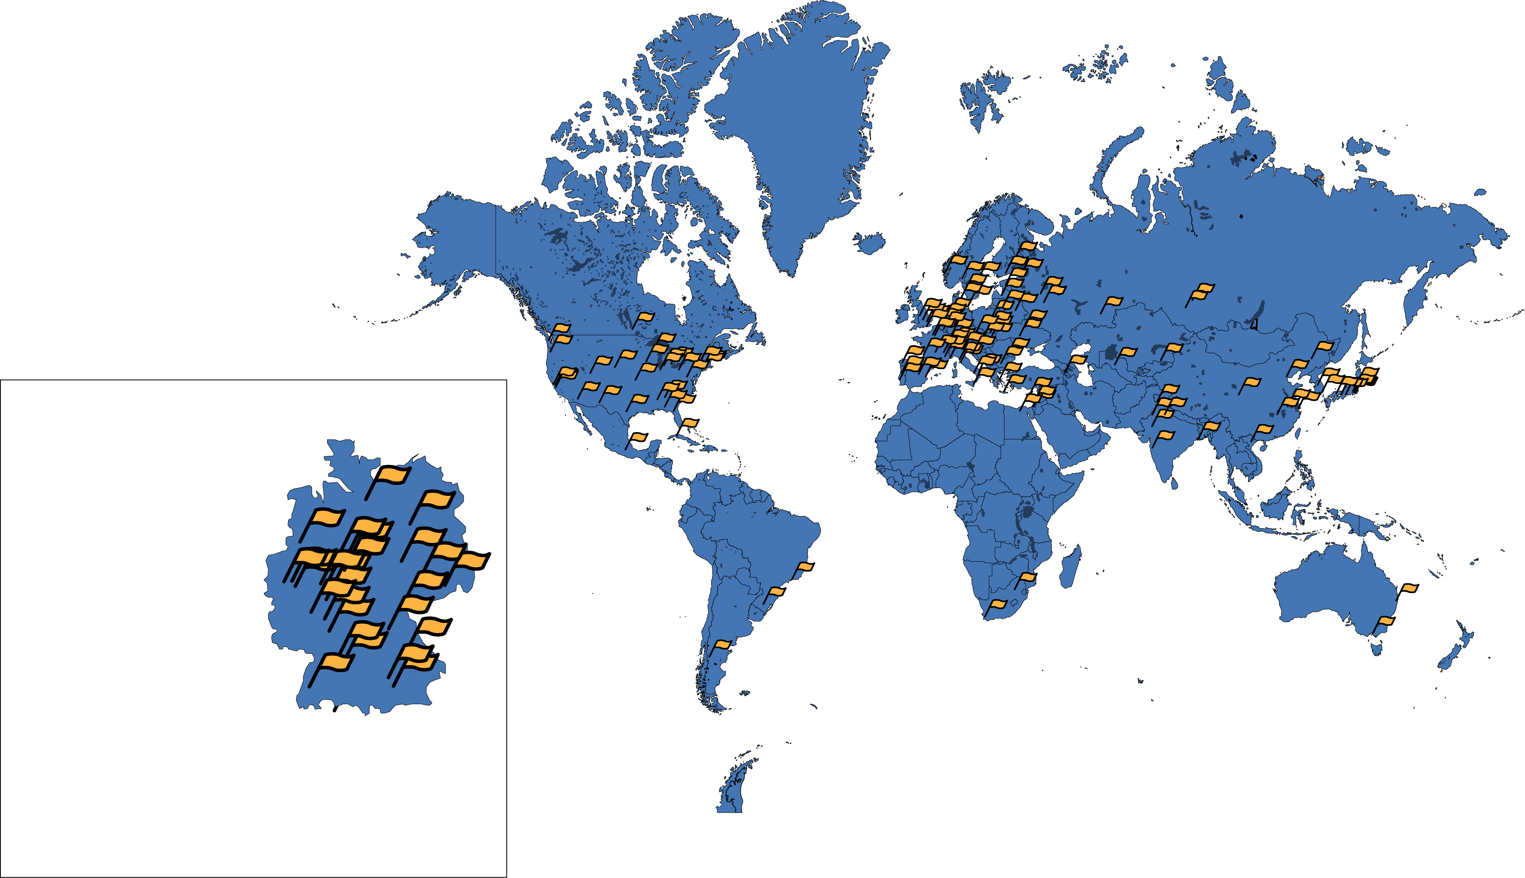
International Cooperation : 2800 FAIR users at 100+ Labs worldwide
… from more than 50 countries, numbers rising -
World‘s largest fundamental science project of this decade … under construction
German participants: 4 Helmholtz centers FZ Juelich, HZDR, KIT, GSI with HIJ, HIM, HiC4FAIR, HA EMMI, 100 University groups , Max Planck Inst. f. Kernphysik

Slide 9

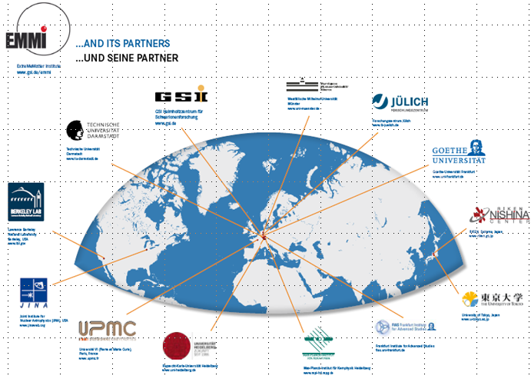
Networking for FAIR
Interdisciplinary research with 100+ partner institutions worldwide
Helmholtz international Center for FAIR
HiC4FAiR
Helmholtz international Graduate school
HiRe for FAIR
Helmholtz Alliance
Cosmic Matter in the Laboratory (Emmi)
HiC4FAiR
HiRe for FAIR
Notes:
Folie sollte zentraler positioniert werden

Slide 10
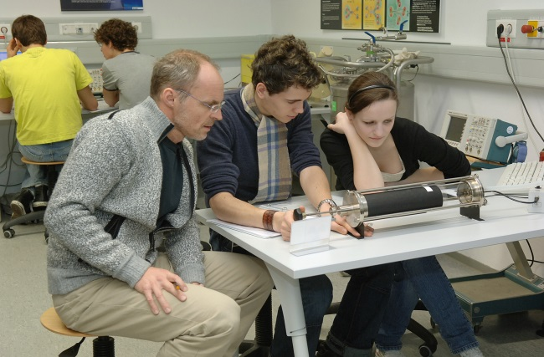
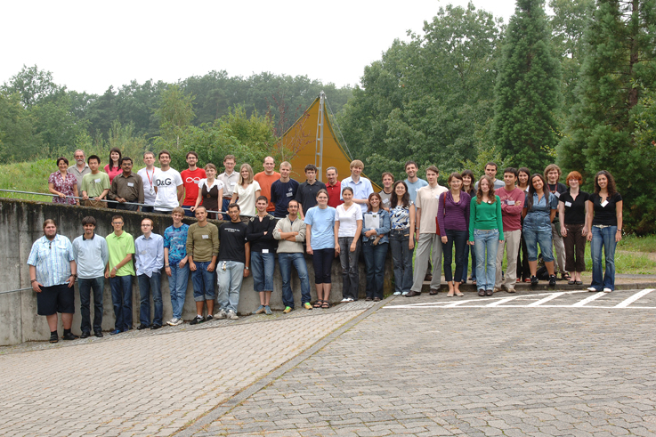
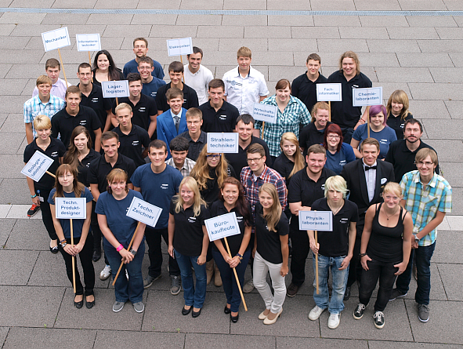
Outreach and Education
International summer student programs
Students and PhD mentoring programs
Advanced training courses for teachers
Laboratory for high-school students
Helmholtz Research School Advanced Photon Science (HI-Jena)
International Helmholtz Graduate School HGSI HIRe for FAIR : 330Studts
Extended apprentices education programs for various professions
Pupils Laboratory
GSI Student Program
HZDR Apprentices

Slide 11
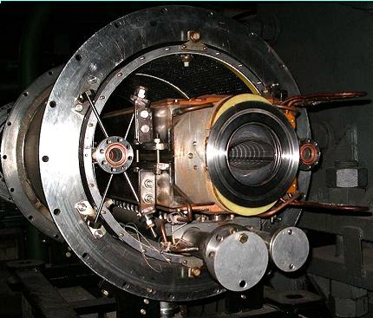
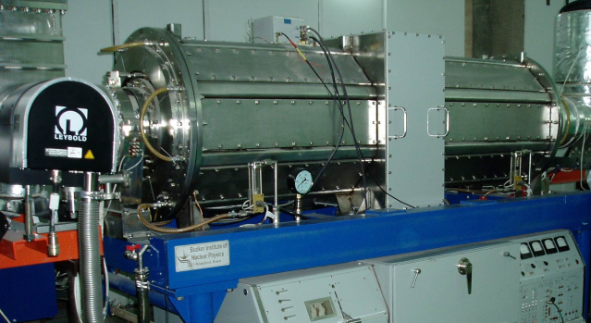
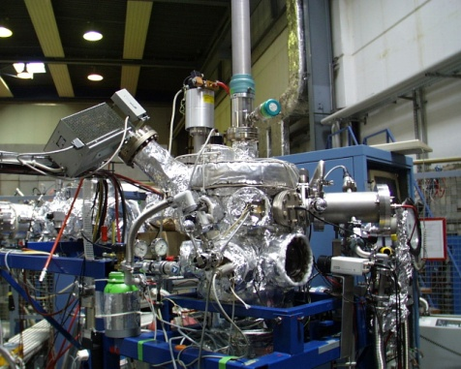
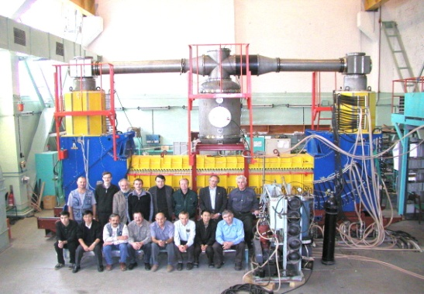
FAIR Accelerator Challenges
Compact & cost effective accelerators
Fast cycling superconducting magnets
dB/dt ~ 4T/s
Fast acceleration
High gradient, variable frequency
Ferrite & MA loaded cavities
XHV @ high beam intensities
Extremely high vacuum ~10⁻¹³ mbar
Precision beams
Electron & stochastic cooling

Slide 12
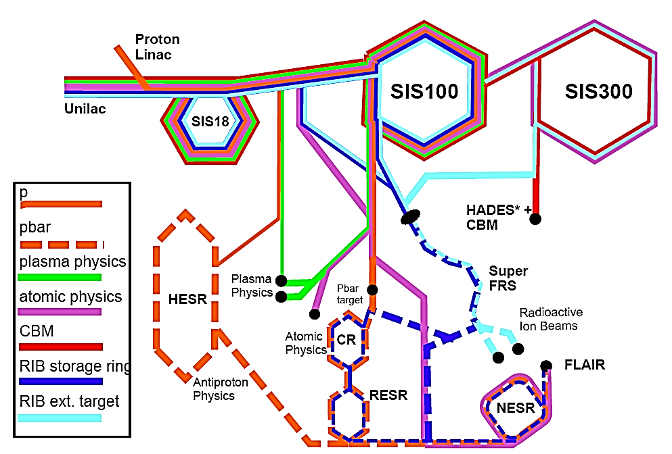
Parallel Operation of Accelerator Complex
GSI
GSI
Dubna
FZ Juelich
Budger
ITEP
CEA, VECC, IMP, GSI
Budger
Notes:
12

Slide 13
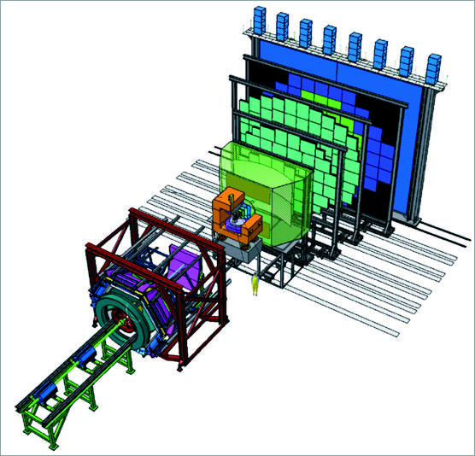
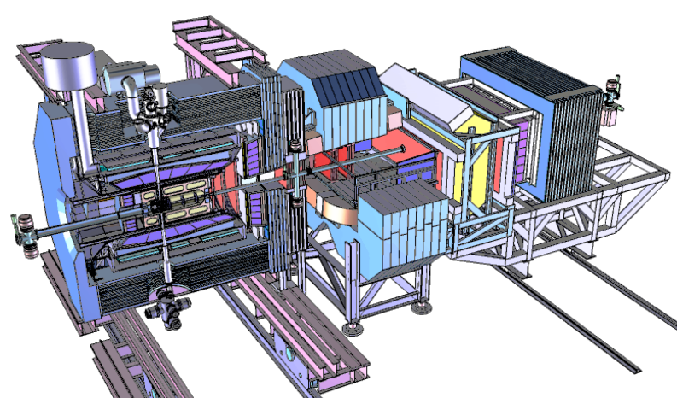
FAIR Experiments
CBM
APPA
NuSTAR
Super- FRS
PANDA

Slide 14

Helmholtz Research Field „Matter“
From Matter to Materials and Life (MML)
APPA
Atomic Physics, Plasma Physics, Applied Science
Biomedical and Materials Science
with high power Lasers and intense Ion Beams
GSI
IBC
Notes:
POF-III On-site Visits
(3 min Statement IBC)
Standing
Unique Ion Beam Facility focused to materials science
Why unique?
Versatile machines / instrumentation perfectly adapted to materials science
Materials modification and analysis
Strong impact on innovations in industry (~ 25% beam time is used from industry)
Spin-Off: HZDR Innovation GmbH : Reference project and unique within Helmholtz
Successful development use of research infrastructure for product innovation
Besides materials science:
Interdisciplinary research focused to geosciences and resource technology
(→ importance for raw materials strategy of Germany)
Basic numbers
Beam time hours / Experiments / Publications / External Rate / Industry fraction
2013: ~ 50 external user groups from approx. 25 countries worldwide / ~ 50 national partners
25% beam time use of industry (Unique)
SPIRIT coordination: one of most successful research infrastructure projects within FP-7
Highlights
Scientific:
Ion patterning capabilities / Specific effects of Ion-solid interaction in nano-menbranes
Instrumentation:
Laterally resolved IBA techniques for fast trace element analysis
Both topics will be described more detailed at specific posters
Strategic Development within POF-III
Ion technologies are unique and essential for materials development in IT and Energy, more specific within POF-III:
Using specific ions (low, highly-charged, cluster) ions for nanofabrication in emerging materials classes, e.g. 2D materials (→ LEINEF facility)
Cutting-edge IBA approaches with respect to highest lateral resolution or ultimate sensitivity (Analytics in an ion microscope, Super-SIMS)
Used of infrastructural resources for technology transfer to industry
thus
Strengthen our status as an attractive ion facility for external users
Competence center for application of ion technologies
SPIRIT-2 within HORIZON 2020

Slide 15
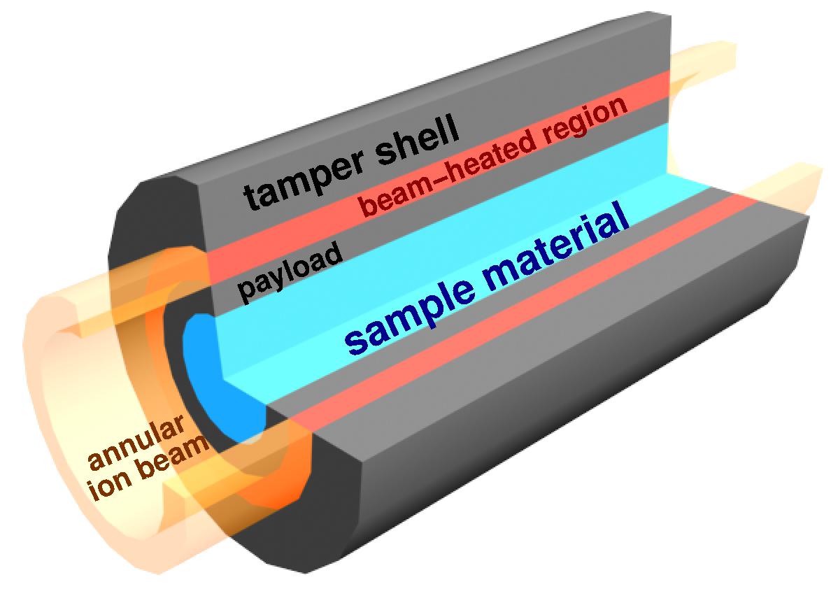
APPA
  Atomic Physics,
  create in ultrashort pulses <10⁻¹⁸s highest “supercritical” electromagnetic fields in the universe
  Plasma physics,
  Create the highest temperature plasmas
  – hotter than in stars
  Applied science
- Biophysics and material science
- spaceflight: “cosmic radiation” in lab
- Medical : Tumor therapy, heart leasu

Slide 16
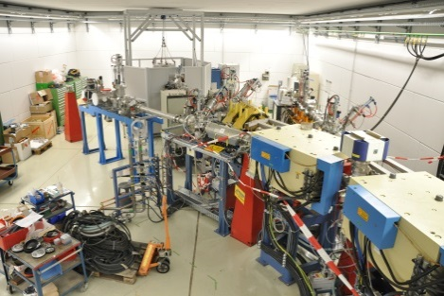
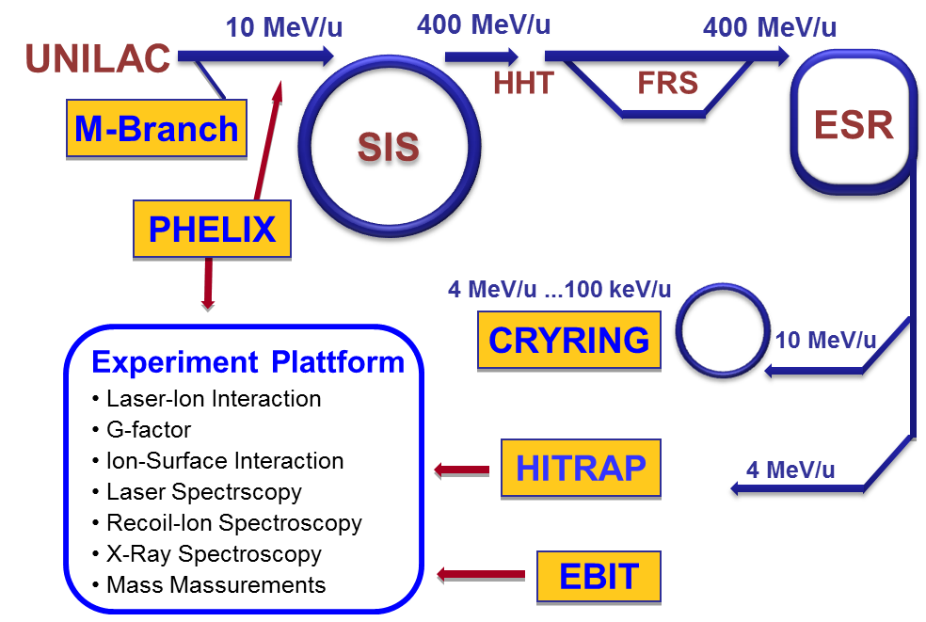
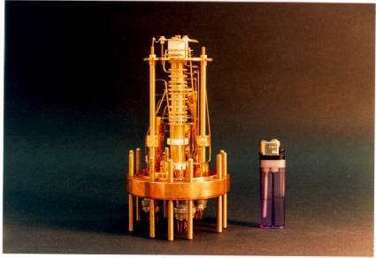
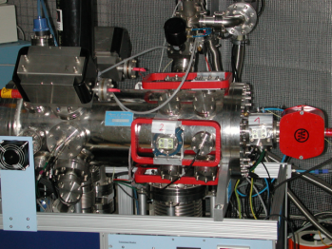
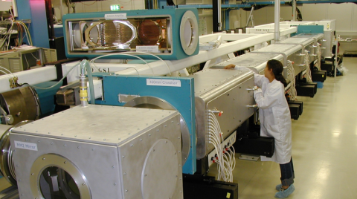
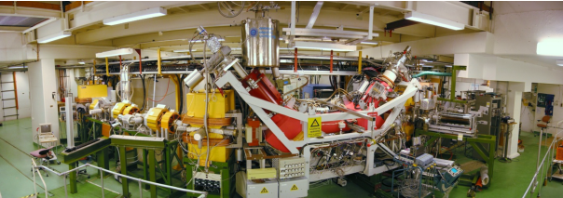
Ions at GSI : challenges and strategies
MML Facillities at GSI
M-branch UNILAC
ion trap facility HITRAP
Super-EBIT
petawatt laser PHELIX
CRYRING
GSI: Serving the user communities
UNILAC, PHELIX, EBIT, and CRYRING in operation until FAIR
R&D beam experiments for FAIR
building novel instrumentation for FAIR

Slide 17

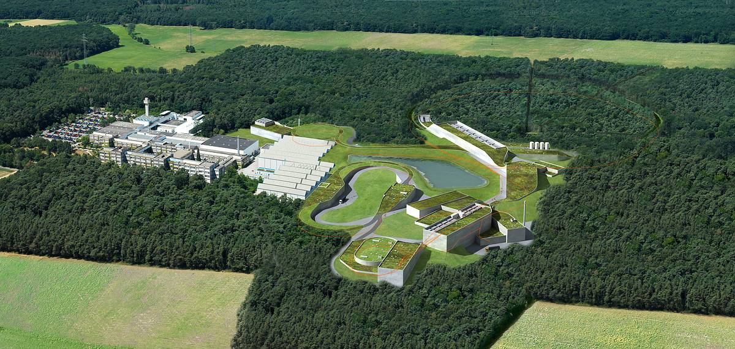
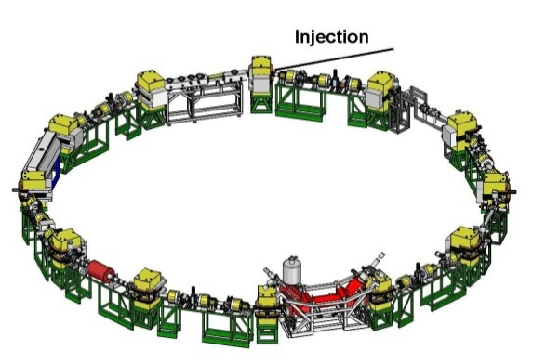
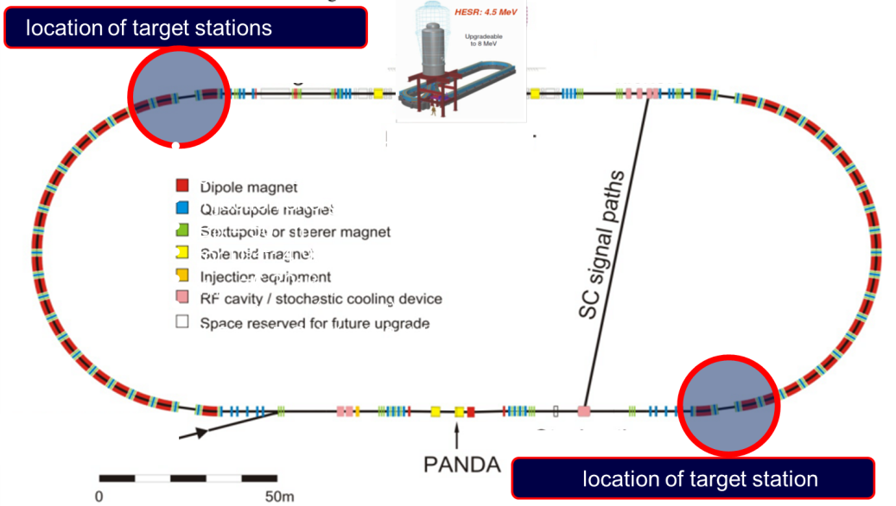
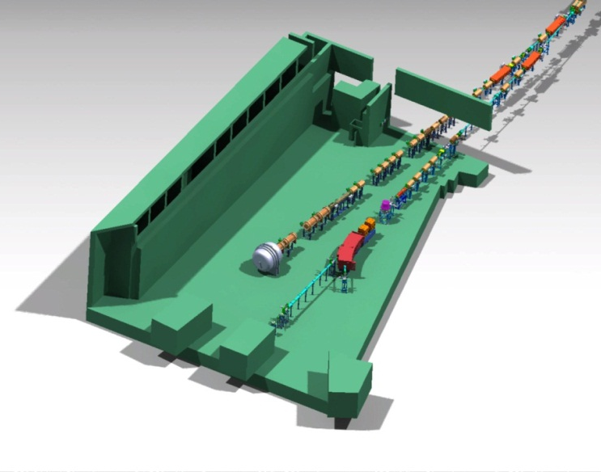
MSV for APPA (Status 2012): The Facilities
CRYRING
Cold Low-Energy Heavy Ions and Anti-Protons
HESR
Cold Relativistic Heavy Ions
APPA Cave
Unique physics opportunities !!!
☺

Slide 18
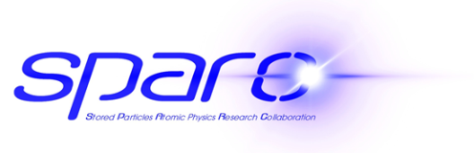

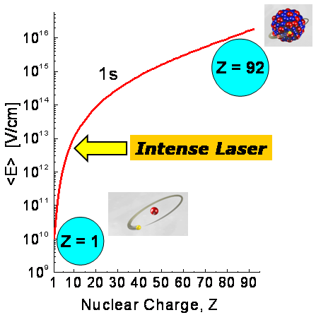
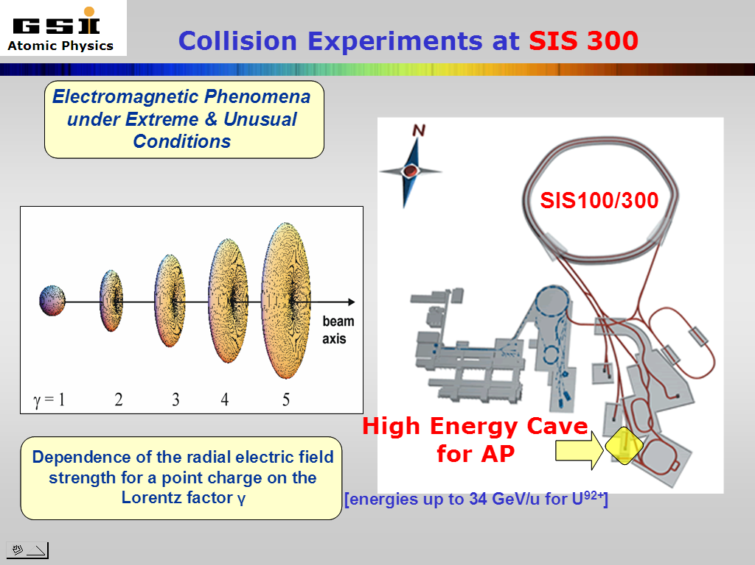
Atomic & Fundamental Physics
QED in the non-perturbative regime
Correlated multi-body dynamics for atoms and ions
Precision determination of fundamental constants
Influence of atomic structure on nuclear decay properties
    Fundamental physics and antimatter

Slide 19
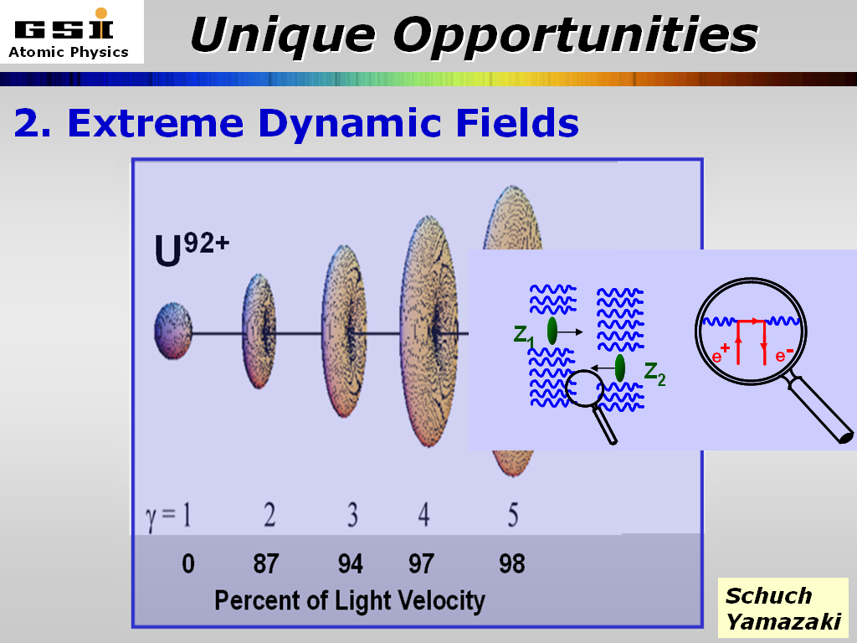
SPARC Challenges & Opportunities
”Heisenbergs dream” shot out the nucleus, let electrons explode !
World-wide unique for strong interaction with vacuum
U⁹²⁺
t ≤ 0.1 as
Multiple Pair Production
Recombination with the Vacuum
Explore correlated electron dynamics
- sub-attosecond time-scale
- not accessible by other means
0 87 94 97 98
Percent of Light Velocity

Slide 20

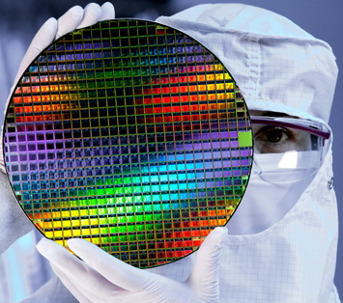
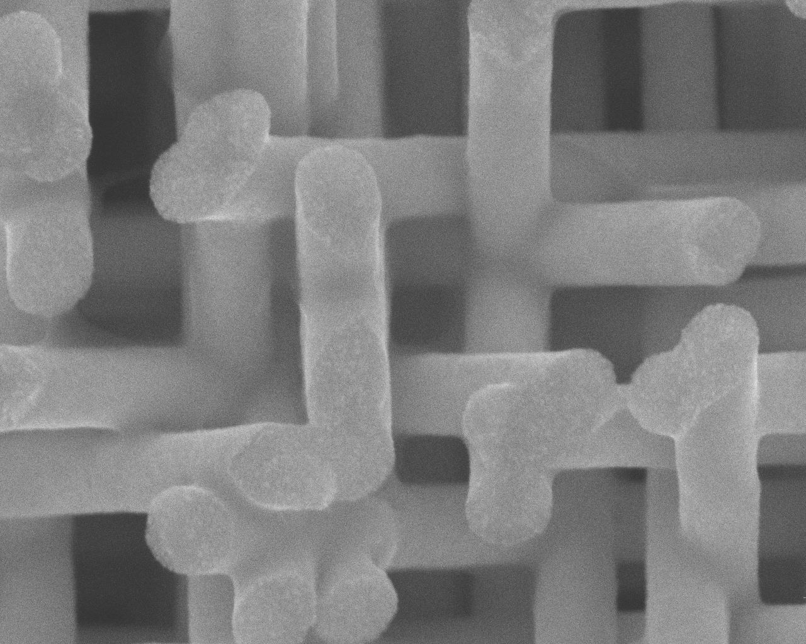
Standing of Ion Facilities
Facility for ion-beam based materials research
All ions species from eV to ~100 MeV
Versatile combination of ion facilities & instrumentation
Materials modification and analysis
Strong impact on industrial innovations
Facility for atomic and plasma physics, and materials research with swift ion beams
All ions species up to 100 GeV
Ions with highest charge state
Unique storage and trapping facilities
Ion track nanotechnology
Notes:
untere Abbildung: Nanodrahtnetzwerke hergestellt mit der Templattechnik:
Bestrahlung von Polymerfolien mit GeV Ionen unter verschiedenen Winkeln, anschließend chemische Ätzung der Ionenspuren → Nanokanäle die mittels Elektrochemie mit Metall gefüllt werden.
Interessant da stabiles Netzwerk mit extrem hohe Oberfläche; Parameter (Zahl der Drähte, Durchmesser, Länge, Material) gut kontrollierbar
Rauber M, Alber I, Müller S, Neumann R, Picht O, Roth C, Schökel A, Toimil Molares ME,
Ensinger W, Nano Letters 11 (2011) 2304-2310

Slide 21

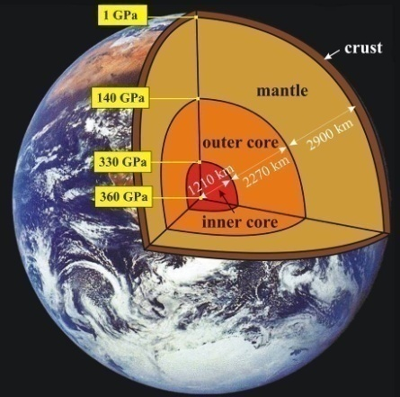
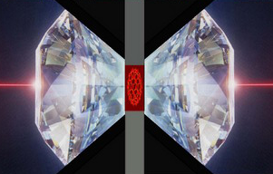
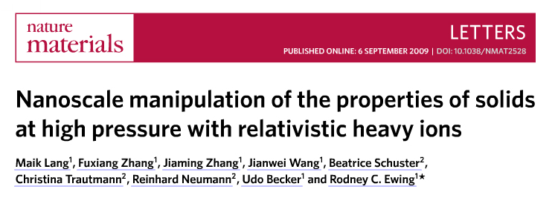
Matter under extreme conditions
Simulating geological processes in the inner Earth
Ion-beam stabilized high pressure phases
pressure
irradiation
temperature
During irradiation T and p like in the inner earth is applied to minerals. So, tracks induced by natural fission fragments in the minerals of the inner earth can be simulated.
21
Notes:
21

Slide 22
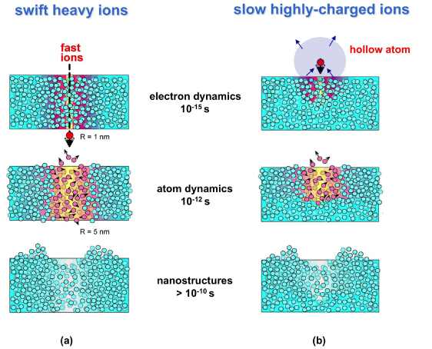
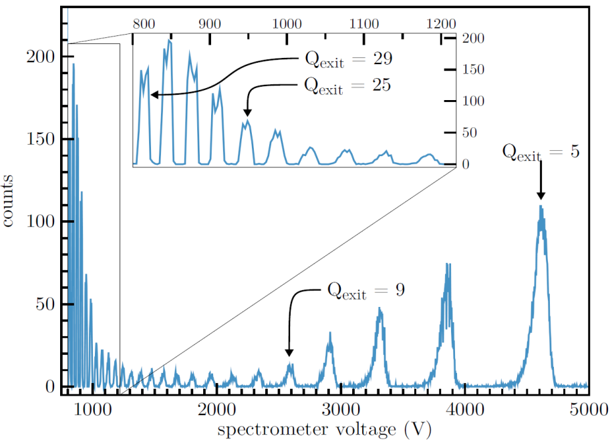
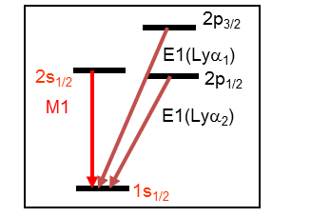

Scientific Highlights
Extra-ordinary effects with highly charged ions (HCI)
Slow HCI’s
High potential energy
Swift HCI’s
High kinetic energy
Xe³⁰⁺
U⁹¹⁺ + H₂
(220 MeV/u)
Lyα₂
₊
_{M1}
Lyα₁
counts
X-ray energy (keV)
Charge exchange and energy loss of Xe³⁰⁺ ions passing a 1 nm carbon nanomembrane
Excitation of H-like uranium in collisions with isolated target atoms
R. Wilhelm et al., Phys. Rev. Lett. 2014
A. Gumberidze et al., Phys. Rev. Lett. 2014

Slide 23
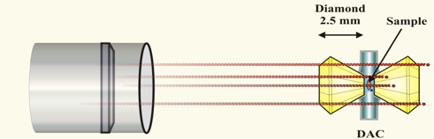
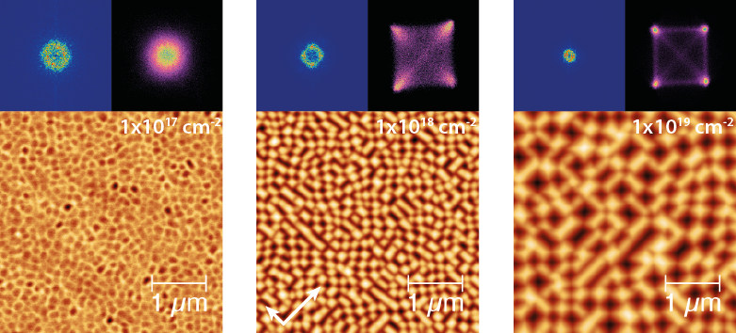
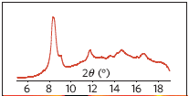
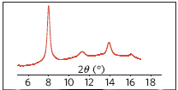
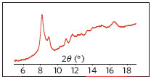
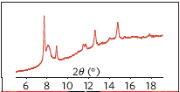
Scientific Highlights
Manipulation of bulk properties by
ion irradiation under high pressure
Controlled surface modification
at the nanoscale
U ions (45 GeV)
diamond anvil cell
ions + pressure (202 kbar) → Gd₂Zr₂O₇ pyrochlore
high-pressure phase (known)
new unknown
stable phase
cotunnite-like
relax
to 1 bar
only pressure (215 kbar)
Ge surfaces irradiated with 1 keV Ar⁺ ions
at T = 350°C
high-pressure phase (known)
disordered phase (known)
relax
Ion-beam induced crystalline surface pattern
by reverse epitaxy
cotunnite-like
to 1 bar
defect-fluorite
X. Ou et al.; Phys. Rev. Lett. (2013)
M. Lang et al., Nature Materials (2009)

Slide 24

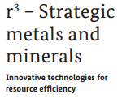
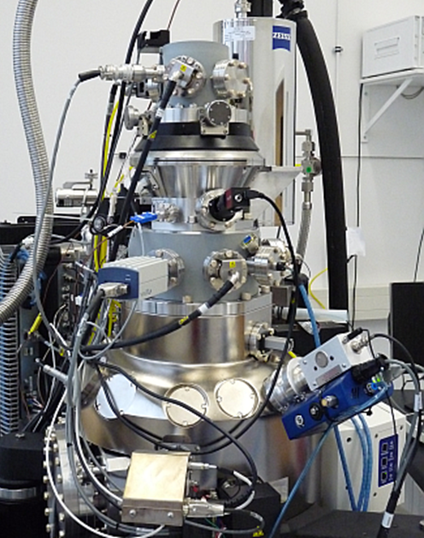
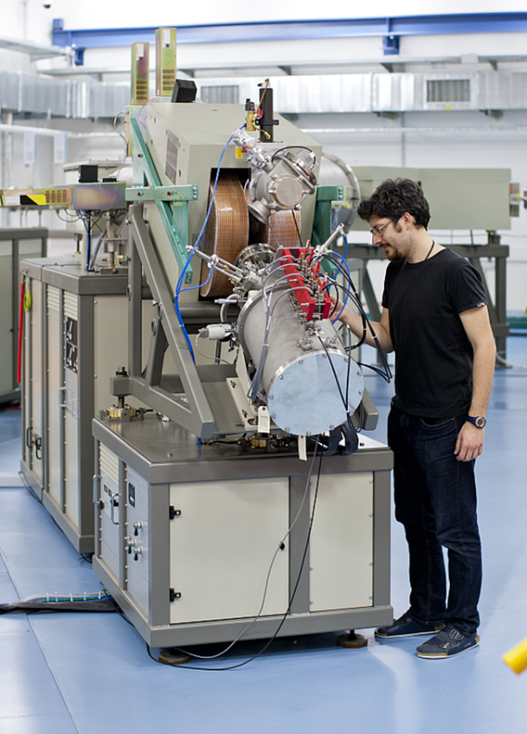
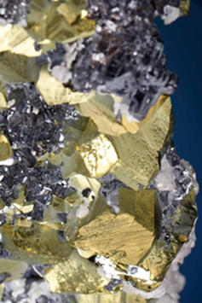
Cross-Linking with other Helmholtz Programs
Helmholtz Infrastructure
Helmholtz CP Activities and Initiatives
Energy Materials
Characterization Platform
DESY, DLR, FZJ, HZB, HZDR, HZG, KIT
Mineral Resources
GEOMAR, HZDR
Climate Initiative
AWI, FZJ, GEOMAR; HZG, KIT, UFZ
(→ Associated: HZDR)
Mineral
Analytics
Ion microscopy
AMS endstation @ IBC
Materials characterization by
by frontier techniques
New IBA approaches for fast
detection of trace elements
AMS methods applied for
climate and environment
Notes:
Noch alle Logos eingebunden.
Bei Mineral Resources müssen die Helmholtz-partner noch ergänzt werden.

Slide 25







Hot Dense Plasmas
Magnetic Fusion
Inertial
Fusion
Energy
Temperature [eV]
XFEL
Sun Core
SIS
100
Laser
Heating
PHELIX
Ideal plasmas
Ion Beam
Heating
Strongly coupled
plasmas
SIS 18
Jupiter
Sun Surface
solid state
density
Particles / cm⁻³
Notes:
25

Slide 26



Biology and Medicine- Tumortherapy with Ionbeams
Tumor
100 %
Ionen-
strahl
Schädigung
harte Röntgenstrahlung
Röntgenstrahlen
50 %
0 %
2
6
10
14
18
Eindringtiefe (cm)
Eindringtiefe [cm]
Notes:
26

Slide 27






Breast cancer
1st cancer in women (1 in 8)
survival rate 80%
high risk of late cardiac mortality
14.3.2013

Slide 28




PRIOR – Proton Microscope for FAIR
Pump-Probe: Ion and Proton beams
the worldwide unique high energy proton microscopy facility PRIOR (10 µm / 10 ns resolution, sub-percent density reconstruction) will be integrated into the HEDgeHOB beam line
using high-energy (5 – 10 GeV), high intensity (5∙10¹²) SIS-100 proton beams
Copper
Aluminum
Tantalum
Tin
Material spall and fragmentation
at micrometer level
courtesy of LANL
joint multidisciplinary research of HEDgeHOB and BIOMAT during FAIR MSV:
materials at extreme dynamic environments generated by external drivers (plasma physics and materials research)
PaNTERA (Proton therapy and radiography) project (biophysics)
PRIOR setup beam time commissioning at GSI: 2013/2014

Slide 29




Particle Therapy at FAIR
BIO*MAT
Biophysics
New project (PANTERA) within APPA to exploit the PRIOR setup for Diagnostics and Therapy
Relativistic protons (4.5 GeV) for image-guided, high-resolution, realtime, stereotactic radiosurgery (proton theranostics), (PRIOR setup)
Images of an antropomorphic phantom and a mouse recorded at LANL (800 MeV)
Investigating also to use high-energy antiprotons for Theranostics (together with FLAIR)

Slide 30




Ion Beam Facilities
Atomic Physics
Plasma Physics
Materials Research
Kinetic Energy (MeV)
Materials Research
Industrial Applications
Notes:
statt „Ions“ → neue Überschrift
Farbrahmen + farbl. Schrifteb

Slide 31






Experiments with Low-Energy pBars
Spectroscopy for tests of CPT and QED Antiprotonic atoms (pbar-He, pbar-p), antihydrogen
Atomic collisions Sub-femtosecond correlated dynamics: ionization, energy loss, antimatter-matter collisions
Antiprotons as hadronic probes X-rays of light antiprotonic atoms: low-energy QCD X-rays of neutron-rich nuclei: nuclear structure (halo) Antineutron interaction
Medical applications: tumor therapy Material Science
FLAIR collaboration uses low-E antiprotons at CERN-AD to test decelerator schemes- initial experiments of the FLAIR physics program

Slide 32



Big Bang, Supernovae, Neutron Stars :
Cosmic Matter – recreated in the FAIR - Laboratories
13 billion years
3 K
Creation of heavy elements SN explosions
1 billion years
20 K
light nuclei created in stars
300.000 years
3.000 K
3 minutes
10⁹ K
Anti-Protons, Neutrons, Hadrons disappear
1 microsec
temperature
10¹² K
time
(Anti-) Baryons created
Gluons, quarks disappear
Genesis - Quarks, Leptons
Notes:
The physics of hadrons and nuclei span a huge range in terms of
age of the universe
size of the universe
while the size of the object stays always in the ballpark of 1 fm (10⁻¹⁵m), the approx. range of the strong force
If we follow the bigbang, we can identify several regions of particular interest
Genesis of Quark
the Freeze-Out
almost Cold Hadrons
and Nuclei
The Genesis of Quarks is a different programme, so I leave it out for further discussions
All the others pose very remarkable questions
What kind of phase transition do exist in strongly interacting fundamental matter (among Quarks and Gluons) leading to the mapping of the phase diagram
The second important question is to understand quantitatively the mass of the proton (and all other hadrons) leading to the investigation of the binding among Quarks and Gluons
Finally the abundance of elements is critically defined by the dynamics of exotic nuclei, making the mapping of exotic nuclei the important challenge for understanding the appearance of our world

Slide 33



Brilliant Anti-proton beams
- Strange & Charm matter
SIS 100/300
50 MeV
SIS18
p-Linac
30 GeV Protons
HESR
ESR
Cu Target
10⁷ p/s @ 3 GeV
Cry
Ring
pbar production :
proton Linac 50 MeV
accelerate p in SIS18/SIS100
produce pbar on target
collect pbar in CR,
cool in RESR
inject pbar into HESR
PANDA
Accelerating
Cooling
Collecting
Accumulating
Precooling
RESR/CR
100m
G.Boca GSI, Germany & U. Pavia, Italy
Courtesy Jim Ritman, FZ Juelich

Slide 34


Anti-Proton ANnihilation in DA
700 tons
Pellet Target
Micro Vertex Detector
Central Tracker
Luminosity Monitor
Electronics
Simulation
Physics
Infrastructure
Computing
DIRC Detector
EM Calorimeter
Planar GEMs
Physics Book, Technical Design Reports: EMC, Magnets, Targets, Tracking
34

Slide 35
Why Antiprotons in PANDA?
Hadron Spectroscopy with Antiproton Annihilation
pBar beams difficult to make – BUT: gluon rich process
gain ~ 2 GeV in annihilation, reduced momentum transfer
all fermion-antifermion quantum numbers accessible
very high resolution in formation reactions
high angular momenta accessible

Slide 36



Example: χ_{c1,2}
e+e- Invariant mass reconstruction depends on the
detector resolution: ≈ 10 MeV
BUT: Formation in pbar-p:
Resonance scan: Resolution depends
on the beam resolution
PANDA@HESR ≈ 30 keV resolution

Slide 37



Particle production in pp collisions
_
Formation:
_
_
All J^{PC} allowed for (qq) accessible in pp
c.f.
Only J^{PC} = 1⁻⁻ allowed in e⁺e⁻
(to 1st order)

Slide 38

Charmonium Spectroscopy
_
open questions below DD threshold: widths-branching
new „XYZ“ states (Belle, BaBar, CLEO, CDF, D0, …)
new degrees of freedom: molecules, tetraquarks, gluonic excitations?
conventional states above DD
high L states:
access in pp , but not in e⁺e⁻
_
_

Slide 39

Open charm: The D_{s} spectrum
new narrow states D_{s}*(2317) and D_{s}*(2460) seen by BaBar, Belle, CLEO
masses significantly lower than quark model expectation
states are just below DK and D*K threshold
interpretation unclear…
DK / D*K molecules?
tetraquarks?
chiral doublers, …?
D. Besson et al., Phys. Rev. D68, 032002 (2003)
B. Aubert et al., Phys. Rev. Lett. 90, 242001 (2003)
B. Aubert et al. (BaBar Collab.),
Phys. Rev. D 74 (2006) 032007

Slide 40

Search for Heavy Glueballs
Charmed glueballs
  flavour blind decays
    charmed final states
  only a few charmed mesons around 3 - 4 MeV/c²
    less mixing
Exotic glueballs (oddballs), no mixing!
  m(2⁺⁻) = 4140(50)(200) MeV
  m(0⁺⁻) = 4740(70)(230) MeV
  decay modes φφ, φη, J/ψη, J/ψφ
  Narrow widths predicted
Morningstar & Peardon, PRD60(1999)34509
Morningstar & Peardon, PRD56(1997)4043

Slide 41



Beyond standard quark configurations
QCD allows much more than what we have observed:
Exotica
Baryons
Mesons
may have J^{PC} not allowed for qq
_
Courtesy C. Hanhart

Slide 42

Multi-Hypernuclei in Panda:
Production Mechanism and Detection Strategy

Slide 43


Instrumentation Panda for Multi-Hypernuclei: T. SAITO

Slide 44

The PANDA Collaboration
517 Members from
67 Institutes
18 Countries
Australia, Austria, Belarus, China, France, Germany, India, Italy, Poland, Romania, Russia, Spain, Sweden, Switzerland, Thailand, The Netherlands, USA, UK

Slide 45
BEAUTY baryon pairs, bcs, Bottom - and Y-xyz- mesons
Run HESR in pBar-p collider mode (R. Maier, FZ Juelich)
L= 3x30 with sqrt(s) = 30 GeV : (bcs)bar - (bcs)- Baryon pairs
Xb, Yb, Zb M >12 GeV

Slide 46
Beauty baryon pairs and multi-Charm-nuclei in Panda @ pBar-p collider:analogous to Hypernuclei ?!
Charm
C
30
C
C
same??
C
C
C
C
C
C
??
??

Slide 47
FAIR Experiments
CBM
APPA
NuSTAR
Super- FRS
PANDA

Slide 48
FAIR’s Charm and Beauty in 2020
Observers
India
Russia
Austria
China
Finnland
France
Germany
Italy
Poland
Slovenia
Spain
Sweden
Romania
UK

