Slide 1
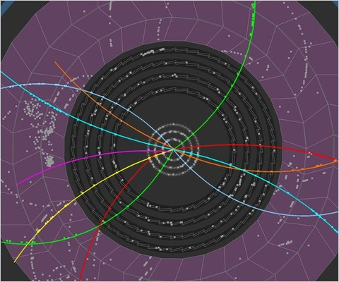
Dynamical approachES to THE
quarkonia SUPPRESSION
Roland Katz
NeD-TURIC – 13th of June 2014
Advisor: P.B. Gossiaux
and TOGETHER Pays de la Loire

Slide 2
In few words ?
Background Pure quantum results Stochastic semi-classical Schrödinger-Langevin
Go beyond the quasi-stationnary sequential suppression to explain observed kinetic dependences
a more dynamical point of view :
QGP genuine time dependent scenario
quantum description of the QQ
diffusion, friction, thermalisation
Roland Katz –13/06/2014

Slide 3
Summary
Background and motivations
Pure quantum approach
Quantum thermalisation ?
Stochastic semi-classical approach
The Schrödinger-Langevin approach
Conclusion
Roland Katz –13/06/2014

Slide 4
Quarkonia suppression
Background Pure quantum results Stochastic semi-classical Schrödinger-Langevin
Predicted by Matsui and Satz as a sign of Quark-Gluon Plasma production and observed experimentally…
… but kinetic dependences still poorly understood
0% suppressed
(<- if no QGP)
1st surprise: same suppression at collision energies
17 GeV and 200 GeV
QGP size and T
100% suppressed
PHENIX, PRL98 (2007) 232301
SPS from Scomparin @ QM06
Roland Katz –13/06/2014

Slide 5
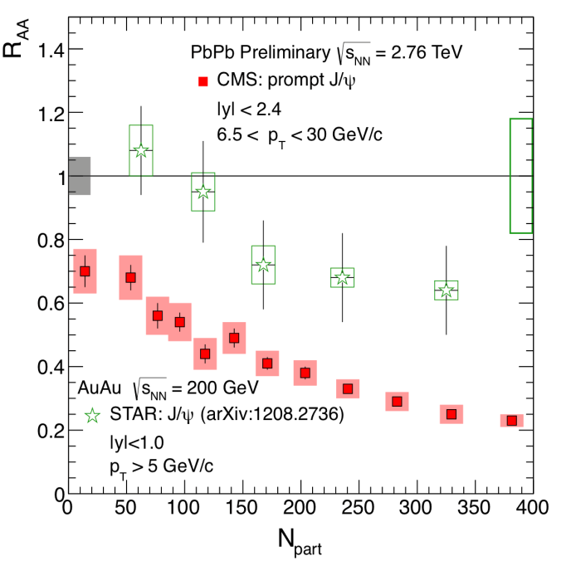
Quarkonia suppression
Background Pure quantum results Stochastic semi-classical Schrödinger-Langevin
Low energy J/ψ
High energy J/ψ
0% suppressed
200 GeV
2760 GeV
200 GeV
2760 GeV
100% suppressed
less high energy J/ψ at 2760 GeV
2nd « surprise »: more low energy J/ψ at 2760 GeV
(Recombination ? Thermalisation ?)
Roland Katz –13/06/2014
Bruno’s & PRL109 (2012) 072301 and JHEP05 (2012) 176 and CMS PAS HIN-10-006

Slide 6
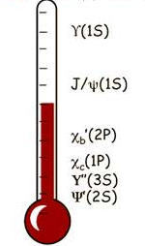
Common theoretical explanation
Background Pure quantum results Stochastic semi-classical Schrödinger-Langevin
Sequential suppression by Matsui and Satz …
States formation at an early stage of the collision
+ Each state has a Tdiss
+ Stationnary medium (T)
= if T > Tdiss the state is dissociated for ever (« all-or-nothing scenario »)
=> quarkonia as QGP thermometer
… and recombination
collision energy
number of QQ in the medium
probability that a Q re-associates with another Q
Roland Katz –13/06/2014

Slide 7
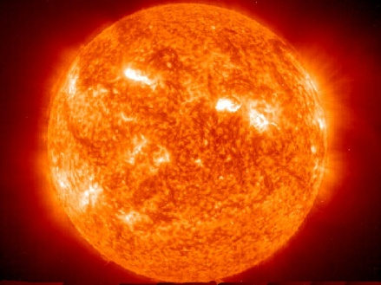
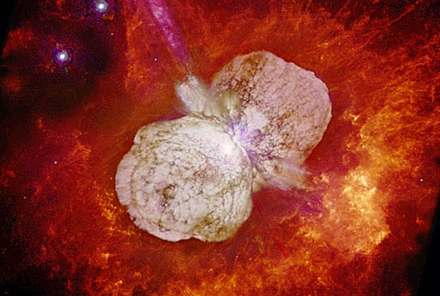
But assumptions …
Background Pure quantum results Stochastic semi-classical Schrödinger-Langevin
Sequential suppression in the « initial state » (formation times ?) and then adiabatic evolution
Very short time scale for QQ decorrelation
(quarkonia forever lost if dissociated)
What a stationnary medium has to do with reality ?
Q
Q
?
Early QGP
States : Yes or No ?
Q
Q
Picture:
Reality:
Roland Katz – 15/05/2014

Slide 8
A more dynamical view
Background Pure quantum results Stochastic semi-classical Schrödinger-Langevin
Quarkonia formation only at the end of the evolution
Quantum description of the correlated QQ pair
Reality is closer to a hydrodynamic cooling QGP
Q
hadronization
Quarkonia or something else ?
QGP
Q
Very complicated QFT problem at finite T !
-> The different states are obtained by projections
Color screened binding potential V(r,T)
Temperature scenarios T(t)
Thermalisation and diffusion
+
+
Cooling QGP
Direct interactions
with the thermal bath
Interactions due to color charges
Roland Katz –13/06/2014

Slide 9
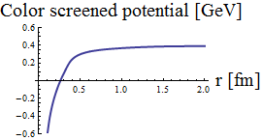
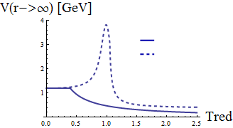
Background Pure quantum results Stochastic semi-classical Schrödinger-Langevin
The color potentials V(Tred, r) binding the QQ
Static lQCD calculations (maximum heat exchange with the medium):
F : free energy
S : entropy
U=F+TS : internal energy (no heat exchange)
T
“Weak potential” F<V<U * => some heat exchange
“Strong potential” V=U ** => adiabatic evolution
F<V<U
V=U
for Tred=1.2
Evaluated by Mócsy & Petreczky* and Kaczmarek & Zantow** from lQCD results
* Phys.Rev.D77:014501,2008 **arXiv:hep-lat/0512031v1
Roland Katz –13/06/2014

Slide 10
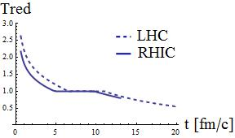
Background Pure quantum results Stochastic semi-classical Schrödinger-Langevin
Cooling over time by Kolb and Heinz* (hydrodynamic evolution and entropy conservation)
At LHC ( ) and
RHIC ( ) energies
The QGP homogeneous temperature scenarios
t0
medium at thermal equilibrium
Initial QQ pair radial wavefunction
Assumption: QQ pair created at t0 in the QGP core
Gaussian shape with parameters (Heisenberg principle):
Roland Katz –13/06/2014
* arXiv:nucl-th/0305084v2

Slide 11
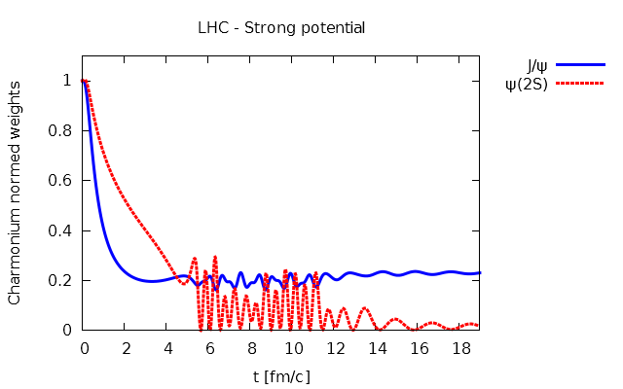
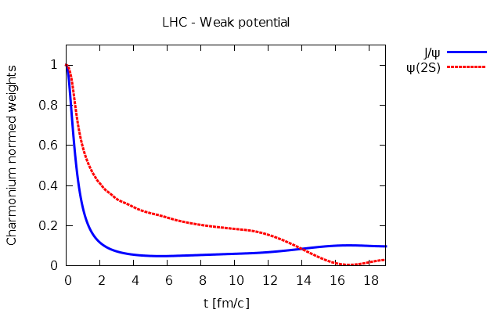
Without direct thermalisation
Background Pure quantum results Stochastic semi-classical Schrödinger-Langevin
Evolution: radial non relativistic Schrödinger equation
Weight(t) = ΨQQ (t) projection onto quarkonia T=0 eigenstates
Already an actual evolution
=> the scenario can not be reduced to its very beginning
V=U at LHC
T ̴ Tc
F<V<U at LHC
Roland Katz –13/06/2014

Slide 12
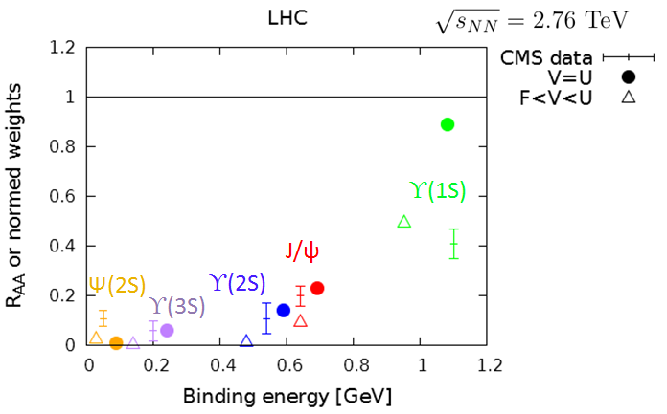
Background Pure quantum results Stochastic semi-classical Schrödinger-Langevin
Without direct thermalisation
Total suppression data and results at the end of the evolution
LHC
CMS data: High pT and most central data
The results are quite relevant for such a simple scenario !
Feed downs from exited states to lower states, etc… may slightly change these values.
Similarly to the data, the results exhibit less J/ψ suppression at RHIC than at LHC.
Roland Katz –13/06/2014
CMS Collaboration JHEP 05 (2012) 063 ; CMS-PAS-HIN-12-007 ; Phys. Rev. Lett. 109 (2012) 222301

Slide 13
Thermalisation
Background Pure quantum results Stochastic semi-classical Schrödinger-Langevin
Experiments => quarkonia thermalise partially
MQQ >> T => quarkonia are Brownian particles
Thermalise our wavefunction ? => Quantum friction/stochastic effects have been a long standing problem because of their irreversible nature
Open quantum system described by a mixed state
(= not only statistics on the measurement (pure state) but also on the state itself)
Roland Katz –13/06/2014

Slide 14
Open quantum system
Background Pure quantum results Stochastic semi-classical Schrödinger-Langevin
The common open quantum approach
density matrix and {quarkonia + bath} => bath integrated out
non unitary evolution + decoherence effects
But defining the bath is complicated and the calculation entangled…
Akamatsu* -> complex potential
Borghini** -> a master equation
✓
Langevin-like approaches
Unravel the common open quantum approach
Knowledge of Drag coefficient A(T) -> need for an effective approach
Rothkopf*** -> stochastic and complex potential
Semi-classical
à la Young and Shuryak****
Schrödinger-Langevin equation
Others
Failed at low/medium temperatures
Mixed state observables obtained from large statistics
* Y. Akamatsu Phys.Rev. D87 (2013) 045016 ; ** N. Borghini et al., Eur. Phys. J. C 72 (2012) 2000
*** Y. Akamatsu and A. Rothkopf. Phys. Rev. D 85, 105011 (2012) ; **** C. Young and Shuryak E 2009 Phys. Rev. C 79: 034907

Slide 15
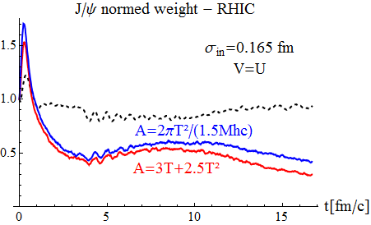
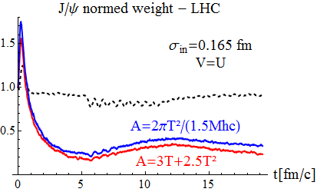
Stochastic semi-classical approach
Background Pure quantum results Stochastic semi-classical Schrödinger-Langevin
Ingredients: Quantum Wigner distribution + classical 1st order in ħ Wigner-Moyal equation + Fokker-Planck terms + classical Einstein law
0.3
0.25
Data ̴ 0.6
Data ̴ 0.2
But
Harmonic case: violation of Heisenberg principle at low temperatures
[we expect when T->0: W(x,p) α exp(-H(x,p)) whereas we have W(x,p) α exp(-H(x,p)/T)]
Roland Katz –13/06/2014
With J. Aichelin and P.B. Gossiaux’s, C. Young and E. Shuryak’s A(T)

Slide 16
Schrödinger-Langevin (SL) equation
Background Pure quantum results Stochastic semi-classical Schrödinger-Langevin
Derived from the Heisenberg-Langevin equation*, in Bohmian mechanics** …
Warming term: stochastic operator
Cooling term: dissipative
non-linear wavefunction dependent potential
?
Brownian hierarchy:
where
σ = quarkonia autocorrelation time with the gluonic fields
= quarkonia relaxation time
Brings the system to the lower state
if the latter has a constant phase
Memoryless friction
gaussian correlation of parameter
and norm B
:
σ
3 parameters: A (the Drag coef), B (the diffusion coef) and σ (autocorrelation time)
* Kostin The J. of Chem. Phys. 57(9):3589–3590, (1972)
** Garashchuk et al. J. of Chem. Phys. 138, 054107 (2013)
Roland Katz –13/06/2014

Slide 17
Background Pure quantum results Stochastic semi-classical Schrödinger-Langevin
Fluctuation-dissipation
relation given by :
, (at t >> )
Mixed state observable ?
=>
Properties
Unitary
Heisenberg principle is ok at any T
Non linear
=> Violation of the superposition principle (=> decoherence)
Analytic solutions*
Free wavepacket and harmonic potential
Restriction to weak coupling
Asymptotic thermal distribution not demonstrated but assumed
=> numerical approach instead !
Roland Katz –13/06/2014
* J. Messer, Acta Phys. Austr. 50 (1979) 75.

Slide 18
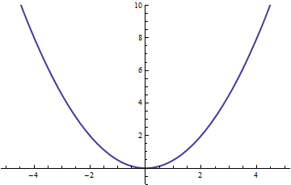
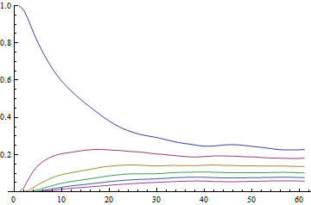
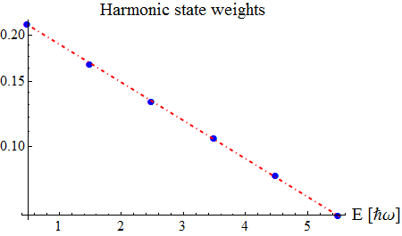
SL: some numerical tests
Background Pure quantum results Stochastic semi-classical Schrödinger-Langevin
Harmonic potential
Asymptotic thermal equilibrium
for any (A,B,σ) and from any initial state
V(x)
(t >> )
Harmonic state weights (t)
Boltzmann distribution line
Roland Katz –13/06/2014

Slide 19
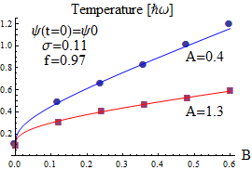
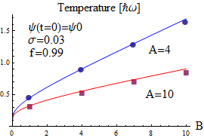
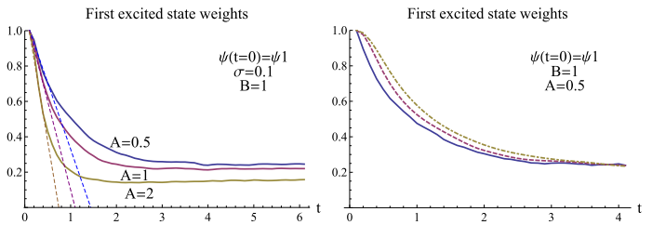
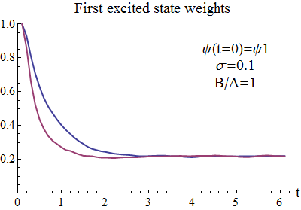
SL: some numerical tests
Background Pure quantum results Stochastic semi-classical Schrödinger-Langevin
Harmonic potential
Derive the SL quantum fluctuation-dissipation relation
=>
Measured
Classical Einstein law
Measured temperature [ħω] at t->∞
Measured temperature [ħω] at t->∞
Ok for
First excited state weight (t)
First excited state weight (t)
Tune B/A or σ
to adjust the relaxation time
A
σ
Roland Katz –13/06/2014

Slide 20
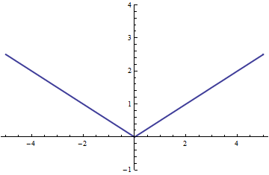
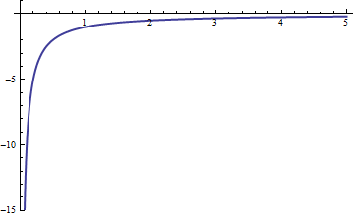
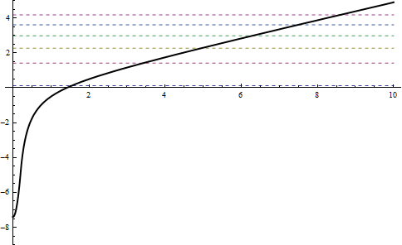
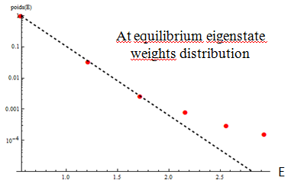
SL: some numerical tests
Background Pure quantum results Stochastic semi-classical Schrödinger-Langevin
Other potentials
V(x)
Asymptotic Boltzmann distributions ?
Linear Abs[x]
Yes
No
Coulomb 1/r
Due to high density of states and divergence effects
Close enough
Light discrepancies from 3rd excited states for some (A,B,σ)
(« saturation effects »)
Quarkonia
approx
Roland Katz –13/06/2014

Slide 21
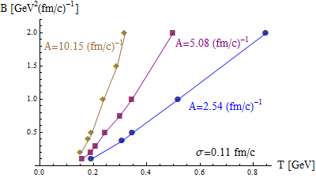
SL: some numerical tests
Background Pure quantum results Stochastic semi-classical Schrödinger-Langevin
Mastering numerically the fluctuation-dissipation relation for the Quarkonia approximated potential ?
From the knowledge of (A,T) => B ? Yes:
Drag coefficient for charm quarks*:
Typically T ∈ [0.1 ; 0.43] GeV => A ∈ [0.32 ; 1.75] (fm/c)⁻¹
Roland Katz –13/06/2014
* Gossiaux P B and Aichelin J 2008 Phys. Rev. C 78 014904

Slide 22
Conclusion
Schrödinger equation
Interesting results are obtained with RHIC and LHC cooling scenarios.
This dynamical approach (“continuous scenario”) might replace the sequential suppression (“all-or-nothing scenario”).
Stochastic semi classical
Results with a classical stochastic evolution of a quantum distribution + classical Einstein law
Heisenberg principle violation at low T => results comparison to a quantum evolution + quantum fluctuation-dissipation relation ?
Schrödinger-Langevin equation
Asymptotic thermal equilibrium for harmonic, linear and quarkonia approximation potentials but failed with Coulomb potential.
Will be applied to the quarkonia (1D and 3D) in the QGP case when related fluctuation-dissipation relation will be mastered.
Might be able to give an alternative explanation to the regeneration
Roland Katz – 13/06/2014 – katz@subatech.in2p3.fr – http://rolandkatz.com/

Slide 23
BACK UP SLIDES

Slide 24
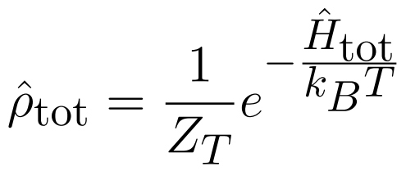
Density matrix

Slide 25
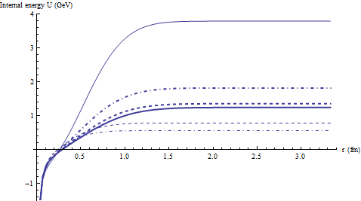
Some plots of the potentials
With weak potential F<V<U with Tred from 0.4 to 1.4
With strong potential V=U with Tred from 0.4 to 1.4

Slide 26
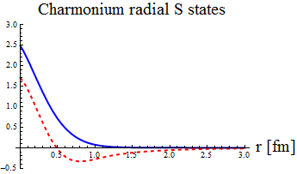
Quantum approach
Schrödinger equation for the QQ pair evolution
Where
Q
r
QGP
Initial wavefunction:
Q
where and
Projection onto the S states: the S weights
Radial eigenstates
of the hamiltonian
Roland Katz – 26/07/2013

Slide 27
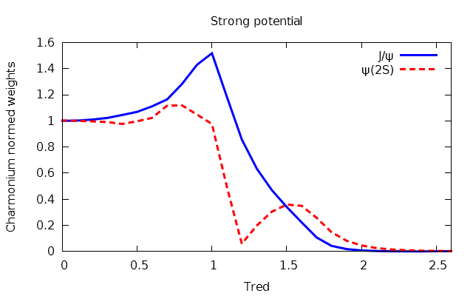
Without direct thermalisation
Evolution: radial non relativistic Schrödinger equation
Weight(t) = ΨQQ (t) projection onto quarkonia T=0 eigenstates
At fixed temperatures
Even without direct
thermalisation
not a all-or-nothing
existence of the states
Roland Katz – 15/05/2014

Slide 28
Semi-classical approach
The“Quantum” Wigner distribution of the cc pair:
… is evolved with the “classical”, 1st order in ħ, Wigner-Moyal equation + FP:
Finally the projection onto the J/ψ state is given by:
But in practice: N test particles (initially distributed with the same gaussian distribution in (r, p) as in the quantum case), that evolve with Newton’s laws, and give the J/ψ weight at t with:
Roland Katz – 26/07/2013

