Slide 1
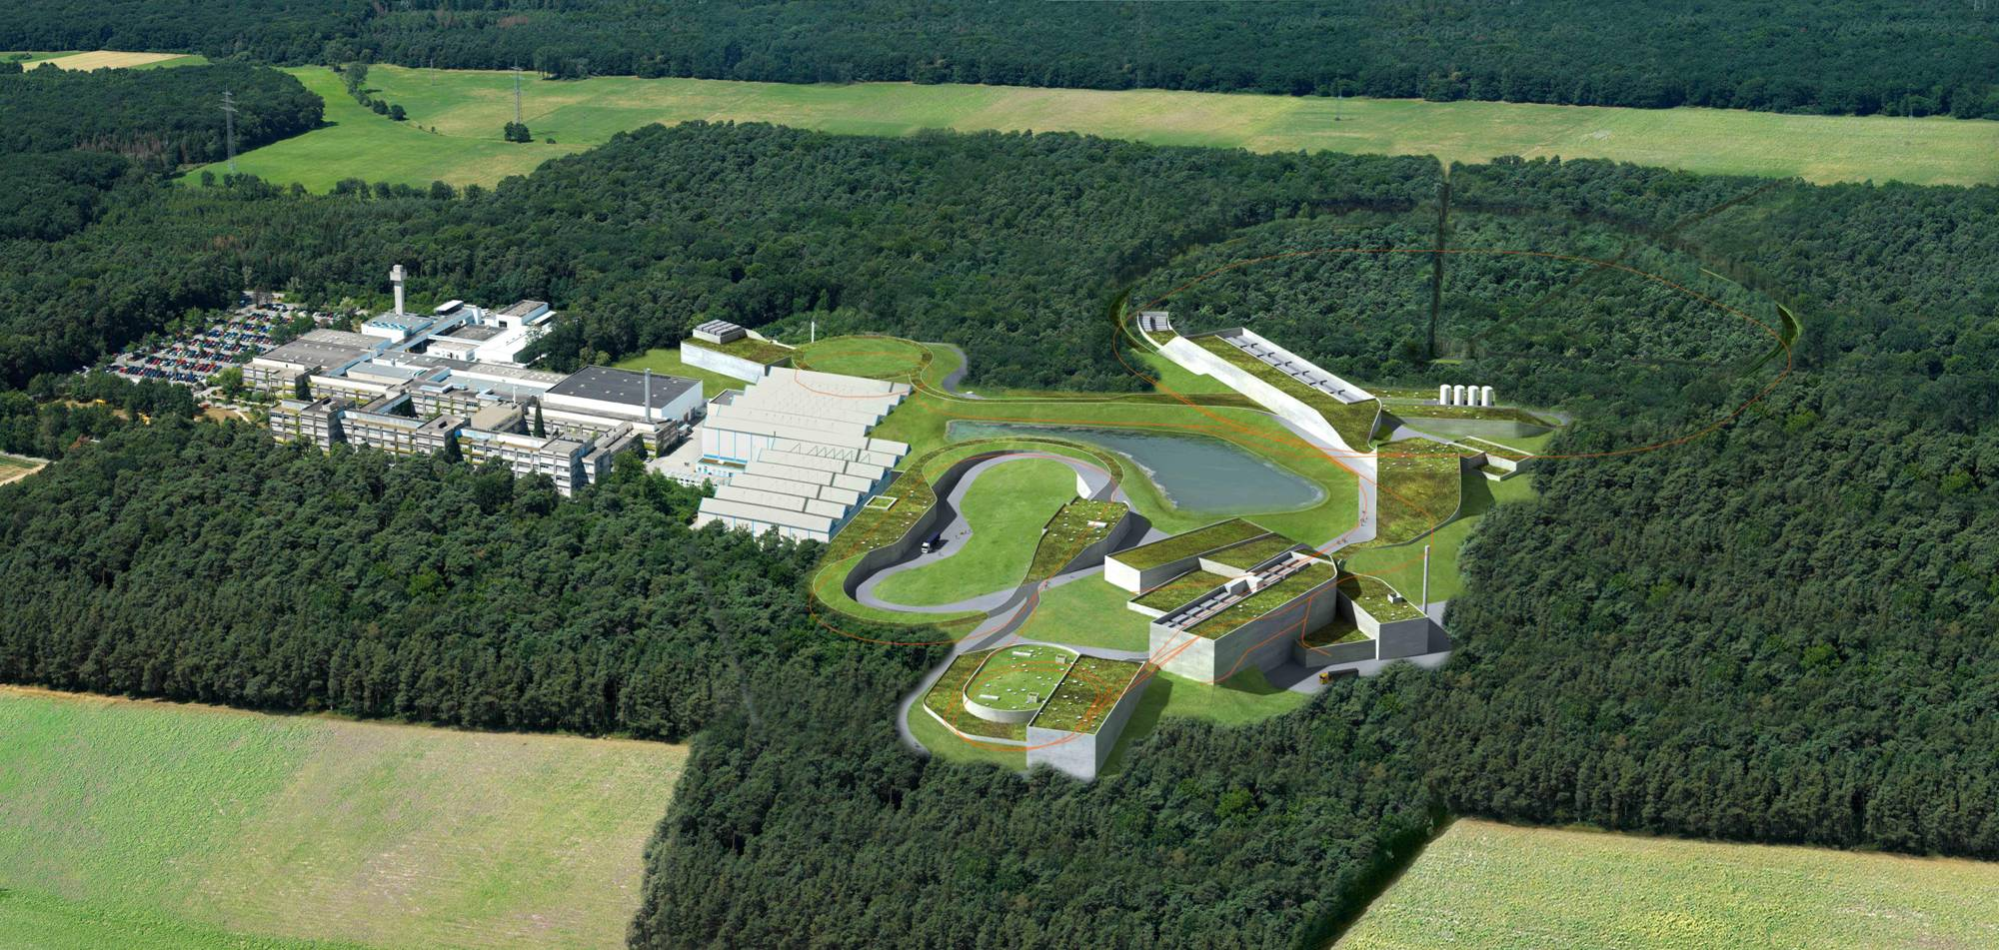


















FAIR’s Charm and Beauty in 2020
Review Part 2 Turic
Observers
India
Russia
Austria
China
Finnland
France
Germany
Italy
Poland
Slovenia
Spain
Sweden
Romania
UK

Slide 2
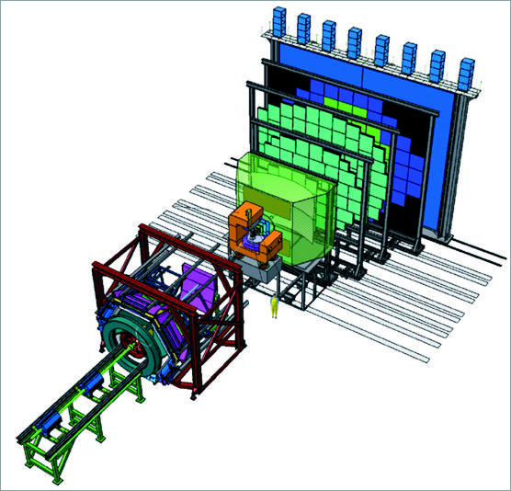
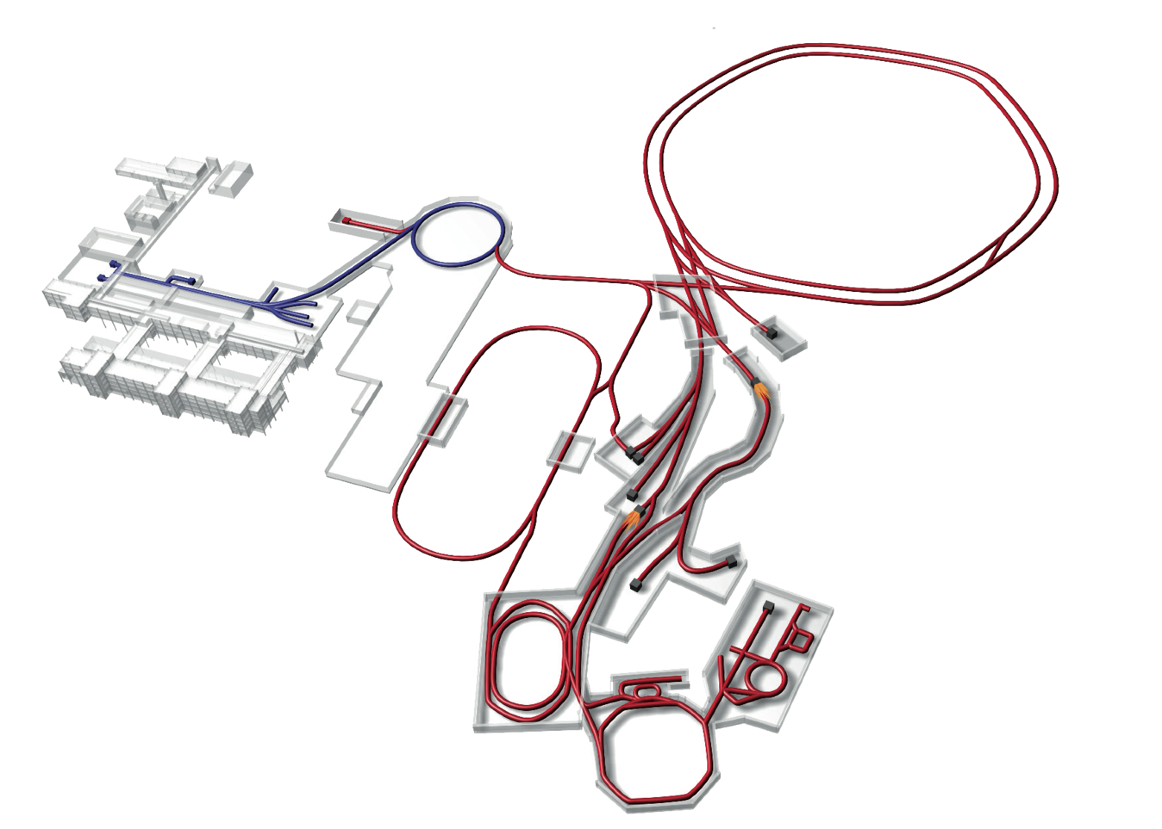
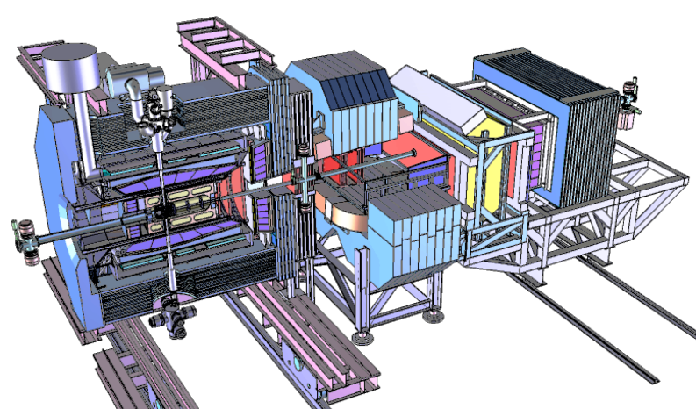
FAIR Experiments
CBM
APPA
NuSTAR
Super- FRS
PANDA

Slide 3
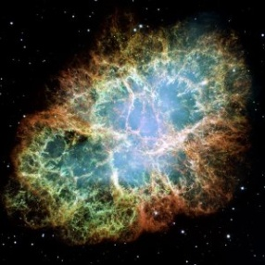

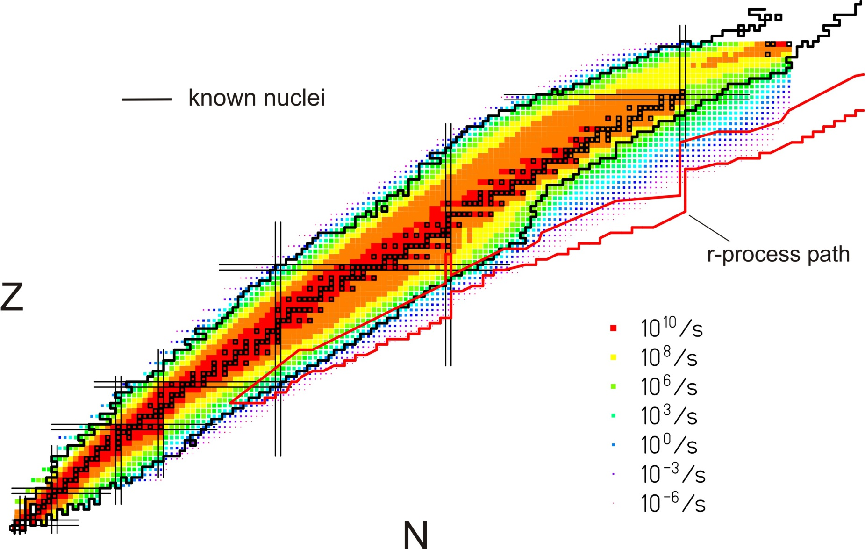
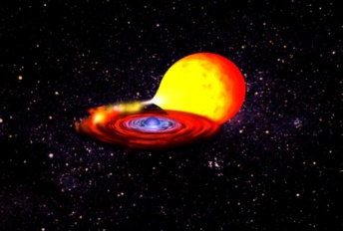
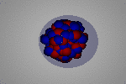
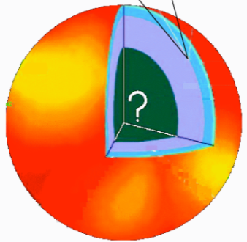
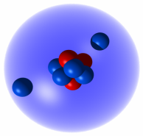
Nuclear Astrophysics at FAIR: NuSTAR
FAIR will provide unique access to many nuclei relevant in explosive nucleosynthesis
Quest for the limits of existence
Halos, Open Quantum Systems, Few Body Correlations
Changing shell structure far away from stability
Skins, new collective modes, nuclear matter, neutron stars
Phases and symmetries of the nuclear many body system
Origin of the elements
➔ unified theory (ab-initio, density functional, shell model)
➔ Combine accurate nuclear physics with precision astronomy to constrain astrophysical scenarios
Neutron Skins
Pygmy Resonance
Neutron stars
Halos
EOS
NuSTAR
3
Notes:
3

Slide 4
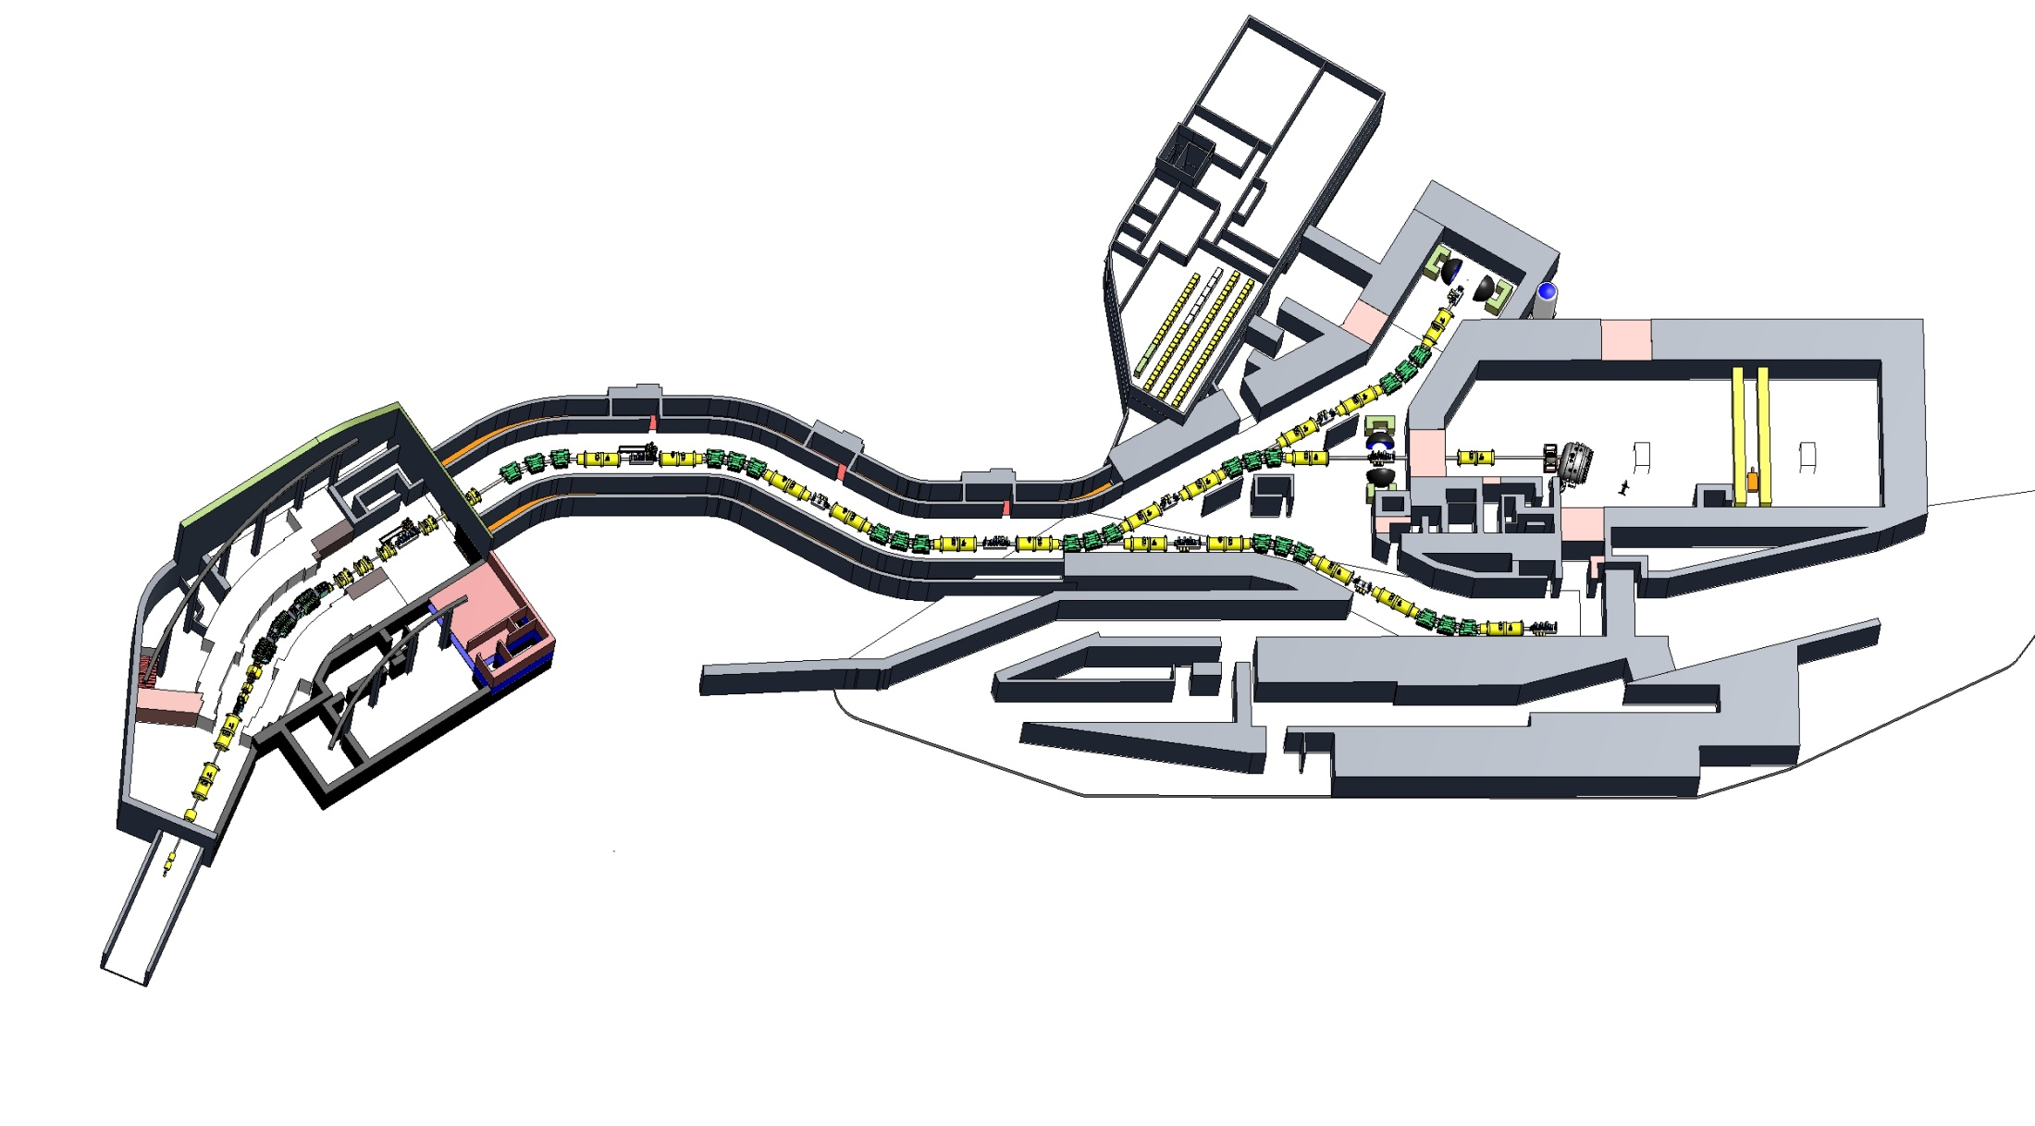
SuperFRS-facility and NuSTAR program
Highest intensity (x100) and transmission (x10)
High energy (unambigous identification)
World-wide unique storage-ring complex
1 – Low-energy branch
High Prior: enlarge CAVE!
2 – High-Energy branch
3 – Storage-ring branch
Search for
  New isotopes (r-nuclides)
  Neutron radioactivity, neutron dripline
  New shell structure
  New excitation modes
Unexpected observations and discoveries

Slide 5
FAIR Experiments
CBM
APPA
NuSTAR
Super- FRS
PANDA

Slide 6
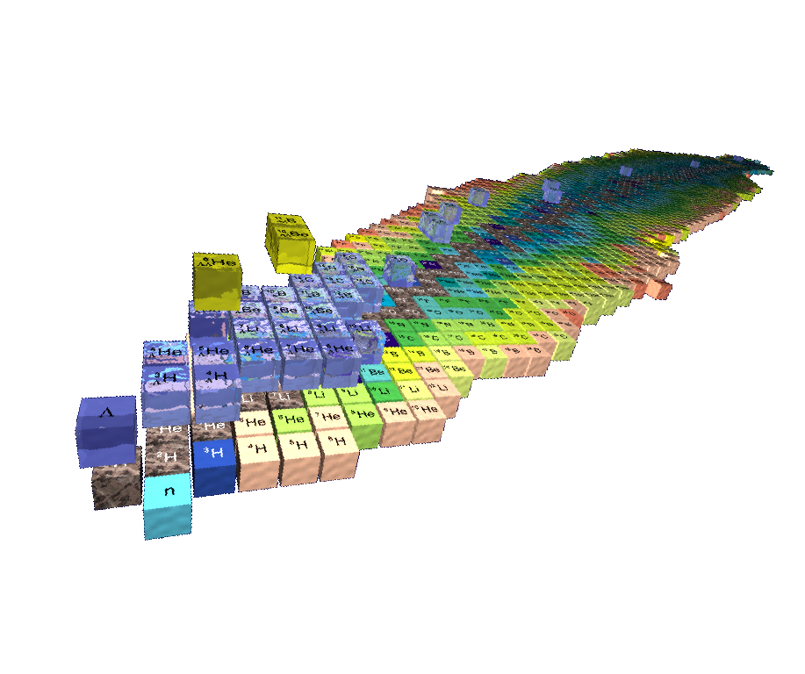
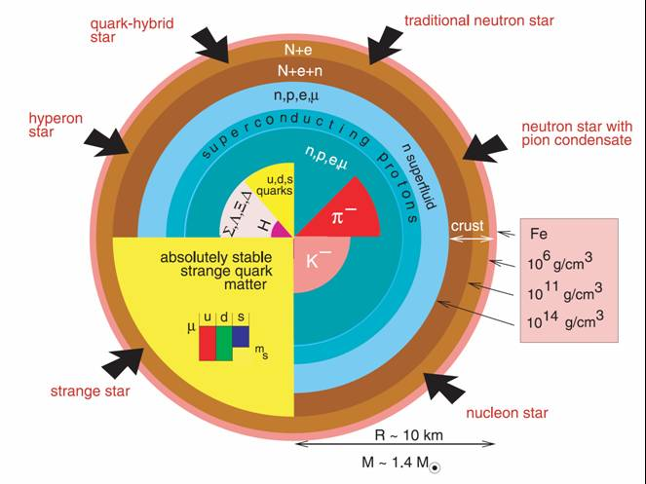
From NuSTAR to CBM : Hypernuclei and Neutron Stars
      hypernuclei Λ-B Interaction Neutron Stars
S=-2
S=-1
S=-0
Saito, HYP06
Several possible configurations of Neutron Stars
  Kaon condensate, hyperons, strange quark matter
Single and double hypernuclei in the laboratory:
  study the strange sector of the baryon-baryon interaction
  provide info on EOS of neutron stars
J.M. Lattimer and M. Prakash,
"The Physics of Neutron Stars", Science 304, 536 (2004)
J. Schaffner and I. Mishustin, Phys. Rev. C 53 (1996):
Hyperon-rich matter in neutron stars

Slide 7
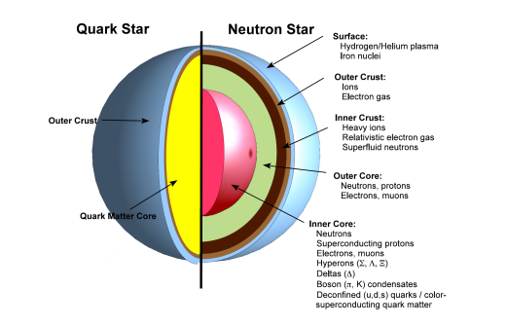
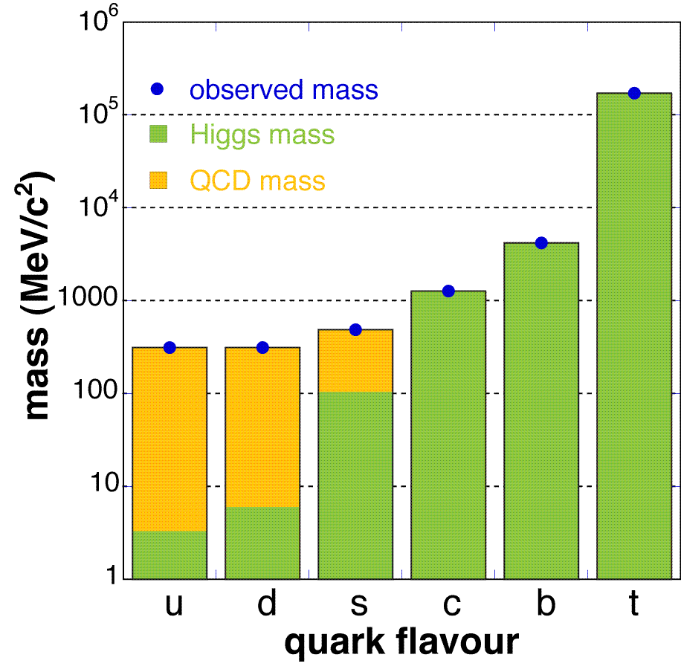
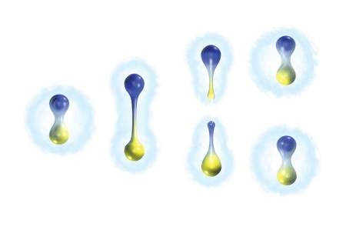
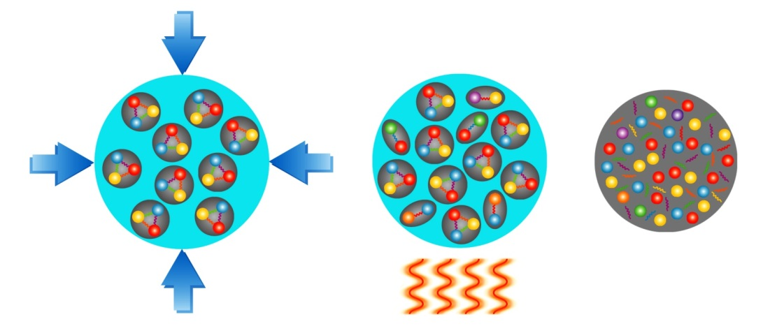
Fundamental Questions of (QCD-) Physics
➢ What is the structure of compact stars?
➢ What is the origin of the mass of the
hadrons which determine the visible
mass of the universe?
➢ Why do we not observe individual quarks,
the elementary building blocks of matter?
➢ What are the properties and the degrees-of-freedom
of nuclear matter under extreme
conditions (high temperature
and/or high density)?

Slide 8
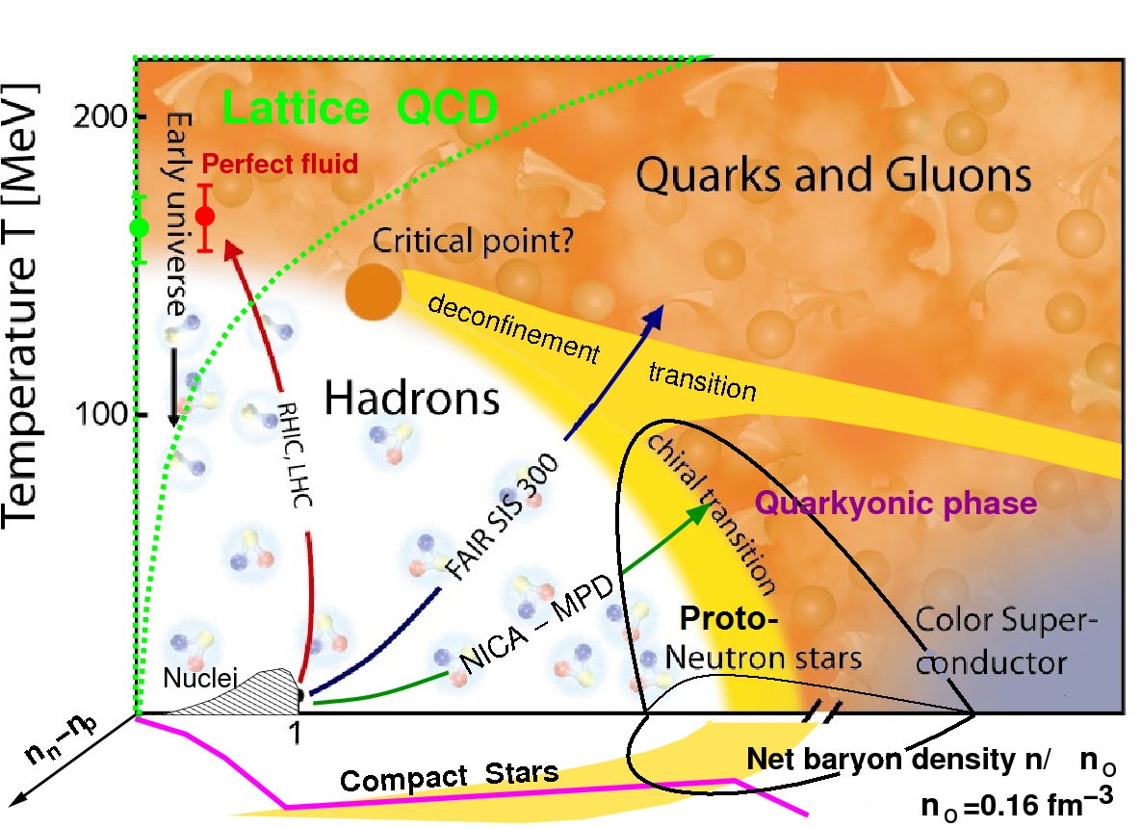
CBM : Big Bang and Neutron Star matter
- in the laboratory
deconfinement phase transition Quarks=> Proton
Equation-of-state at neutron star densities, Multi-Strange Quarks
in-medium properties of hadrons, hadron mass generation
FAIR SIS100
Highest Proton Densities in the Universe !

Slide 9
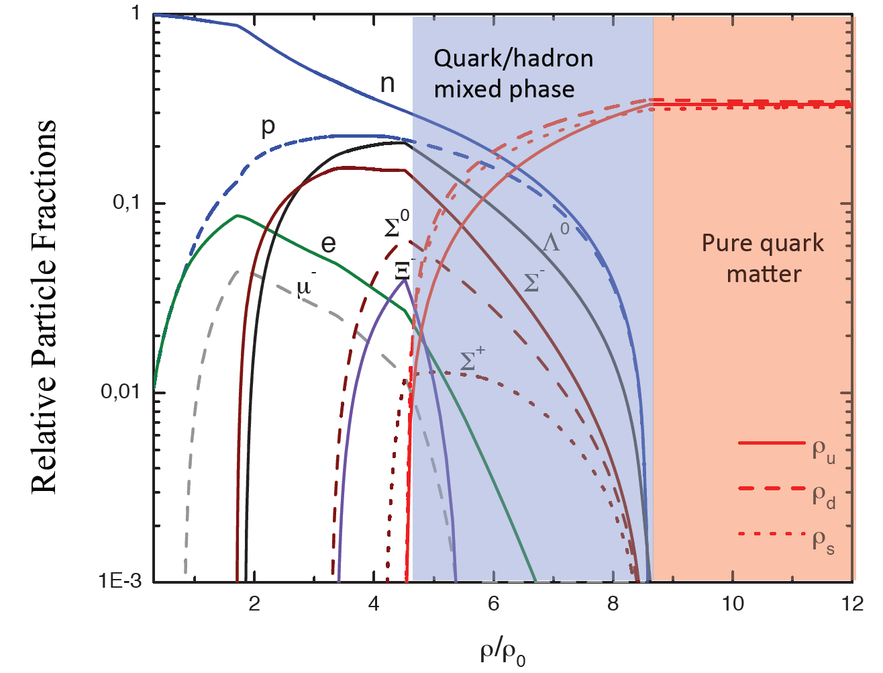
Quark/Hadron composition and mixed phase in neutron stars
M. Orsaria, H. Rodrigues, F. Weber (August 2012)

Slide 10
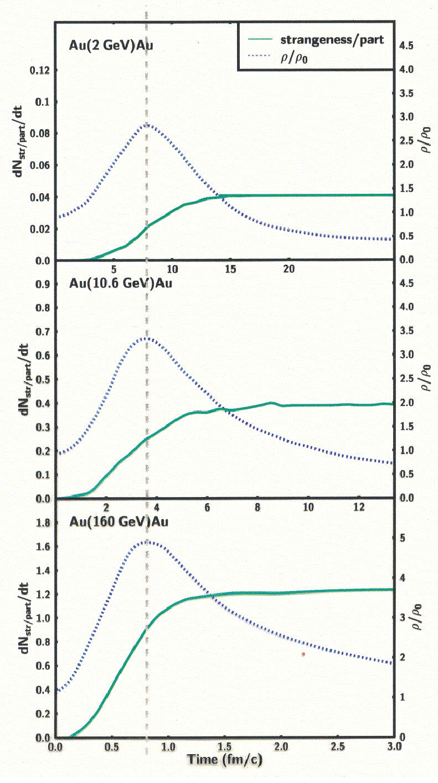
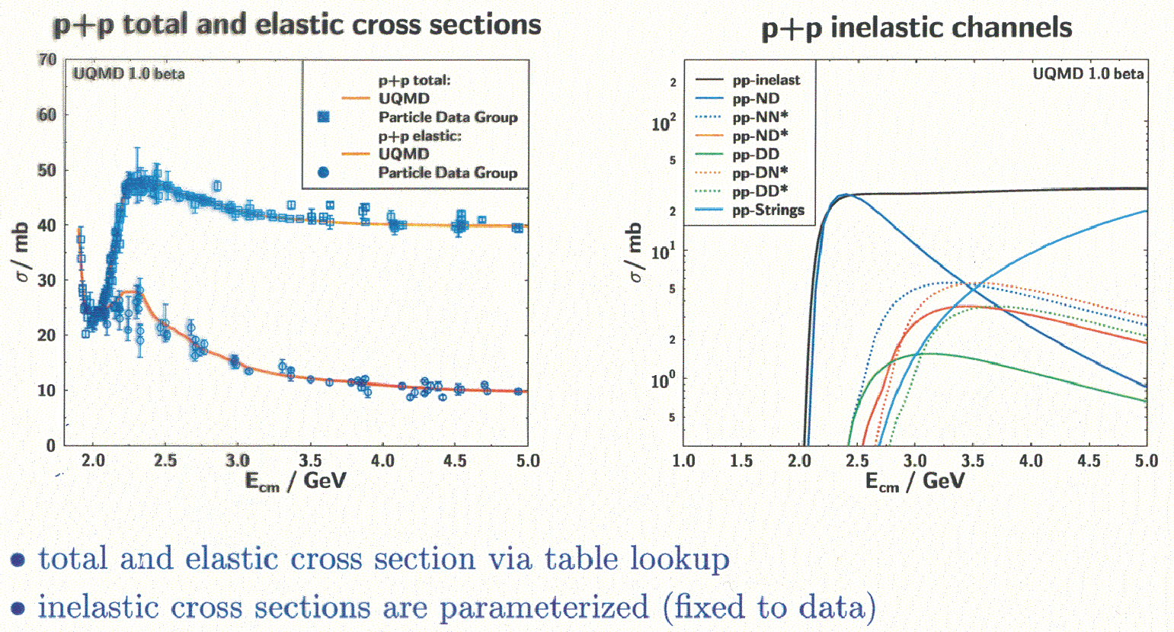
Heavy Ion Collisions: Hadron Composition and - densities
match Neutron Star matter well …

Slide 11
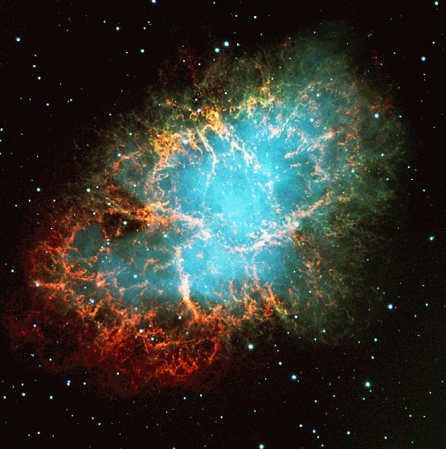
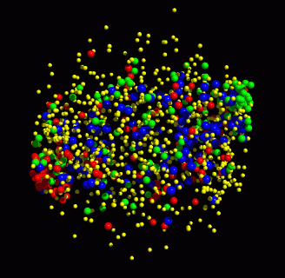
CBM: The Compressed Baryonic Matter Experiment
Science case
Status experiment preparation
Courtesy of Peter Senger (GSI)

Slide 12
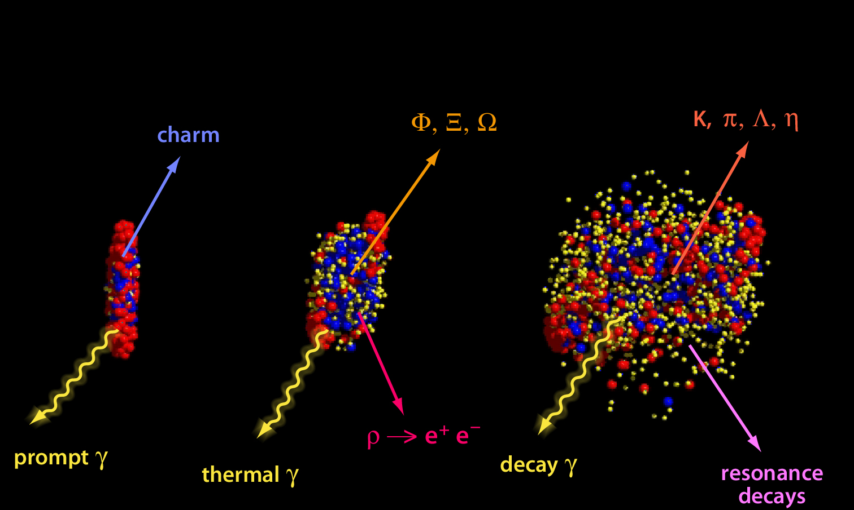
CBM = Look deep into neutron stars !
High density matter - EoS: collective explosive flow of protons
Quark-Hadron phase boundary @ high baryon density ρ_{B}:
- multi-strange + charm production
QCD critical point
Chiral symmetry at high ρ_{B}: open charm, J/Psi, dilepton production
D Mesons

Slide 13
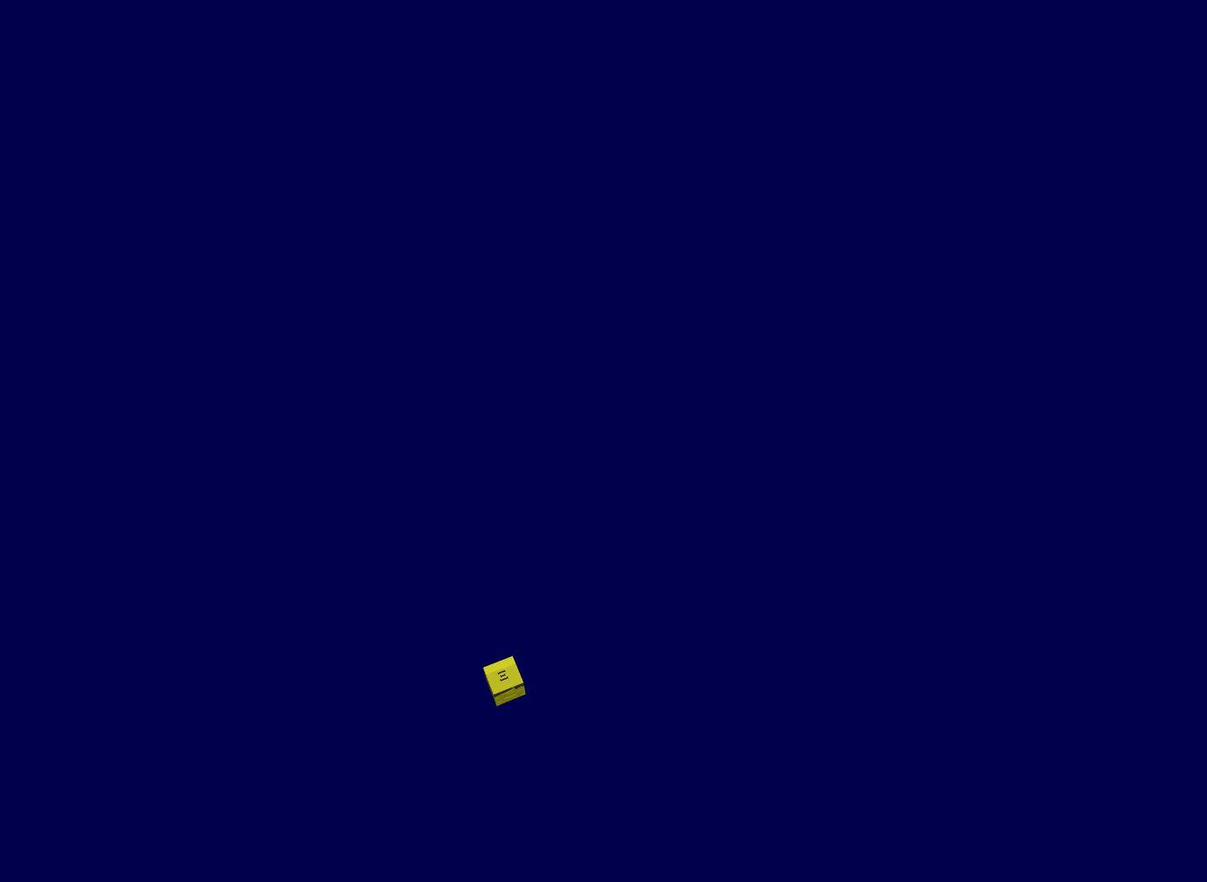
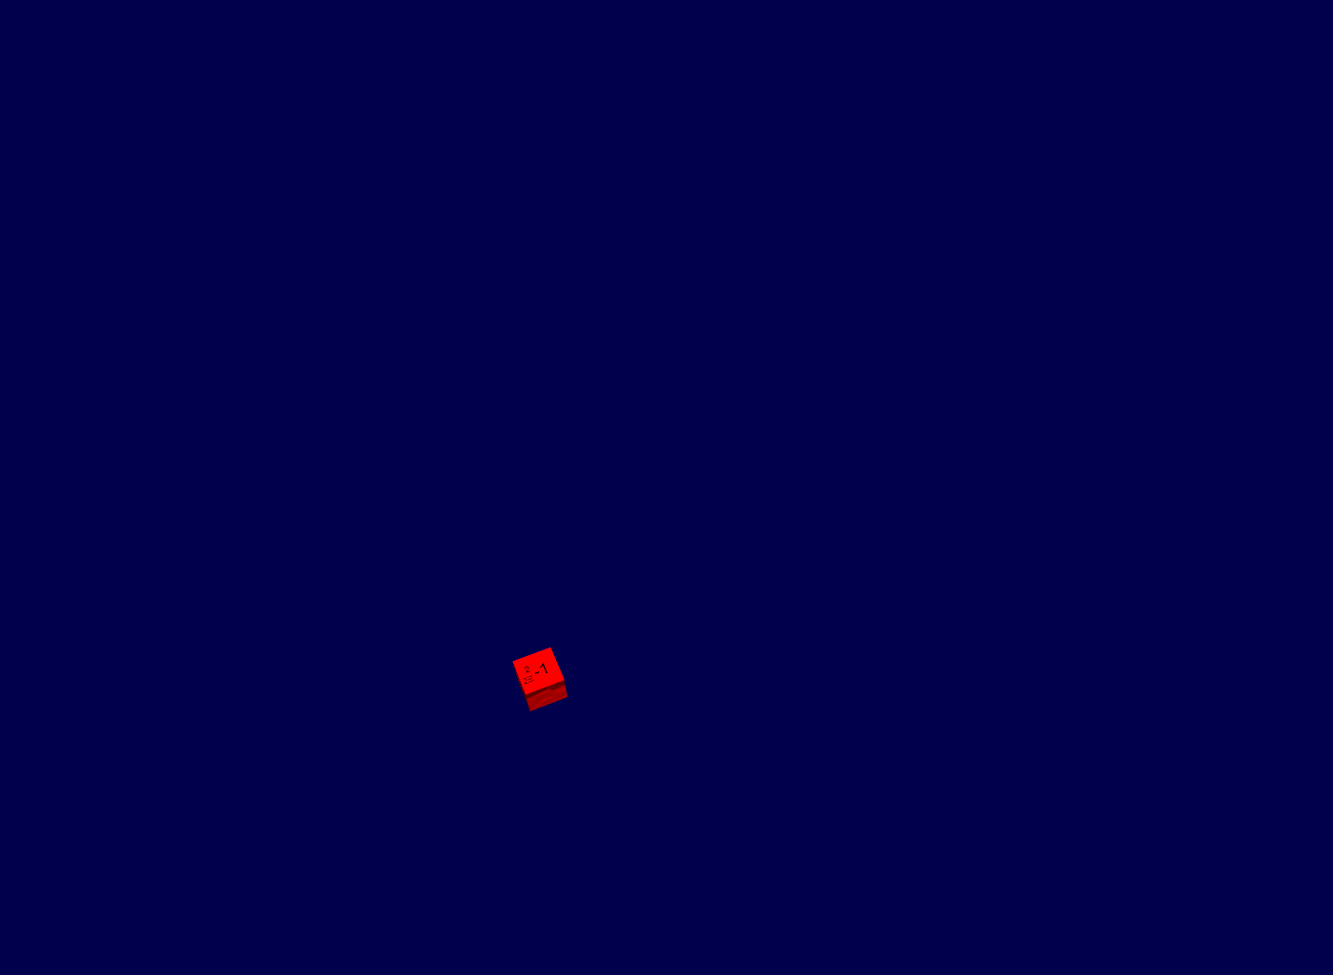
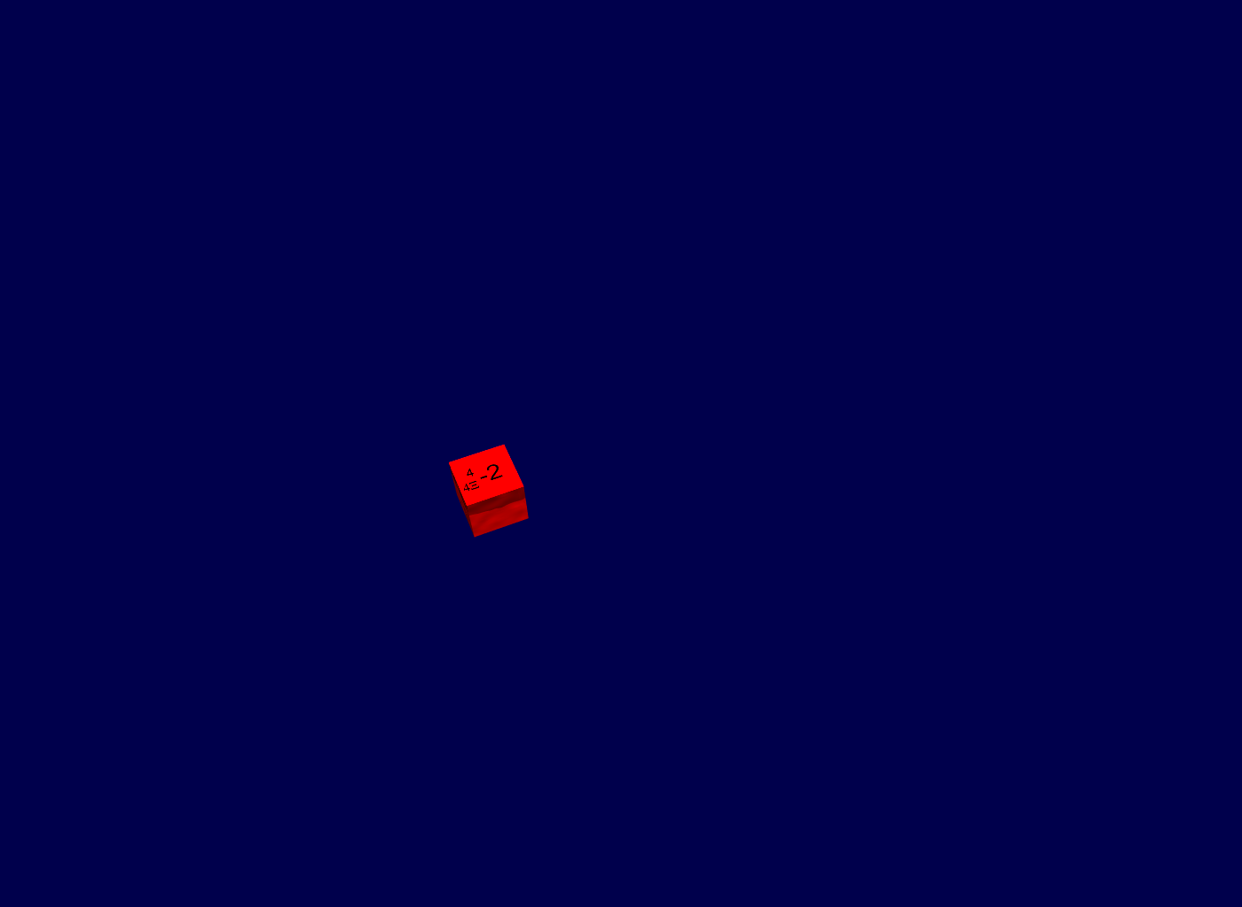
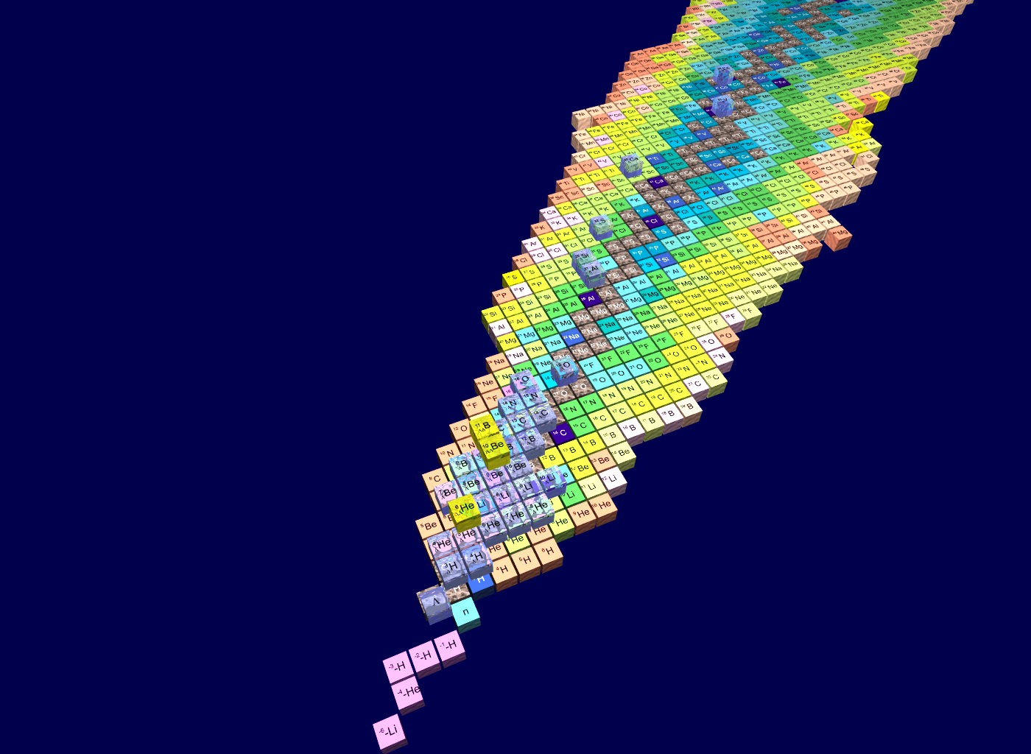
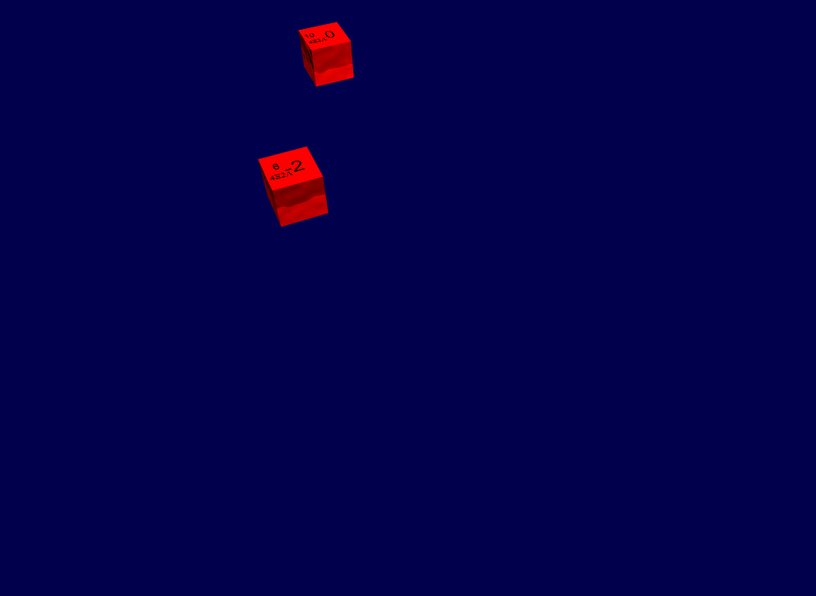
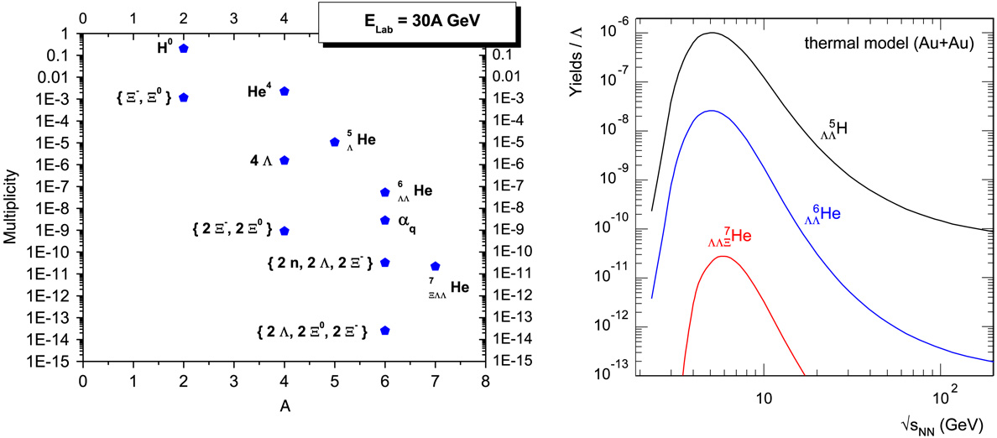
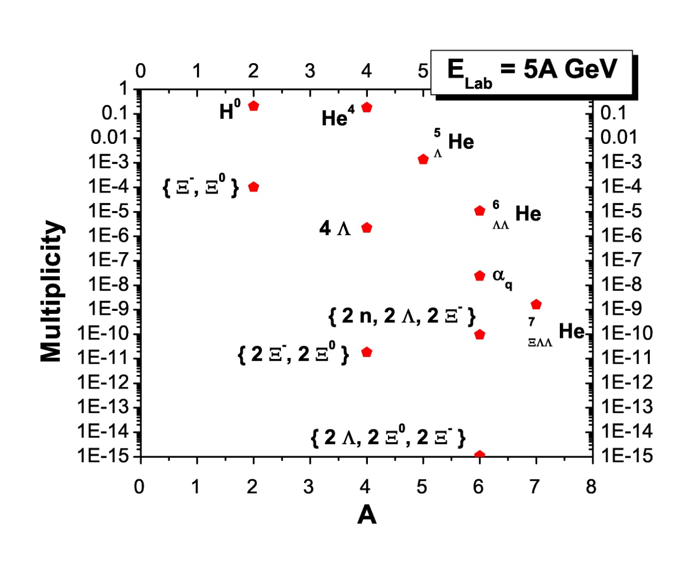
Hypernuclei and metastable multistrange matter
J. Steinheimer, P. Senger, H. Stöcker et. al.
Progress in Particles and Nuclear Physics
62 (2009) 313-317

Slide 14
Hadrons in nuclear- / Neutronstar Matter
Partial restoration of chiral symmetry in nuclear matter
  Light quarks sensitive to quark condensate
(c‾c) states sensitive to gluon condensate
  Small (5-10 MeV/c²) in medium modifications for low-lying (c‾c) (J/ψ, η_{c})
  Significant mass shifts expected for excited states: 40, 100, 140 MeV/c² for χ_{cJ}, ψ’, ψ(3770) resp.
D mesons - QCD analogue of H-atom
  Chiral symmetry to be studied on a single light quark
  Theoretical calculations disagree in size and sign of mass shift (50 MeV/c² attractive – 160 MeV/c² repulsive)
Vacuum
Nuclear
medium
π⁻
π
25 MeV
π⁺
K⁺
K
100 MeV
K⁻
D
D⁻
50 MeV
D⁺
Hayaski, PLB 487 (2000) 96
Morath, Lee, Weise, priv. Comm.

Slide 15
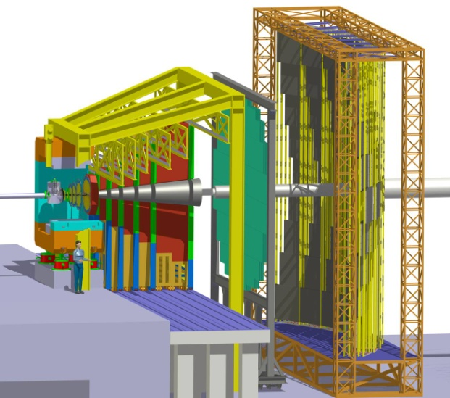
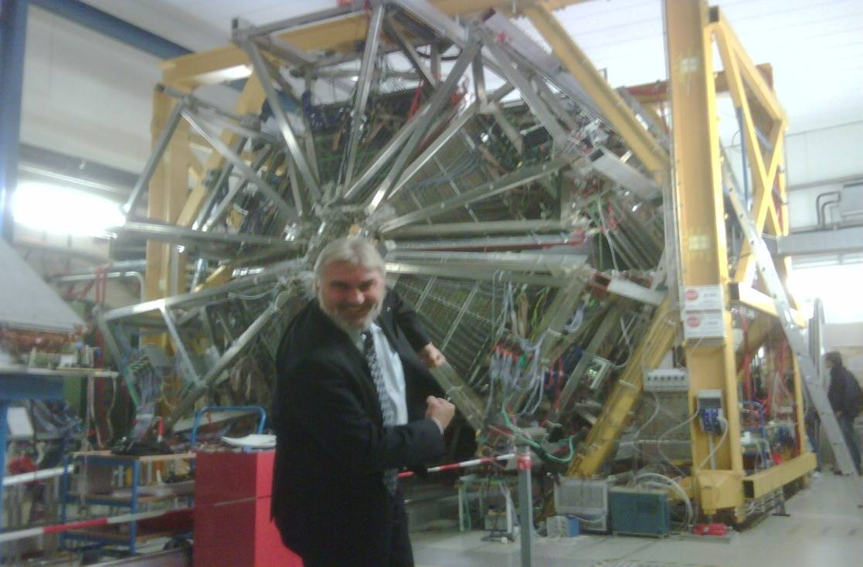
From Hades to CBM
CBM
Highest 10x Baryon densities
in the universe
- probing the center of
neutron stars
HADES high multiplicity upgrade
Au+Au @ SIS18
Ag+Ag @ SIS100
CBM

Slide 16
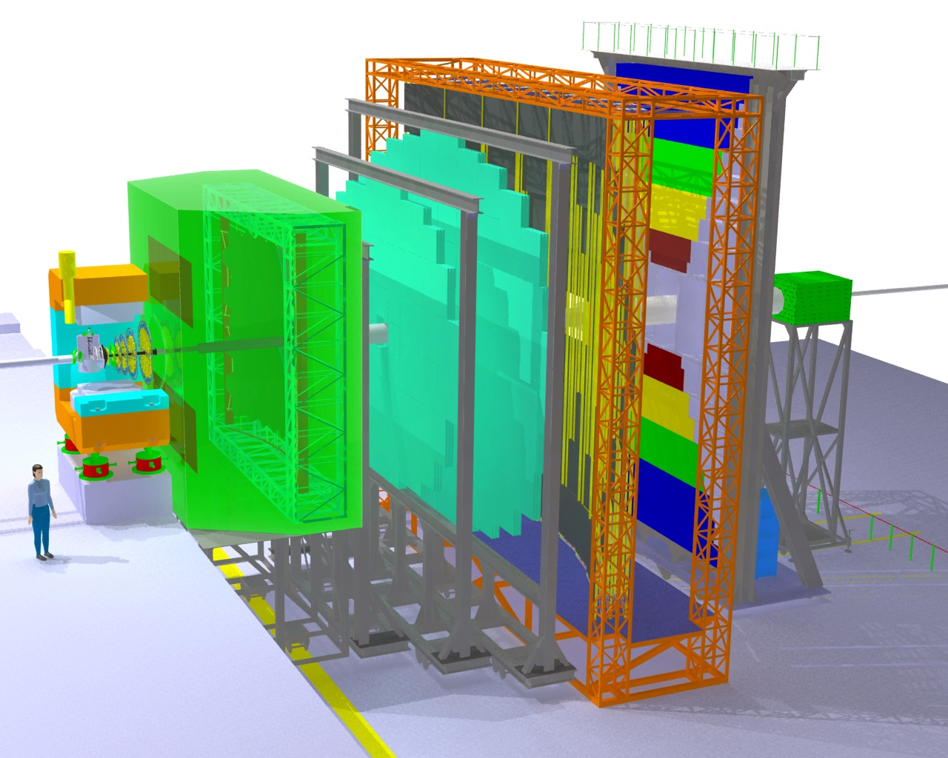
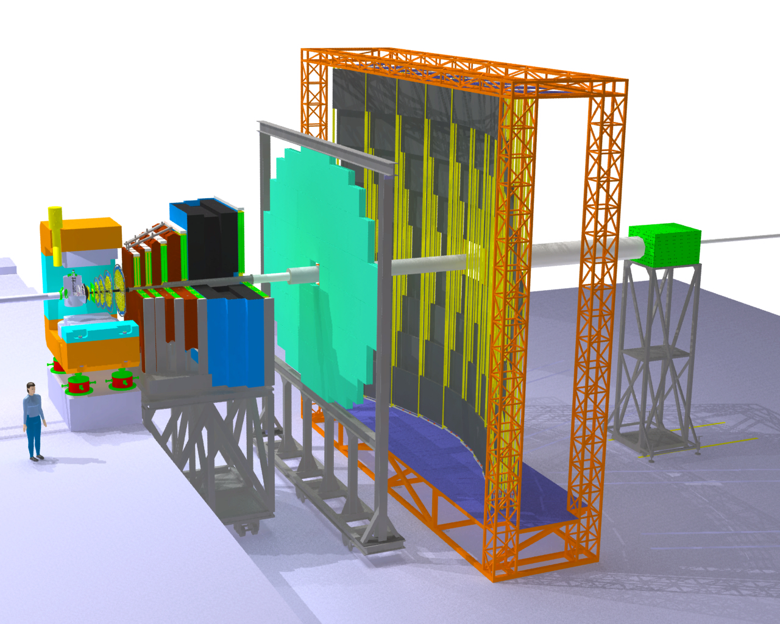
CBM: The Compressed Baryonic Matter Experiment
Transition
Radiation
Detectors
Tracking
Detector
Muon
detection
System
Electro-
magnetic
Calorimeter
Ring Imaging
Cherenkov
Detector
Silicon
Tracking
Stations
Vertex
Detector
Projectile
Spectator
Detector
(Calorimeter)
Dipol
magnet
Resistive
Plate
Chambers
(TOF)

Slide 17

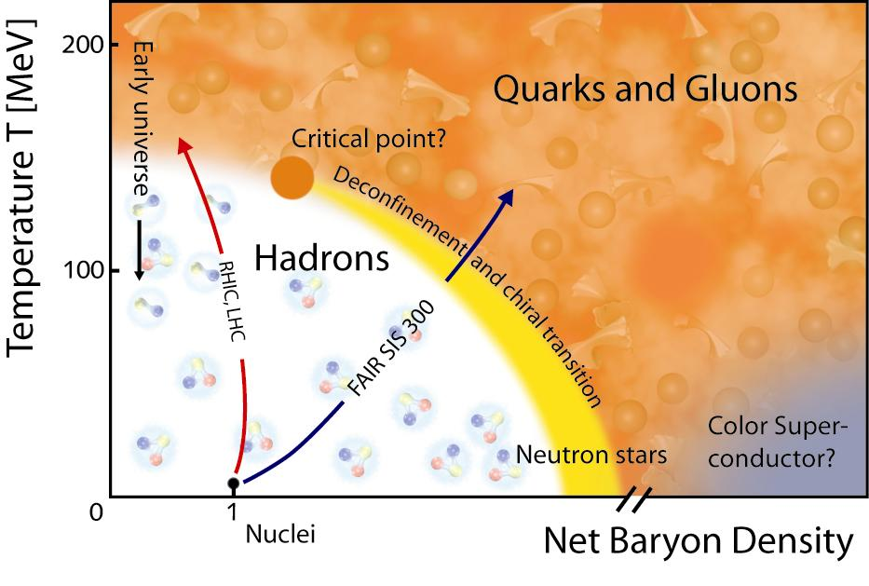

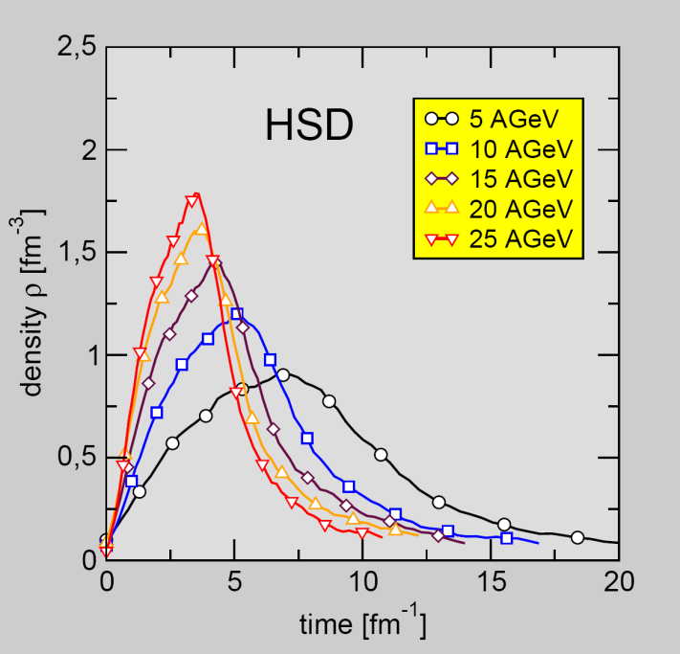
Exploring the QCD phase diagram
?
Quark‘yonic‘
Matter
Baryon density
in central Au+Au
collisions
SIS100 +300

Slide 18
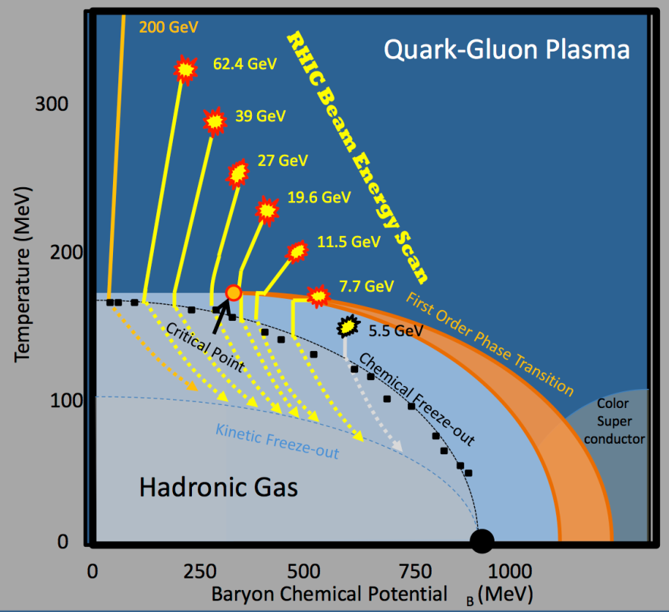
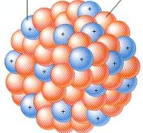
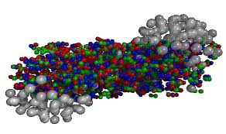
Directed flow as Baryon-Barometer px/pt = v1
First form of flow predicted (one-fluid hydro, H.St. & W. Greiner)
observed@LBL Nagamiya, Plastic Ball, Streamer Chamber in 1980’s
later less focus on v1 at higher energies, where
  signal is smaller than v2
  v2 stole the limelight
  2D models cannot address this explicitly 3-D phenomenon
Geometrical seeds
of directed flow
imprinted during
Interpenetration
→ early pressure signal !
Courtesy
M. Lisa, STAR

Slide 19
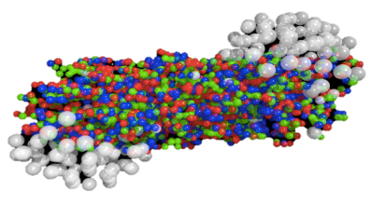
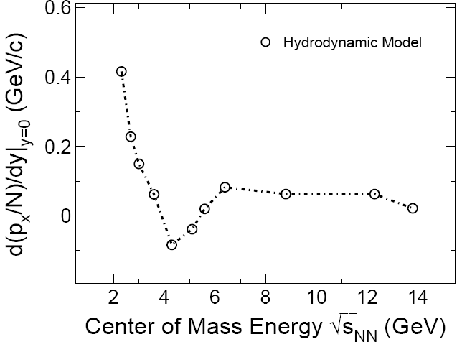
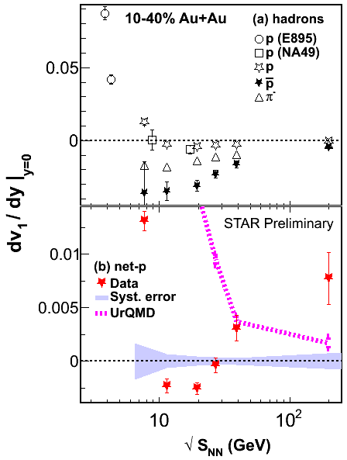
Directed flow v1 probes early pressure:
“Bounce off as a Barometer for RHIC”
H. St., B. Mueller, W.Greiner 1979
Collapse and reappearance of flow
V1 double sign-change due to P.T.
to guide the eye
Brachmann, Dumitru, H.St. W.Greiner
H. Stoecker, NPA 750, 121 (2005) RHIC white papers
Nontrivial qualitative soft-spot prediction confirmed at RHIC
STAR BES results
(based on) D. Keane Confinement 2012
First-order anisotropy imprints itself on momentum space in first instants of collision
Promising soft-spot probe, due to rapid dynamics
Long-standing probe for 1st-order transition neglected in v2 @RHIC

Slide 20
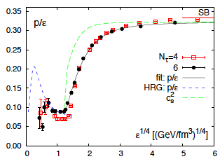
P. Sorensen‘s Optimistic point of view
v₁ reveals the pressure at τ=0 !?
H.St, B. Mueller:
„Bounce Off as
Barometer“
1979
STAR :
RHIC
BES data
dv₁/dy for net protons
very well may be the smoking gun we’ve been looking for.
It deserves more theoretical attention!

Slide 21
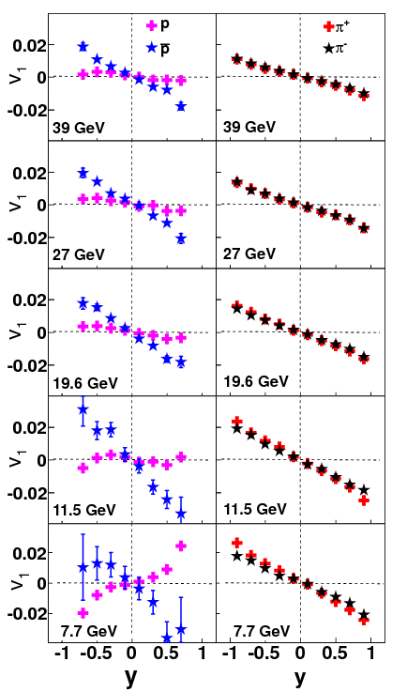
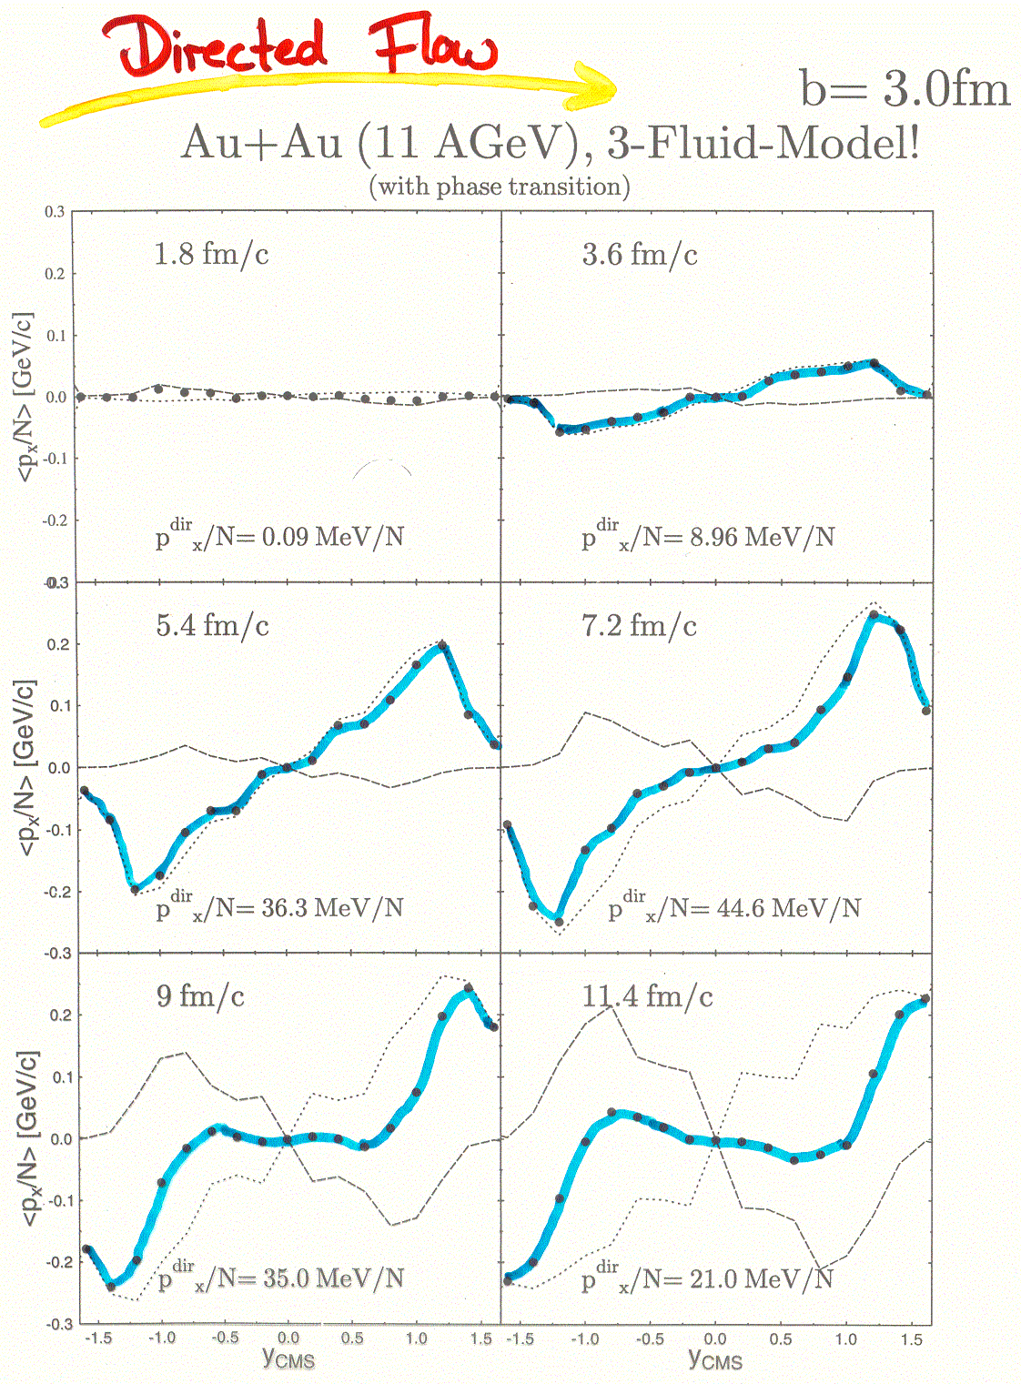
px/pt shows double sign change
Brachmann, Dumitru, H.St., W.Greiner EPJC 2000
A.Schmah STAR

Slide 22
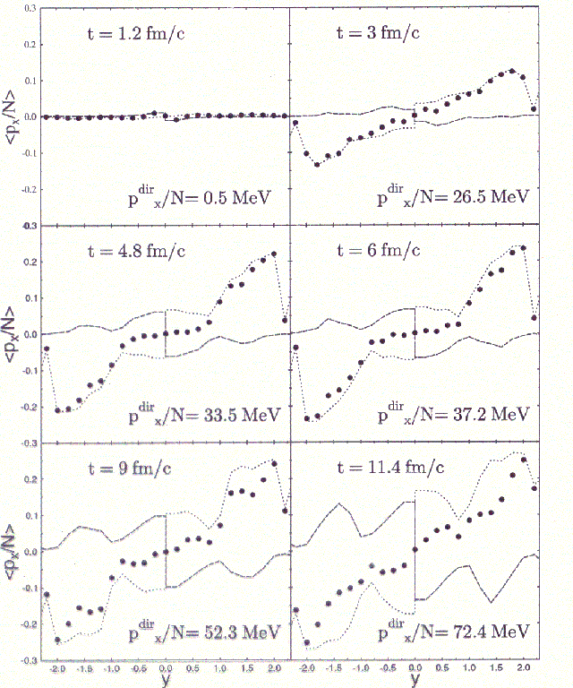
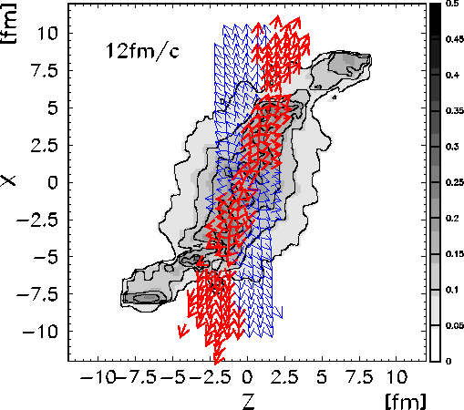
E_{lab} ~ 40 AGeV – 3 Fluid Model Recovers Flow!
v1
Reaction (x-z) plane

Slide 23
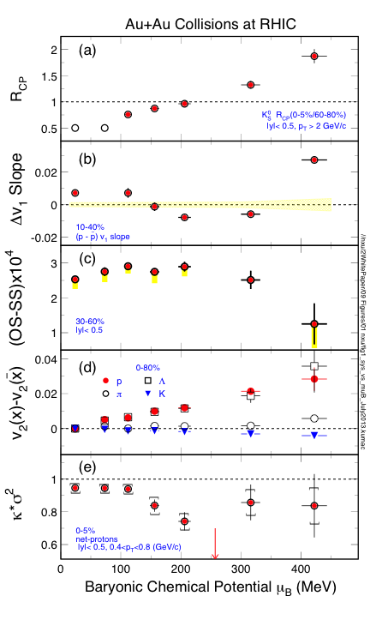
STAR
Nu Xu

Slide 24
Under consideration...

Slide 25
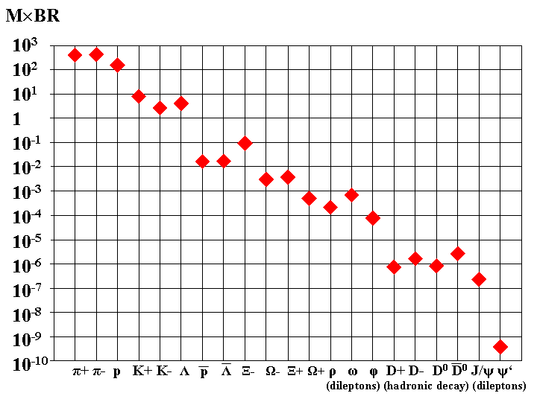
Experimental challenge: 10000000x STAR-yields!!
Particle multiplicity x branching ratio
for min. bias Au+Au collisions at 25 A GeV
(from HSD and thermal model)
SPS Pb+Pb 30 A GeV
STAR Au+Au √s_{NN}=7.7 GeV
Driving CBM
experimental
requirements
in precision
and rates

Slide 26







CBM: Dileptons from central Au+Au 25 AGeV : SiS 300 !!
Micro-Vertex detector (MAPS)
+ Silicon-Microstrip System
...with RICH +TRD
..with Muon Detector
ρ, ω, φ → e+e-
ρ, ω, φ → μ+μ-
Λ_{C}: τ = 60 μm/c
J/ψ → e+e-
J/ψ, ψ' → μ+μ-

Slide 27
Experiments on superdense nuclear matter
Experiment | Energy range (Au/Pb beams) | Reaction rates Hz
STAR@RHIC BNL | √s_{NN} = 7 – 200 GeV | 1 – 800 (limitation by luminosity)
NA61@SPS CERN | E_{kin}= 20 – 160 A GeV √s_{NN}= 6.4 – 17.4 GeV | 80 (limitation by detector)
MPD@NICA Dubna | √s_{NN}= 4.0 – 11.0 GeV | ~1000 (design luminosity of 10²⁷ cm⁻²s⁻¹ for heavy ions)
HADES@SIS100 | 1.5 A GeV Au+Au 8 A GeV Ni+Ni | 5∙10⁴
CBM@FAIR Darmstadt | E_{kin}= 2.0 – 35 A GeV √s_{NN}= 2.7 – 8.3 GeV | 10⁵ – 10⁷ (limitation by detector)

Slide 28
CBM technological challenges
Central Au+Au collision at 25 AGeV (UrQMD + GEANT4):
160 p 400 π⁻ 400 π⁺ 44 K⁺ 13 K⁻
➢ 10⁵ - 10⁷ Au+Au reactions/sec
➢ determination of (displaced) vertices (σ ≈ 50 μm)
➢ identification of leptons and hadrons
➢ fast and radiation hard detectors
➢ free-streaming readout electronics
high speed data acquisition and high performance
computer farm for online event selection
➢ 4-D event reconstruction

Slide 29











CBM technical developments
SC Magnet: JINR Dubna
Micro-Vertex Detector:
Frankfurt, Strasbourg
Silicon Tracking System: Darmstadt, Dubna, Krakow, Kiev, Kharkov, Moscow, St. Petersburg, Tübingen
MRPC ToF Wall: Beijing, Bucharest, Darmstadt, Frankfurt, Hefei, Heidelberg, Moscow, Rossendorf, Wuhan, Zagreb
RICH Detector:
Darmstadt, Giessen, Pusan,
St. Petersburg, Wuppertal
Muon detector:
Kolkata + 13 Indian Inst., Gatchina, Dubna
Transition Radiation Detector:
Bucharest, Dubna, Frankfurt, Heidelberg, Münster
Forward calorimeter:
Moscow, Prague, Rez
DAQ and online event selection:
Darmstadt, Frankfurt, Heidelberg, Kharagpur, Warsaw

Slide 30


The Big Challenge ...
Gain Factors
FAIR facility
GSI today
Beam intensities by factors of 100 - 10000
Beam energies by a factor 20
Production of antimatter beams
Factor 10000 in beam brilliance via cooling
Efficient parallel operation of programs
SIS 100/300
UNILAC
SIS 18
ESR
Construction Period, Cost, Users
Construction of modules 1, 2, 3 until 2017
Total cost 1.6 Giga €
Scientific users: 2500 - 3000 per year
Four pillars : APPA -CBM-NuSTAR-PANDA
HESR
Super
FRS
Financing International Shareholders
25 % international Partners 12 Countries
10 % State of Hessen
10 % Helmholtz Gemeinschaft
55 % Federal Gov. Germany
RESR
CR
100 m
NESR

Slide 31

First Post Drilling started 31/8/2011
1500 posts finished 2/6/2014

Slide 32
FAIR
Nuclear Structure & Astrophysics
(RIBS Rare-isotope beams)
Hadron Physics
(Stored and cooled _
14 GeV/c anti-protons /p-p collider)
SIS18
p-Linac
SIS100/SiS300
UNILAC
QCD-Phase Diagram
(HI beams 2 to 45 GeV/u)
Sparc
Target
ESR
Cryring
CBM Target
HESR
Rare-Isotope
Production Target
Fundamental Symmetries FLAIR
& Ultra-High EM Fields
(Antiprotons & naked ions in Cryring/ESR)
Panda
Target
Anti-Proton
Production Target
Dense Bulk Plasmas
(Ion-beam bunch compression
& Petawatt-laser , Prior)
CR &
RESR
Cryring ?
Materials Science & Radiation Biology
(Ion- & antiproton beams)
100 m
NESR
Accelerator Physics

