Slide 1



QGP Shear Viscosity & Electric Conductivity
A. Puglisi - S. Plumari - V. Greco
UNIVERSITY of CATANIA - INFN-LNS
Mainly based on next weekend arXiV submission
Notes:
Mettere formula RTA con p4/E2

Slide 2
Outline
Transport Coefficients in kinetic theory:
  Green-Kubo and Ohm’s Law
  Comparison to Relaxation Time Approximation
  Kinetic Transport Theory at fixed η/s [M. Ruggeri talk]
Shear Viscosity and Electric Conductivity:
  Comparison of σ_{el}/T with recent lQCD data
  Ratio (η/s)/(σ_{el}/T): disentangling q and g interaction?!

Slide 3
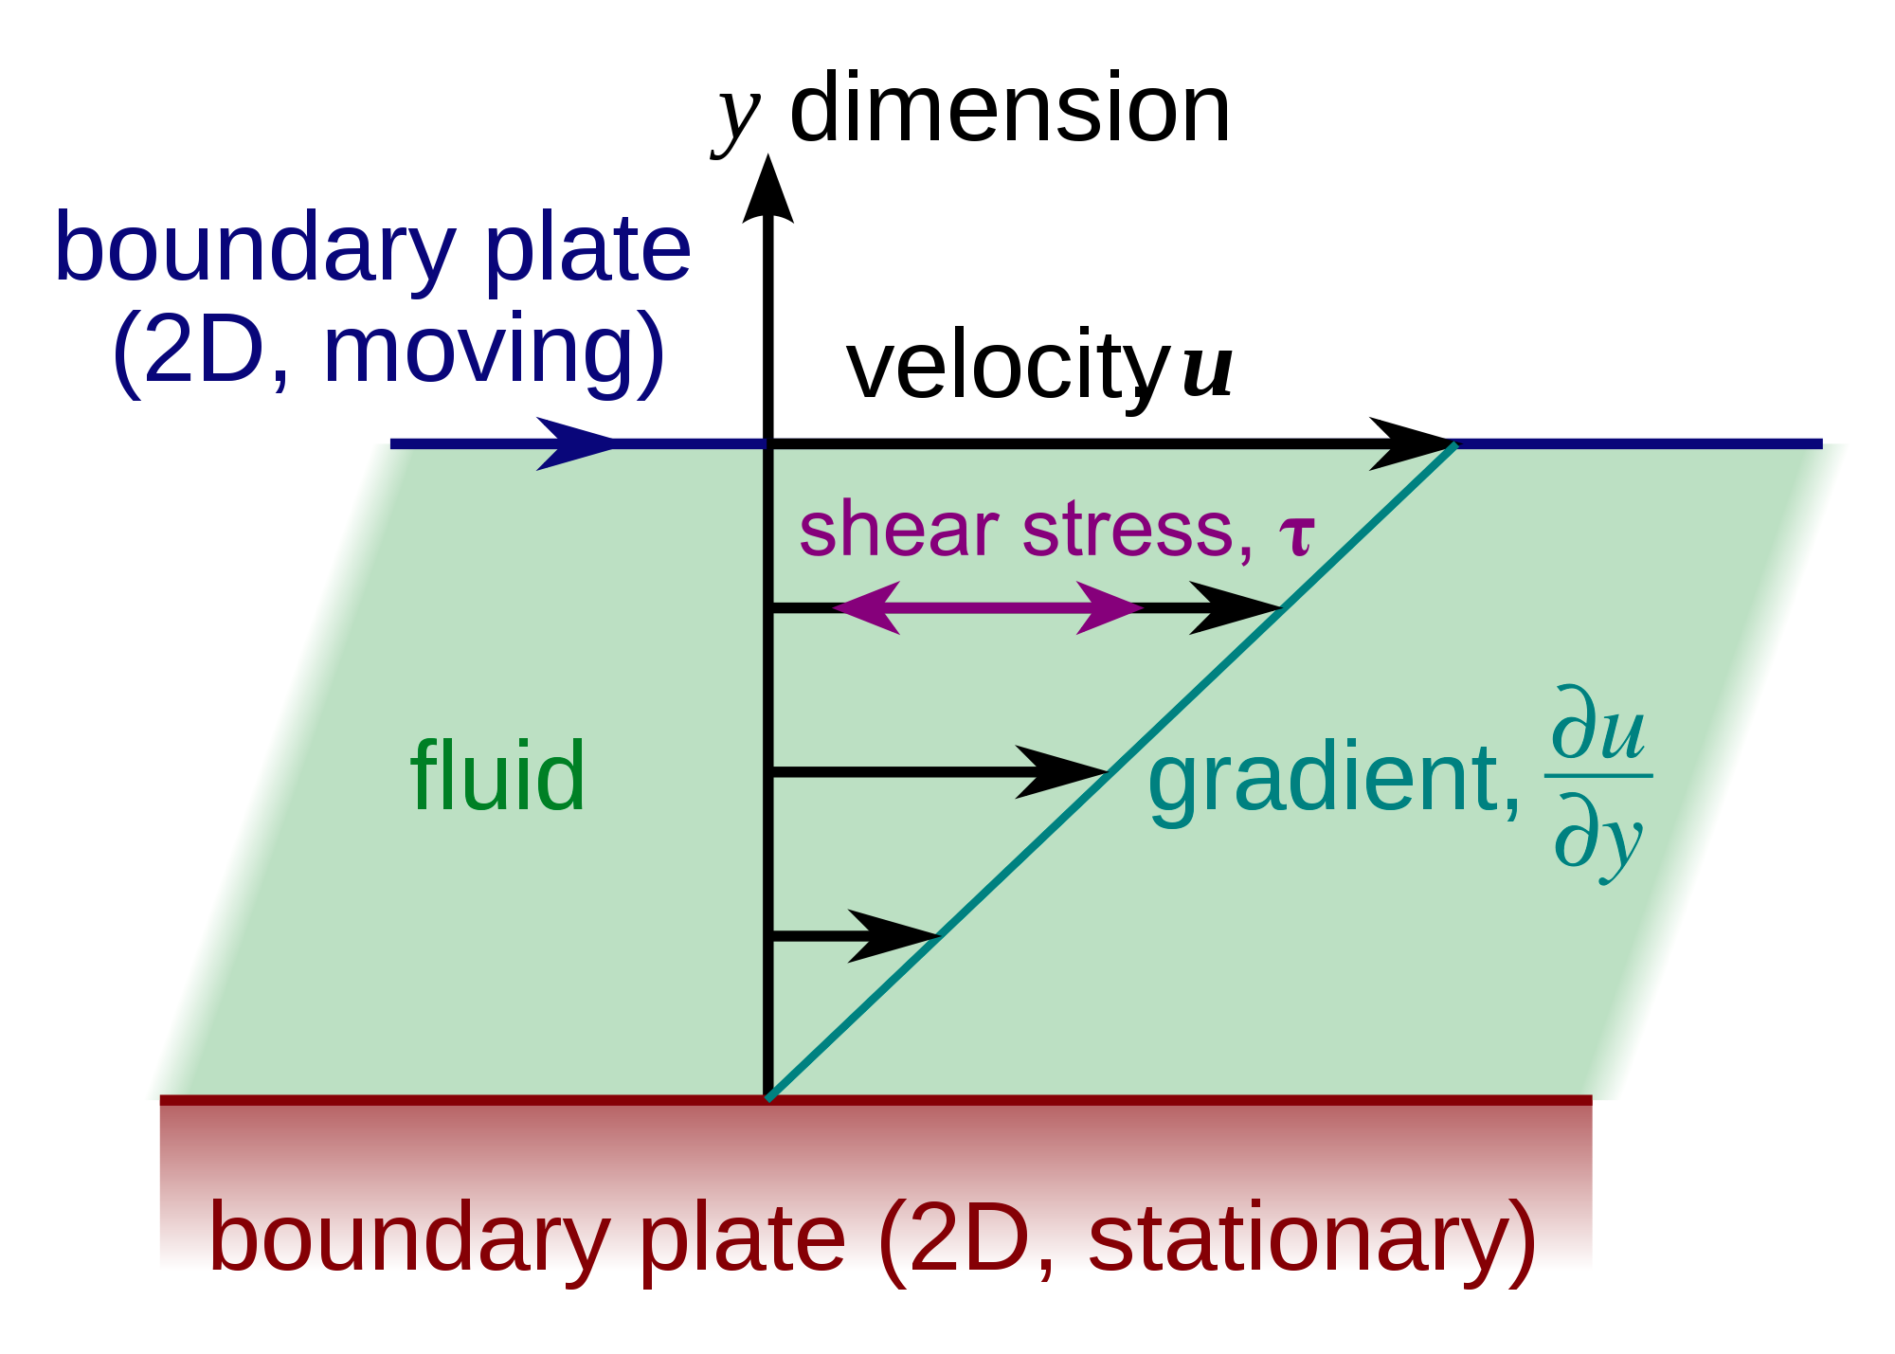
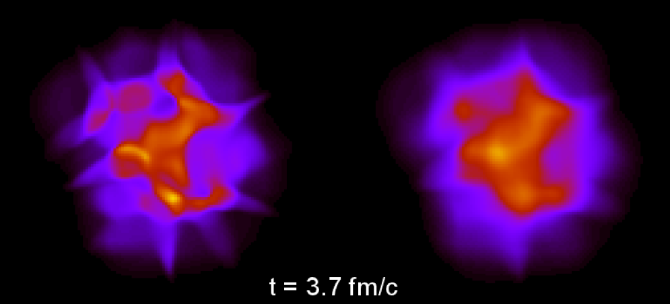
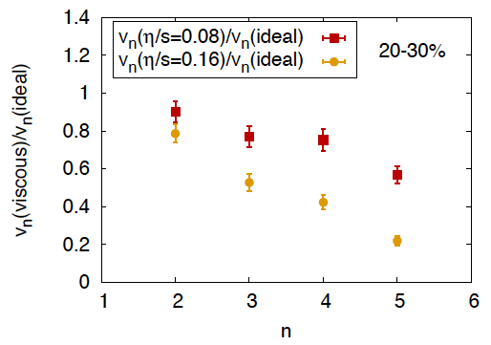
Shear viscosity η -> anisotropic flow v_{n}
Operative definition
Green-Kubo
η/s=0
η/s=0.16
η/s smoothen fluctuations and
affect more higher harmonics
B.Schenke
Shear Viscosity regulates:
How the fluid drag itself
in the transverse direction ->
damping of anisotropies v_{n}=<cos(nφ)>
Entropy production
B. Schenke, PRC85(2012)

Slide 4
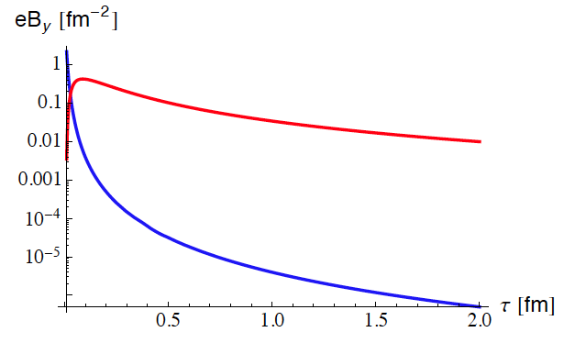
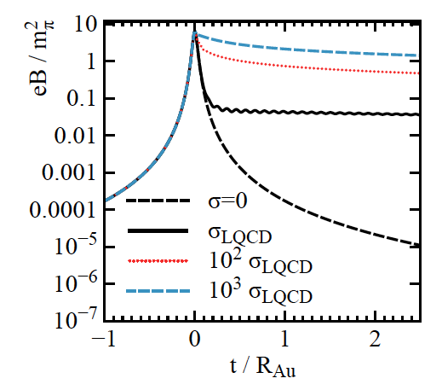
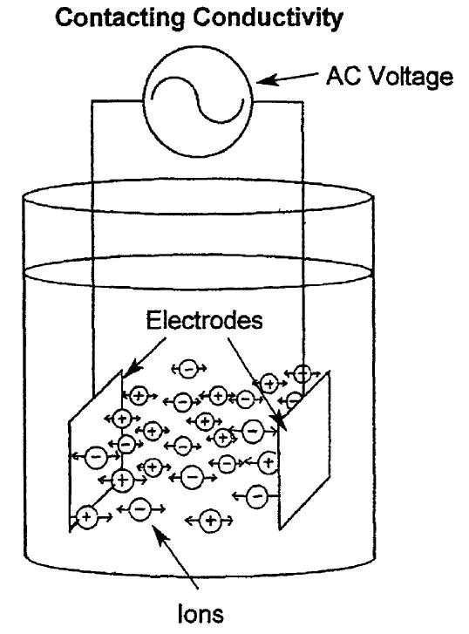
Electric Conductivity
Green-kubo
σ_{lQCD}
Ohm’s Law
Electric Conductivity σ_{el} regulates:
Damping of Magnetic Field in HIC τ ≈ σ_{el} L²
Tuchin ‘13, Sokokov-McLerran ‘13, Kharzeev-Rajagopal ’14
-> Chiral Magnetic Effect, charge asymmetry of directed flow v₁
Damping of Magnetic Fields in the Early Universe
Soft photons rate
Kapusta ’93
Insight into quark vs gluon scattering rates
σ=0

Slide 5
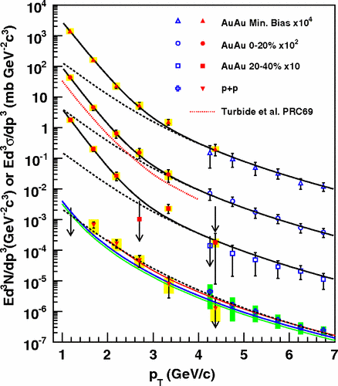
Electric Conductivity
Green-kubo
Ohm’s Law
Electric Conductivity σ_{el} regulates:
Damping of Magnetic Field in HIC τ ≈ σ_{el} L²
Tuchin ‘13, Sokokov-McLerran ‘13, Kharzeev-Rajagopal ’14
-> Chiral Magnetic Effect, charge asymmetry of directed flow v₁
Damping of Magnetic Fields in the Early Universe
Soft photons rate
Kapusta ’93
Insight into quark vs gluon scattering rates

Slide 6
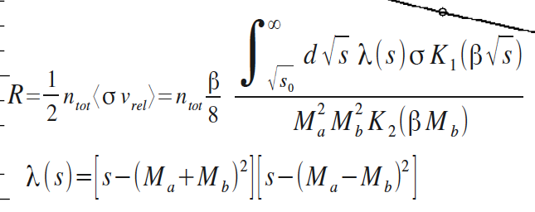
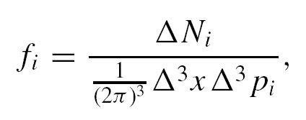
Relativistic Boltzmann Equation
Free streaming
Field Interaction
Collisions
f_{q},_{g}(x,p) is a one-body distribution function for quark and gluons
Rate of collisions
per unit time and
phase space
Solved discretizing the
space in (η, x, y)_{α} cells
Collision rate
Δt→0
Δ³x→0
exact
solution

Slide 7
Transport at fixed shear viscosity
Usually input of a transport approach are cross-sections and fields, but here we reverse
it and start from η/s with aim of creating a more direct link to viscous hydrodynamics
Relax. Time Approx. (RTA)
Transport simulation
σ_{tr} is the effective cross section
Space-Time dependent cross section evaluated locally
α=cell index in the r-space
1+1D expansion
G. Ferini et al., PLB670 (09)
V. Greco at al., PPNP 62 (09)
One maps with C[f] the phase space evolution
of a fluid at fixed η/s !
Convergency to IS Viscous
Hydro for large K
Huovinen-Molnar, PRC79(2009)

Slide 8
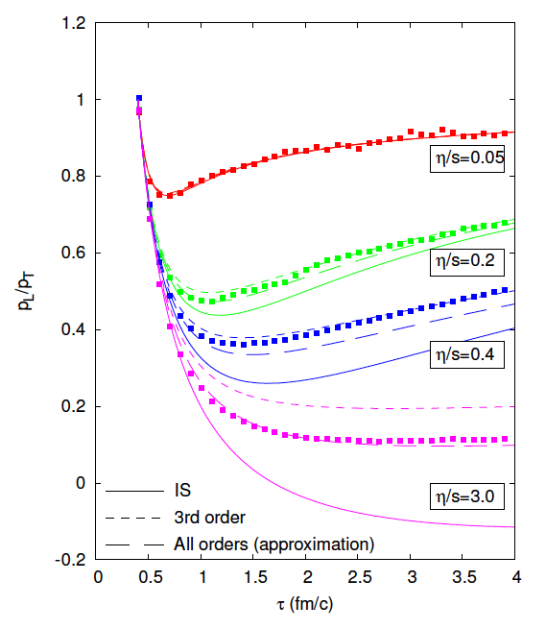
Similar results from BAMPS-Frankfurt
- Convergency for small η/s of Boltzmann
transport at fixed η/s with viscous hydro
- Better agreement with 3rd order viscous
hydro for large η/s
Similar studies by Bazow, Heinz, Strickland
for anisotropic hydordynamics
arXiv:1311.6720 [nucl-th]
El, Xu, Greiner, Phys.Rev. C81 (2010) 041901
Notes:
Check how the viscosity was fixed

Slide 9
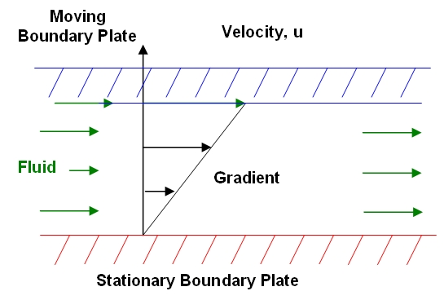
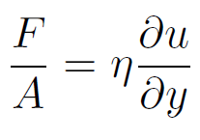
Do we really have the wanted shear viscosity η
with the relax. time approx.?
- Check η with the Green-Kubo correlator

Slide 10
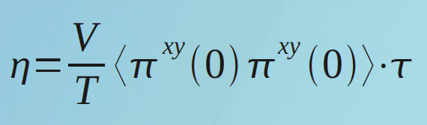
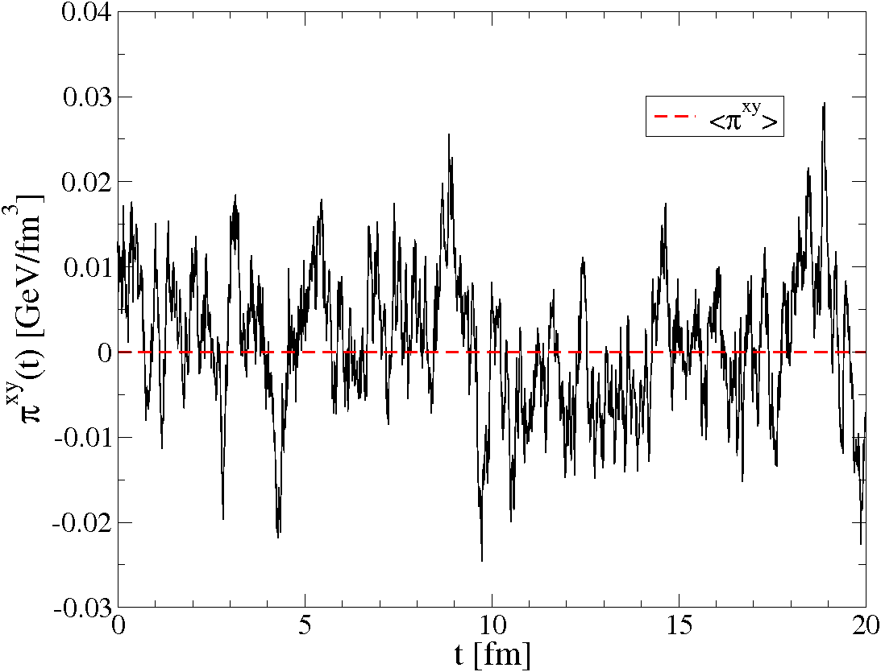
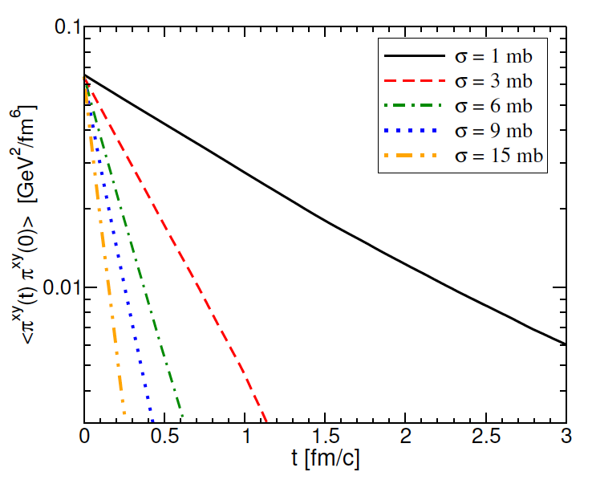
Shear Viscosity in Box Calculation
microscopic scatterings
macroscopic
thermodynamics
η ↔ σ(θ), ρ, M, T …. ?
S. Plumari et al., arxiv:1208.0481;see also:
Wesp et al., Phys. Rev. C 84, 054911 (2011);
Fuini III et al. J. Phys. G38, 015004 (2011).
F. Reining et al., Phys.Rev. E85 (2012) 026302
Needed very careful tests of convergency
vs. N_{test}, Δx_{cell}, # time steps !

Slide 11
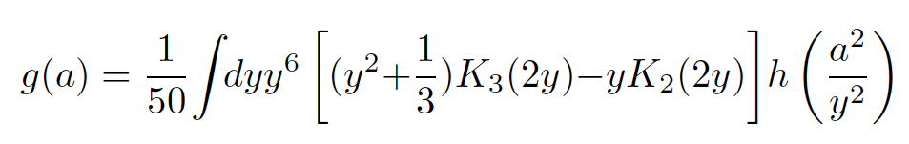
Non Isotropic Cross Section - σ(θ)
Relaxation Time Approximation
RTA is the one usually employed to make theoroethical estimates: Gavin NPA(1985); Kapusta, PRC82(10); Redlich and Sasaki, PRC79(10), NPA832(10); Khvorostukhin PRC (2010) …
for a generic cross section:
h(a)=σ_{tr}/σ_{tot} weights cross section by q²
Chapmann-Enskog (CE)
m_{D} regulates the angular dependence
Green-Kubo in a box - σ(θ)
g(a) correct function that fix the
momentum transfer for shear motion
CE and RTA can differ by about a factor 2
Green-Kubo agrees with CE
S. Plumari et al., PRC86(2012)054902
Notes:
Update figure

Slide 12
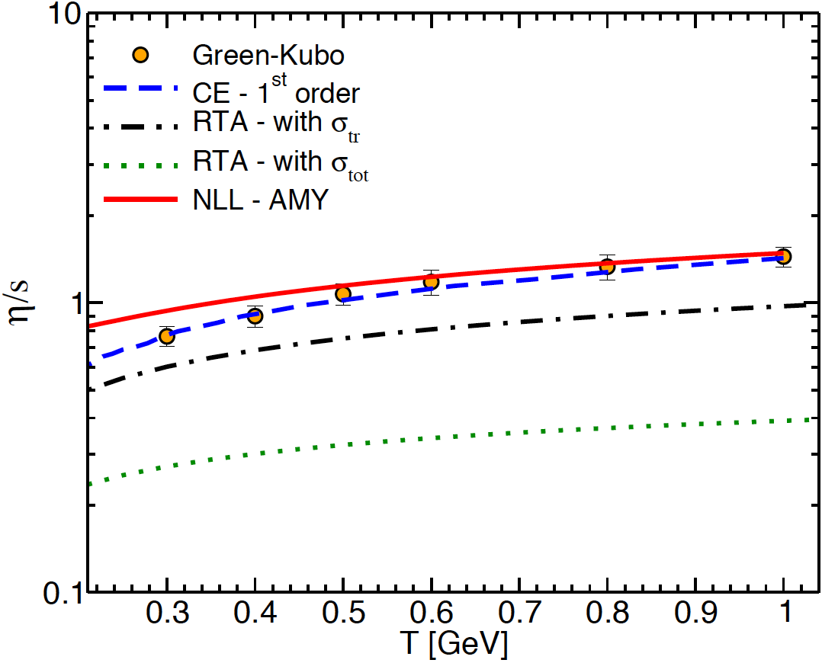
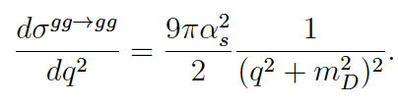
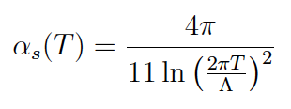

Viscosity of a pQCD gluon plasma
Agreement with AMY, JHEP 0305 (2003) 051
close to AMY result JHEP(2003),
but there is a significant simplification:
only direct u & t channels with simplified HTL propagator

Slide 13
  We have checked the Chapmann-Enskog:
  - CE good already at I° order ≈ 4-5%
  - RTA even with σ_{tr} generally underestimates η
  (≈25% for pQCD gluon matter, ±15% for udsg matter)
  We know how to fix locally η/s(T) in the transport approach

Slide 14
Applying kinetic theory to A+A Collisions….
- Impact of η/s(T) on the build-up of v₂(p_{T})
p_{y}
p_{x}
y
z
x
Extend to Higher p_{T}
p_{T} ≈3T
Larger η/s
Hydro ← Transport
η/s<<1
Initial off-equilibrium
M. Ruggeri’s talk – this afternoon
Heavy Quarks
S.K. Das talk – tomorrow afternoon

Slide 15
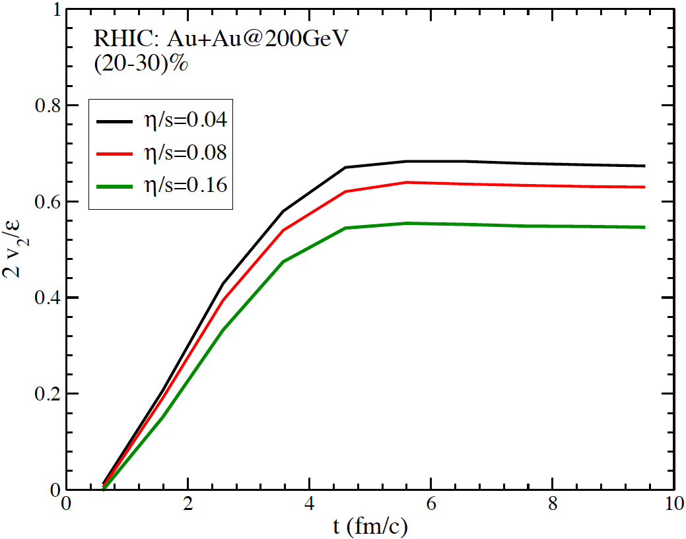
Test in 3+1D: v₂/ε response for almost ideal case
EoS c_{s}²=1/3 (dN/dy tuned to RHIC)
Integrated v₂ vs time
Ideal -Hydro
Transport at η/s fixed
v₂/ε
Bhalerao et al., PLB627(2005)
Time rescaled
In the bulk the transport has an hydro v₂/ε₂ response!
Just one tip on what can be studied with a transport at fixed η/s:
impact of power law spectrum at intermediate p_{T}

Slide 16
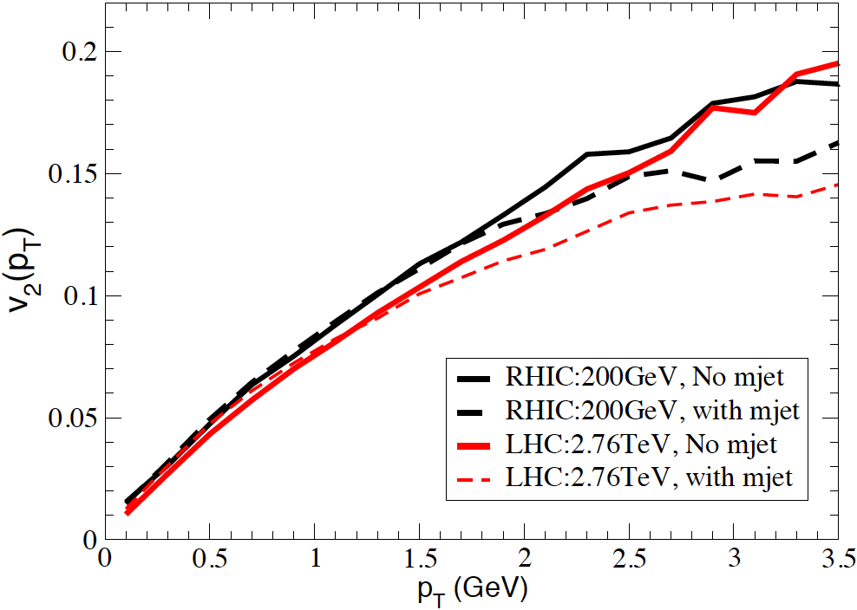
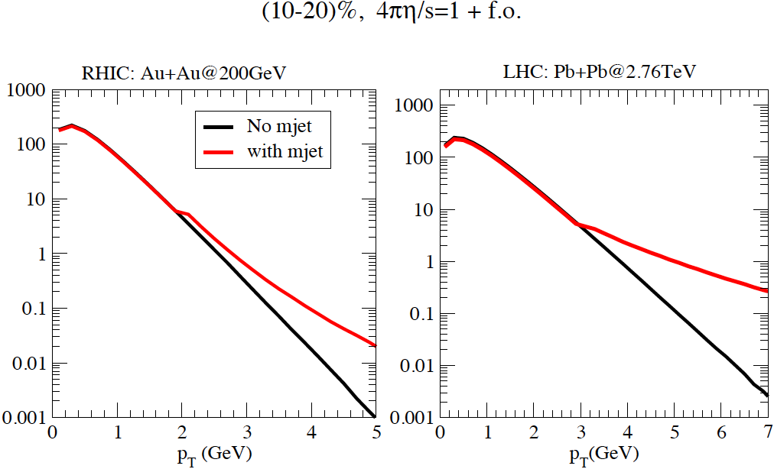
Non equilibrium at larger p_{T}:
impact of minijets on v₂(p_{T})
minijets
J.Y. Ollitrault, Plumari, VG, in preparation
- Mini-jets starts to affect v₂(p_{T}) for p_{T}>1.5 GeV
- Effect non-negligible. A flatter spectrum leads to smaller v₂
- The physics can be mocked-up by arbitrary δf (p_{T}) viscous correction in hydro

Slide 17
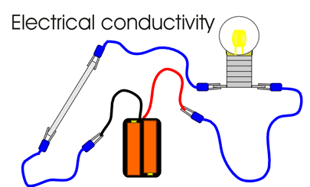

Slide 18
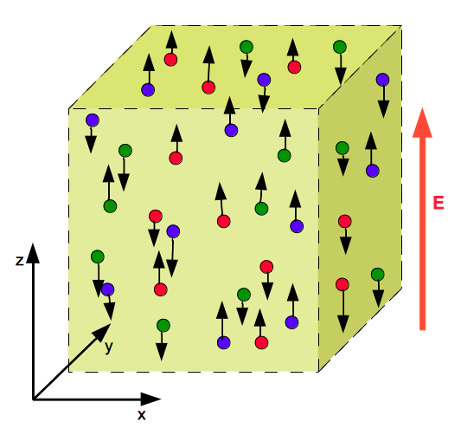
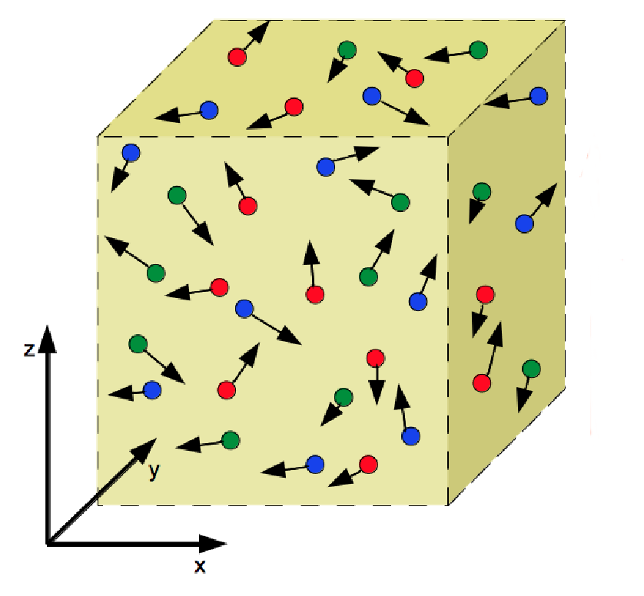
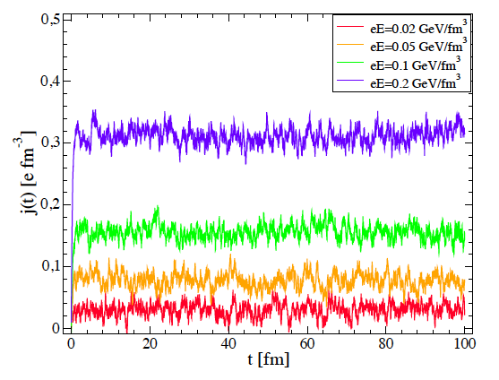
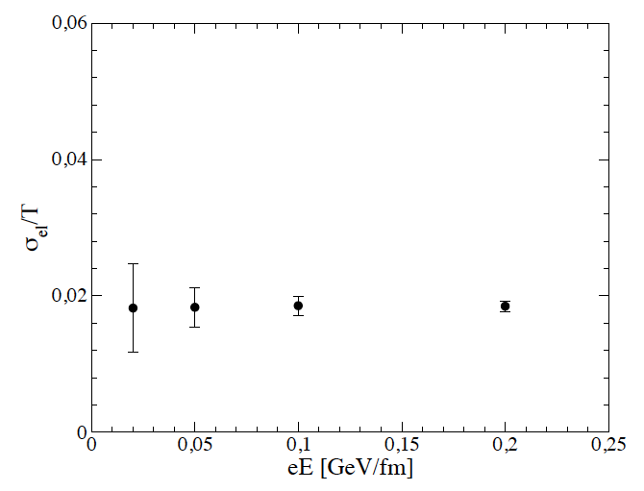
Electric Conductivity in a Box with boundary condition
Ohm’s Law method
J_{z}/E_{z} independent on E_{z}
-> one can define
the conductivity
See also Cassing et al., PRL110 (2013) + Moritz talk this afternoon

Slide 19
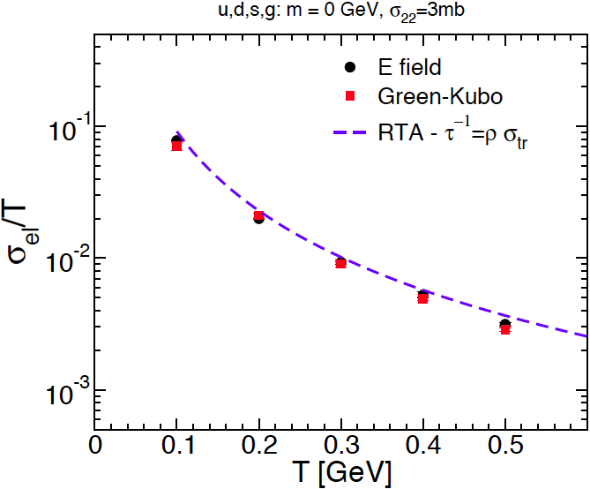
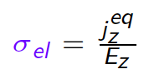
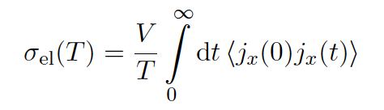
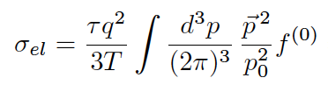
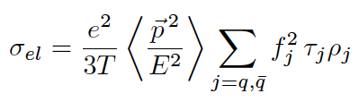

Comparing with Green-Kubo correlator
Ohm’s Law
Isotropic
Green-Kubo
RTA with τ_{tr}
Similarly to η for anisotropic cross section
the RTA with σ_{tr} underestimate σ_{el}
i=u,d,s,g
j=u,d,s
Notes:
E’ possibile calcolare il valore del correlatore corrente a t=0 come si fa per la viscosita

Slide 20
Moving to more realistic case for QGP:
Fitting “thermodynamical” part of transport
coefficient by QP model tuned to lQCD thermodynamics
Using the Relax. Time Approx. for both η and σ_{el}
to follow their relation analytically

Slide 21
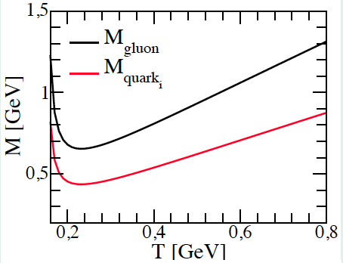



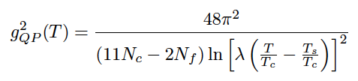
Simple QP-model fitting lQCD
Plumari, Alberico, Greco, Ratti, PRD84 (2011)
W_{B}=0 guarantees
Thermodynamicaly consistency
g(T) from a fit to ε from lQCD
-> good reproduction of P, ε-3P, c_{s}
λ=2.6
T_{s}=0.57 T_{c}
g(T) practically identical to DQPM

Slide 22
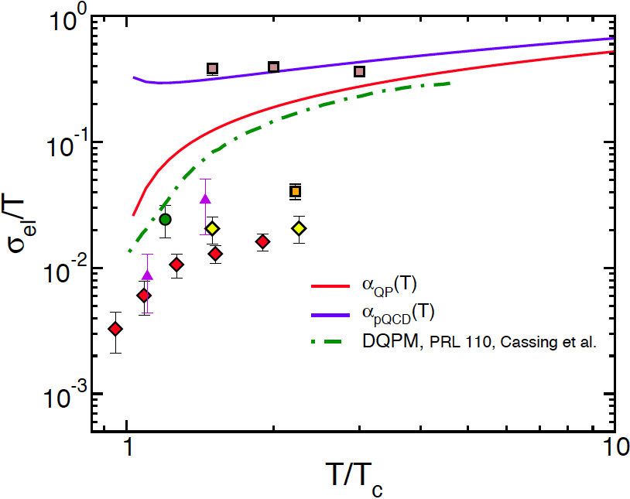
Electric Conductivity of the QGP
i=u,d,s,g
J=u,d,s
β^{qq}=16/9 β^{qq} = 8/9
β^{gg} =9 β^{qg}=2
Most of the difference with DQPM comes from the fact that our scattering is anisotropic -> large τ_{tr}
QP -DQPM probably overestimates the conductivity,
what happens for η/s?

Slide 23
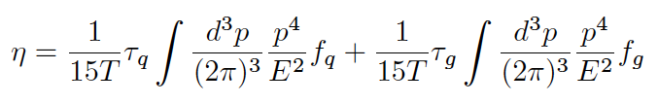
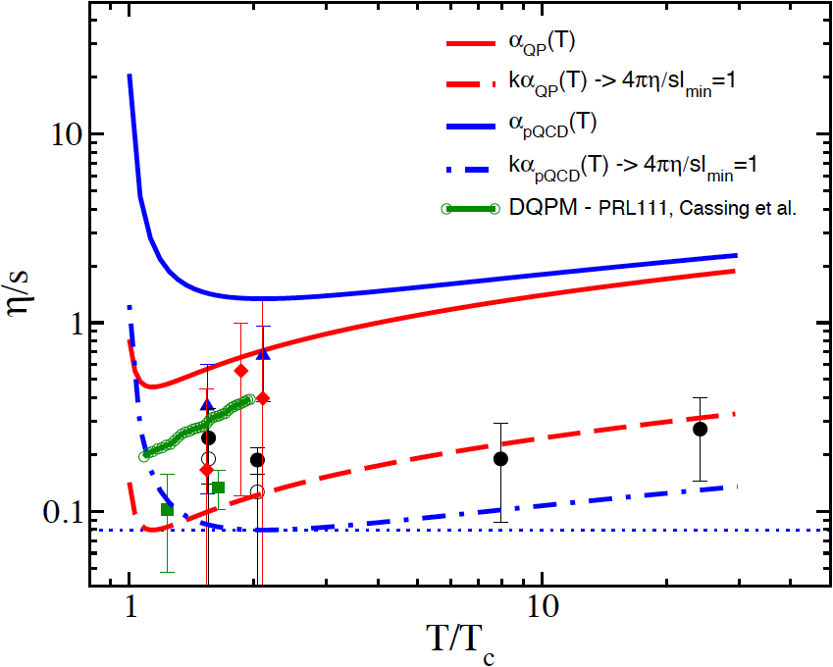

Shear Viscosity to Entropy Density
Kapusta ’93
i, j=u,d,s,g
Also the η/s seems to be over estimated!
What happens to sel rescaling by a K factor the cross section
to have a minimum of η/s = 0.08

Slide 24
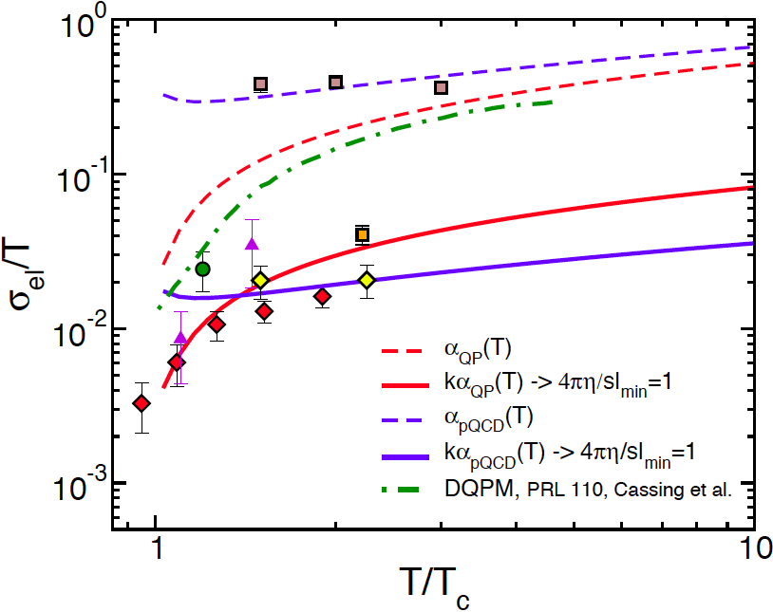
Electric Conductivity of the QGP
β^{qq}=16/9 β^{qbarq} = 8/9 β^{gg} =9 β^{qg}=2
Ads/CFT
σ_{el} is strongly T- dependent
Rescaling the cross section we get at the same time η/s and σ_{el}/T !
Of course small η/s tend to give small conductivity

Slide 25
Relation between Shear Viscosity and Conductivity
So one expects:
Steep rise of σ_{el} just above T_{c} even if the η/s is nearly T independent

Slide 26
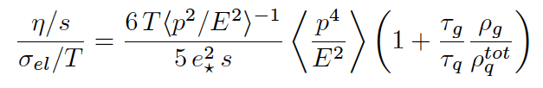
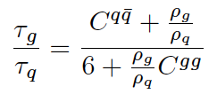

η/s to σ_{el} /T ratio
Fixed by the lQCD
thermodynamics
Depending on the relative
quark to gluon relaxation time
Practically unknown!
Relaxation times
= 28/9
= 9/2

Slide 27
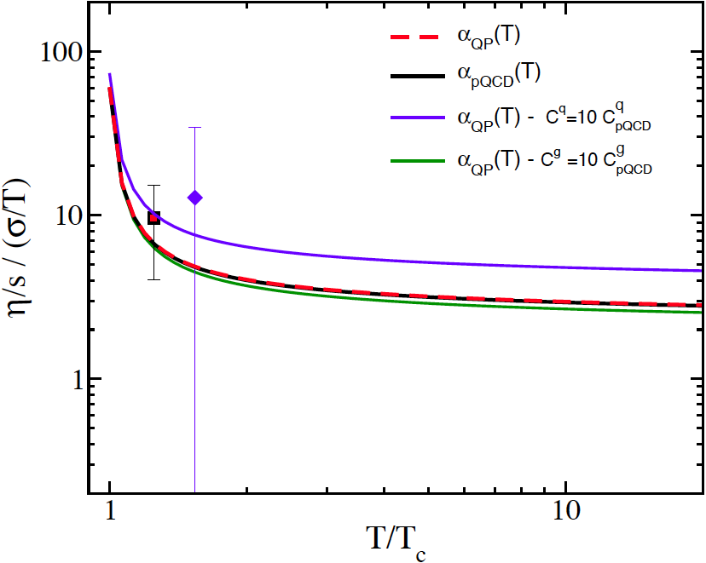
η/s to σ_{el} /T ratio
Symbols are dividing lQCD data
η/s for the lowest σ_{el}/T
Enhancement of scattering
The ratio is independent on both K-factor and α_{s}(T)
T->T_{c} increase by one order of magnitude (σ_{el}(T) quite stronger T dependence)
Sensitive to increase in the qq scattering respect to qg, gg
Not very sensitive to increase of gg respect to qq

Slide 28
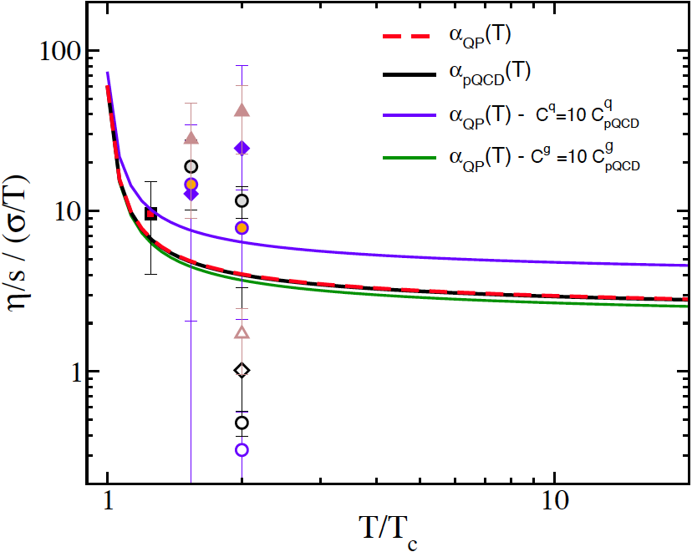
η/s to σ_{el} /T ratio
Overestimate
Symbols are dividing lQCD data:
- Highest η/s for lowest σ_{el}/T
- Lowest η/s highest σ_{el}/T
Warning: we are considering
lQCD quenched, unquenched
and with different actions and T_{c}
Underestimate
The ratio is independent on both K-factor and α_{s}(T)
T->Tc increase by one order of magnitude (σ_{el}(T) quite stronger T dependence)
Sensitive to increase in the qq scattering respect to qg, gg
Not very sensitive to increase of gg respect to qq

Slide 29
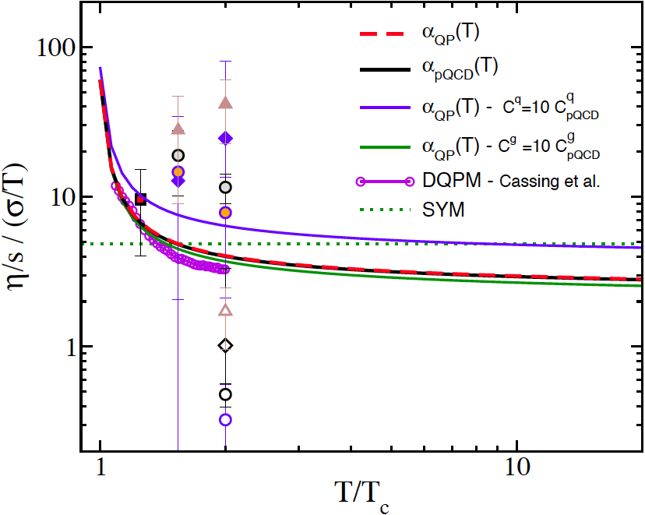
η/s to σ_{el} /T ratio
AdS/CFT
AdS/CFT would predict a flat behavior
Agreement with DQPM confirm the ratio
There could be even a structure

Slide 30
Summary
  Numerical Transport approach:
  Chapmann-Enskog I°order agree with Green-Kubo for η
  Relax. Time Approx. underestimate both η and σ_{el}
  Electric conductivity:
  New lQCD data on σ_{el} appear self-consistently
  related to 4πη/s ≈ 1, also σ_{el} ≈ g⁻¹(T) η/s
  The ratio (η/s)/(σ_{el}/T) is :
  - independent on K-factor of α_{s}(T) coupling
  - sensitive to the relative strength of q /g scattering rates
  - T-> T_{c} steep increase , test for AdS/CFT approach

Slide 31
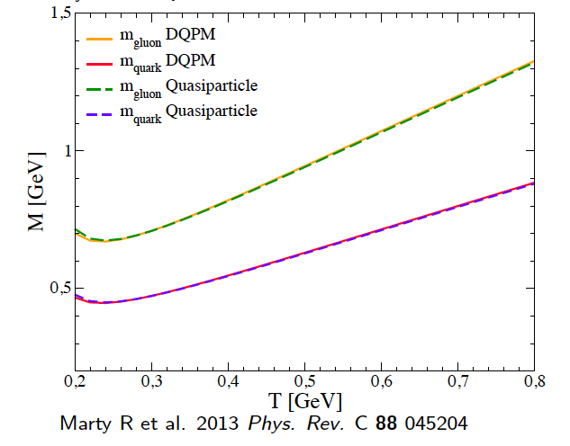
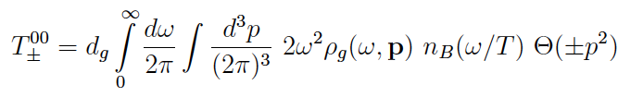


Width has small impact on thermodynamics?
Both fit to WB-lQCD data
DQPM: E. Braktovskaya et al.,NPA856 (2011) 162
QP: Plumari et al., PRD84 (2011)
DQPM

Slide 32
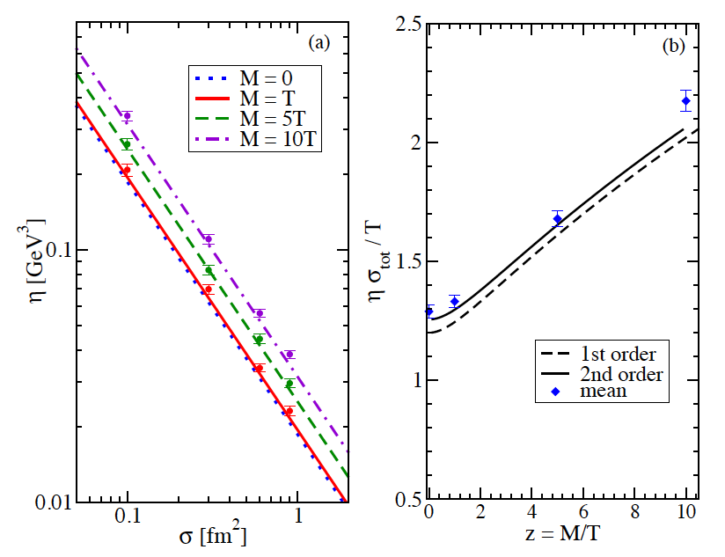
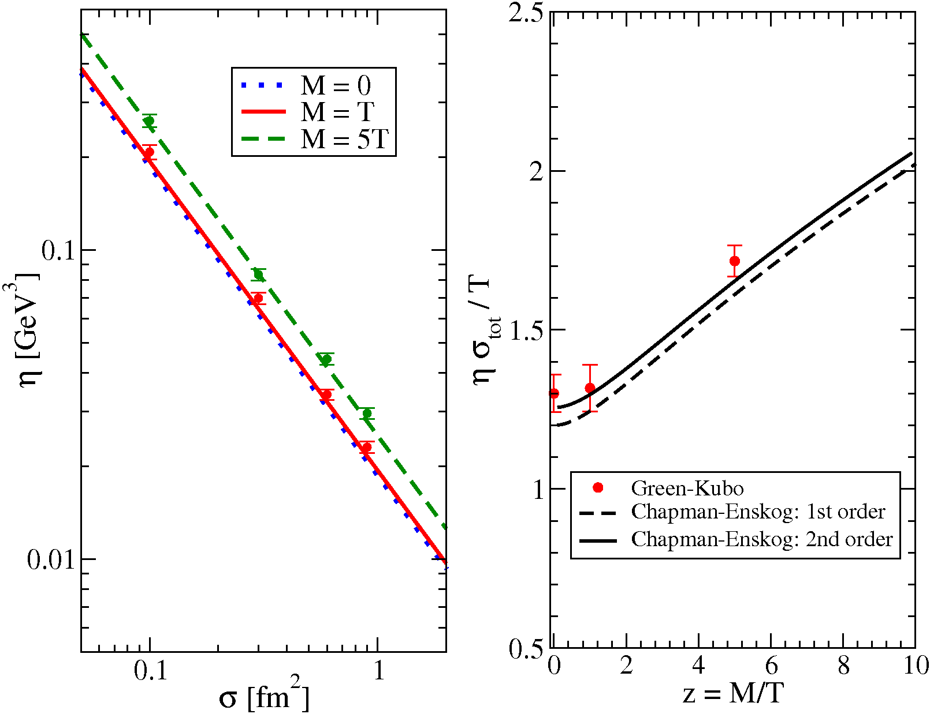
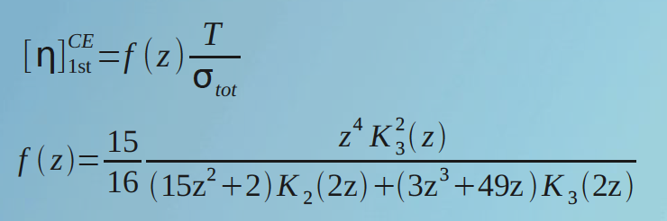
Chapmann-Enskog vs Green Kubo:massive case
Massive case is relevant in quasiparticle models where M_{q,g}(T)=g(T)T
Hence we need it to extend the approach to Boltzmann-Vlasov transport
Again good agreement with CE 1st order for σ(θ)=cost.
Isostropic σ – massive particles
z=M/T
Still missing Chapmann-Enskog for
massive & anisotropic cross section

Slide 33
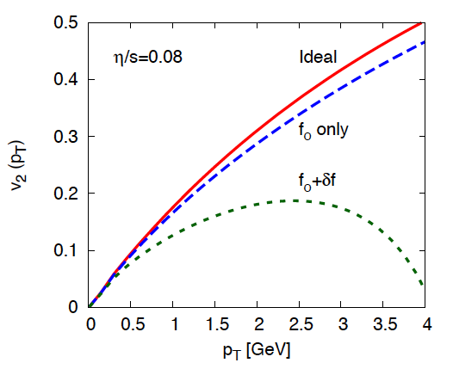
Viscous Hydrodynamics
Asantz used
K. Dusling et al., PRC81 (2010)
Problems related to δf:
dissipative correction to f -> f_{eq}+δf_{neq} just an ansatz
δf_{neq}/f at p_{T}> 1.5 GeV is large
δf_{neq} <-> η/s implies a RTA approx. (solvable)
Π^{μν} (t₀) =0 -> discard initial non-equil. (ex. minijets)
p_{T} -> 0 no problem except if η/s is large
Notes:
Effetto df con l’altra figura
Df comunque non considerata all’inzio e corrisponderebbe ad un valore finito di pmv
Aggiungere ref. di dusling

Slide 34
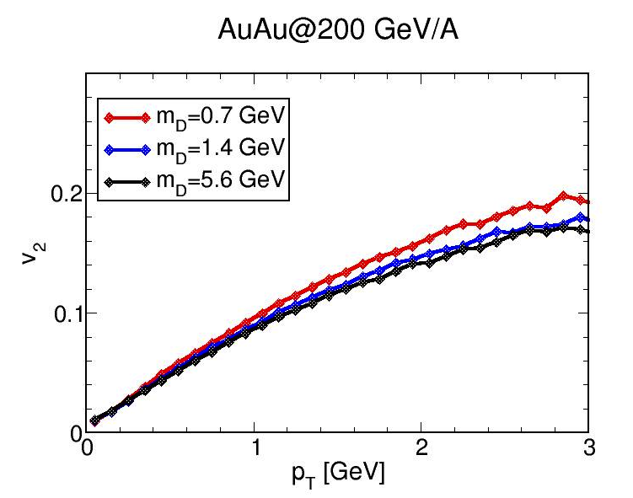



η/s(T) shear viscosity or details of the cross section?
cross section
Keep same η/s means:
η/s is really the physical parameter determining
v₂ at least up to 1.5-2 GeV
microscopic details become relevant at higher p_{T}
First time η/s<-> v₂ hypothesis is verified!
for m_{D}=1.4 GeV -> 25% smaller σ_{tot}
for m_{D}=5.6 GeV -> 40% smaller σ_{tot}
Does the microscopic degrees of freedom
matter once P(ε) and η/s is fixed?

Slide 35
η/s(T) shear viscosity or details of the cross section?
cross section
Keep same η/s means:
η/s is really the physical parameter determining
v₂ at least up to 1.5-2 GeV
microscopic details become relevant at higher p_{T}
First time η/s<-> v₂ hypothesis is verified!
for m_{D}=1.4 GeV -> 25% smaller σ_{tot}
for m_{D}=5.6 GeV -> 40% smaller σ_{tot}
Does the microscopic degrees of freedom
matter once P(ε) and η/s is fixed?

Slide 36

η/s(T) shear viscosity or details of the cross section?
cross section
Keep same η/s means:
η/s is really the physical parameter determining
v₂ at least up to 1.5-2 GeV
microscopic details become relevant at higher p_{T}
First time η/s<-> v₂ hypothesis is verified!
for m_{D}=1.4 GeV -> 25% smaller σ_{tot}
for m_{D}=5.6 GeV -> 40% smaller σ_{tot}
Does the microscopic degrees of freedom
matter once P(ε) and η/s is fixed?

Slide 37




Standard Initial Conditions
r-space: standard Glauber model
η=y Bjorken boost invariance (flexible)
p-space: Boltzmann-Juttner T_{max} [p_{T}<2 GeV ]+ minijet [p_{T}>2-3GeV]
We fix maximum initial T at RHIC 200 AGeV
Discarded in viscous hydro
No fine tuning
T_{max0} = 340 MeV
T₀ τ₀ =1 -> τ₀=0.6 fm/c
Typical hydro
condition
Then we scale r-profile according to initial ε
and with beam energy according to dN/dy
 | 62 GeV | 200 GeV | 2.76 TeV
T₀ | 290 MeV | 340 MeV | 590 MeV
τ ₀ | 0.7 fm/c | 0.6 fm/c | 0.3 fm/c

Slide 38


Impact of η/s(T) vs √s_{NN}
w/o minijet Π^{μν} (t₀) =0
10-20%
f.o.
Plumari, Greco,Csernai, arXiv:1304.6566
4πη/s=1 during all the evolution of the fireball -> no invariant v₂(p_{T})
-> smaller v₂(p_{T}) at LHC.
Initial p_{T} distribution relevant (in hydro means π^{μν}(τ₀) ≠ 0, but it is not done!

Slide 39

Impact of η/s(T) vs √s_{NN}
Plumari, Greco,Csernai, arXiv:1304.6566
η/s ∝ T² too strong T dependence→ a discrepancy about 20%.
Invariant v₂(p_{T}) suggests a “U shape” of η/s with mild increase in QGP
See also, Niemi-Denicol et al., PRL106 (2011)

Slide 40


Viscous correction

Slide 41


Terminology about freeze-out
Freeze-out is a smooth process: scattering rate < expansion rate
η/s increases in the cross-over region, realizing the smooth f.o.: small σ -> natural f.o.
Different from hydro that is a sudden cut of expansion at some T_{f.o.}
No f.o.

Slide 42

Comparison for anisotropic cross section
Similarly to h for anisotropic cross section the RTA with σ_{tr} underestimate σ_{el}

